Slide 1
Chapter 4: The Processor
ITSC 3181 Introduction to Computer Architecture https://passlab.github.io/ITSC3181/
Department of Computer Science
Yonghong Yan
yyan7@uncc.edu
https://passlab.github.io/yanyh/

Slide 2
Chapter 4: The Processor
☛
Lecture
  4.1 Introduction
  4.2 Logic Design Conventions
  4.3 Building a Datapath
Lecture
  4.4 A Simple Implementation Scheme
Lecture
  4.5 An Overview of Pipelining
Lecture (Pipeline implementation), will not be covered!
  4.6 Pipelined Datapath and Control
  4.7 Data Hazards: Forwarding versus Stalling
  4.8 Control Hazards
  4.9 Exceptions
  4.13 Advanced Topic: An Introduction to Digital Design Using a Hardware Design Language to Describe and Model a Pipeline and More Pipelining Illustrations
Lecture (Advanced pipeline techniques and real-world CPU examples)
  4.10 Parallelism via Instructions
  4.11 Real Stuff: The ARM Cortex-A8 and Intel Core i7 Pipelines
  4.12 Going Faster: Instruction-Level Parallelism and Matrix Multiply
  4.14 Fallacies and Pitfalls
  4.15 Concluding Remarks

Slide 3
Introduction
§4.1 Introduction
CPU performance factors
  Instruction count
    Determined by ISA and compiler
  CPI and Cycle time
    Determined by CPU hardware
We will examine two CPU implementations
  A simplified version
  A more realistic and pipelined version
Simple subset, shows the most aspects
  Memory reference: ld/lw, sd/sw
  Arithmetic-logical: add, sub, and, and or
  Condition branch: beq (branch if equal)

Slide 4
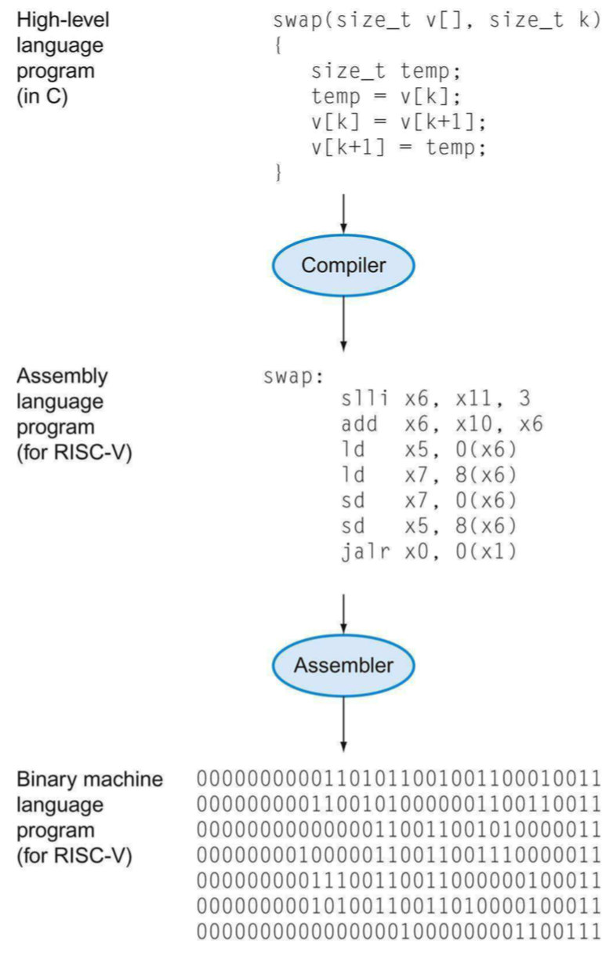
Instruction Set Architecture: The Interface Between Hardware and Software
software
The words of a computer language are called instructions, and its vocabulary/dictionary is called an instruction set
  lowest software interface, assembly level, to the users or to the compiler writer
Instruction Set Architecture – A type of machine
A language represents a race
instruction set
hardware

Slide 5
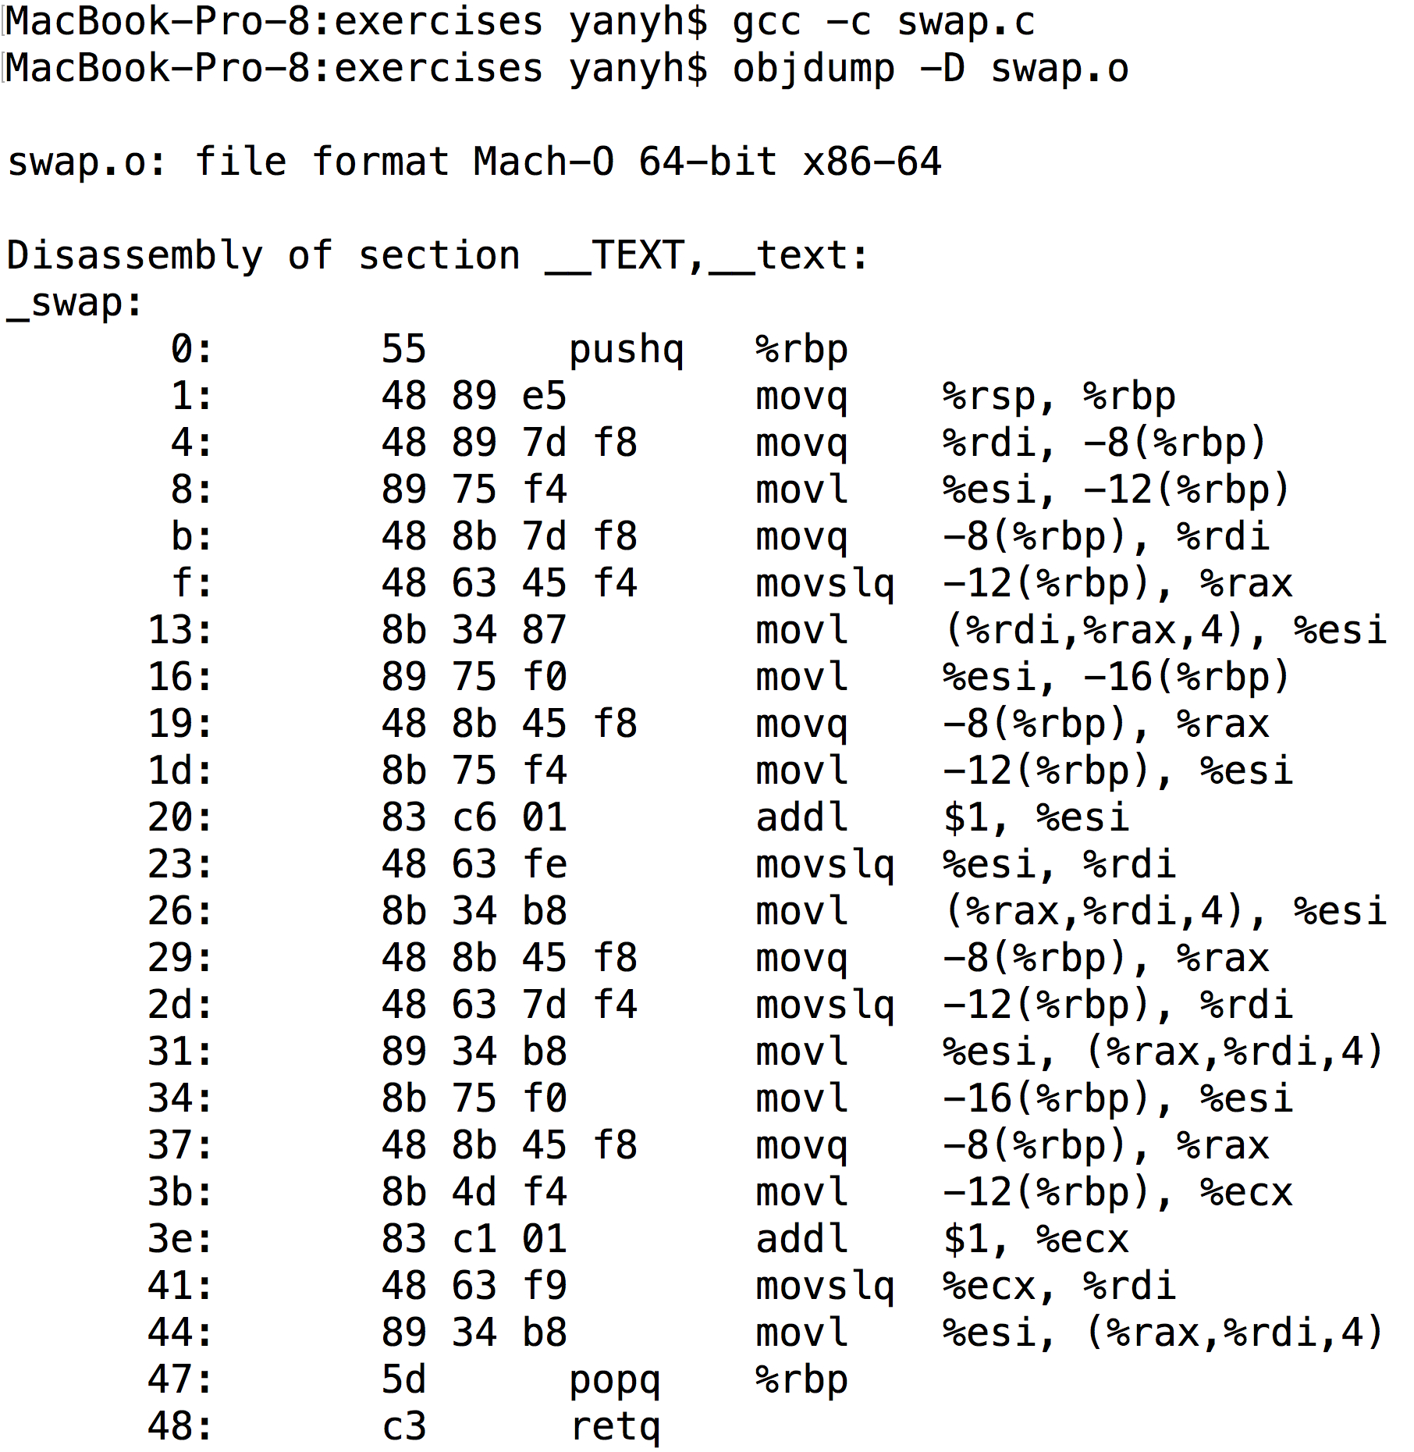
RISC-V and X86_64 Assembly Example

Slide 6
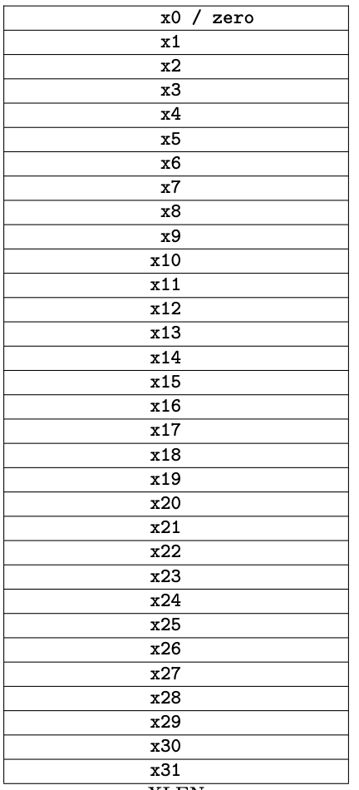
Three Classes of Instructions
Arithmetic-logic instructions
  add, sub, addi, and, or, shift left|right, etc
Memory load and store instructions
  lw and sw: Load/store word
  ld and sd: Load/store doubleword
Control transfer instructions (changing sequence of instruction execution)
  Conditional branch: bne, beq
  Unconditional jump: j (
  Procedure call and return: jal and jr

Slide 7
Arithmetic-logic and load/store
Arithmetic-logic instructions
  Three operands, could be either register or immediate (for source operands only)
    add x10, x5, x6; sub x5, x4, x7; and x10, x5, x7
    addi x10, x5, 10;
Load and store (L/S) instructions: Load data from memory to register and store data from register to memory
  Remember the way of specifying memory address (base+offset)
  ld x9, 64(x22) // load doubleword
  sd x9, 96(x22) // store doubleword
With these two classes instructions, you can implement the following high-level code, and different ways of combining them
  f = (g + h) - (i + j);
  A[12] = h + A[8];
  For L/S: Left-value (of =) to Store, Right-value of (=) to Load

Slide 8
Load and Store Operations
Format: ld rd, offset(rs1)
Example: ld x9, 64(x22) // load doubleword to x9
ld: load a doubleword from a memory location whose address is specified as rs1+offset (base+offset, x22+64) into register rd (x9)
  Base should be stored in an register, offset MUST be a constant number
  Address is specified similar to array element, e.g. A[8], for ld, the address is offset(base), e.g. 64(x22)
Format: sd rs2, offset(rs1)
Example: sd x9, 96(x22) // store a doubleword
sd: store a doubleword from register rs2 (x9 in the example) to a memory location whose address is specified as rs1+offset(base+offset, x22+96). Offset MUST be a constant number.
Load and store are the ONLY two instructions that access memory
lw: load a word from memory location to a register
sw: store a word from a register to a memory location

Slide 9
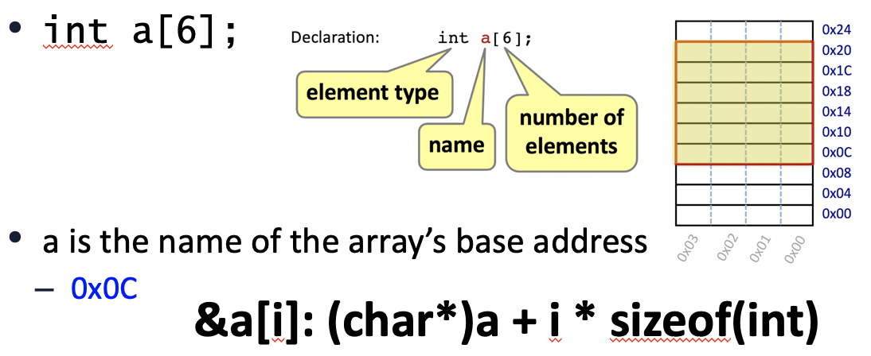
Memory Operand Example
C code:
double A[N]; //double size is 8 bytes
A[12] = h + A[8];
  h in x21, base address of A in x22
Compiled RISC-V code:
  Index 8 requires offset of 64
  A[8] right-val, A[12]: left-val
ld x9, 64(x22) // load doubleword
add x9, x21, x9
sd x9, 96(x22) // store doubleword

Slide 10
Conditional Branch
Branch to the labeled instruction if a condition is true, otherwise continue
beq rs1, rs2, L1
  if (rs1 == rs2, i.e. true) branch to instruction labeled L1 (branch target);
  else continue the following instruction
  beq x1, x2, label1
  add x5, x6, x7
  …
  addi …
  label1: sub x5, x6, x7
  …
bne rs1, rs2, L1
  if (rs1 != rs2) branch to instruction labeled L1 (branch target);
  else continue the following instruction
J: unconditional jump (not an instruction)
  beq x0, x0, L1
  beq x1, x2, label1
  add x5, x6, x7
  …
  addi …
  label1: sub x5, x6, x7
  …
False
True
True
Notes:
L2: addi x5, x5, 1 //L1 could be here
add x10, x5, x11
beq x5, x6, L1 //can branch backward
add x10, x10, x9
sub ….
…
L1: sub x10, x10, x9
add …
…
True

Slide 11
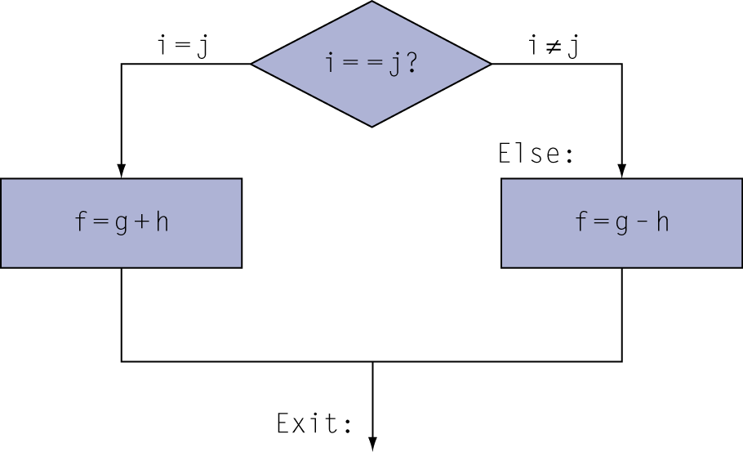
Translating If Statements 1/2
C code:
if (i==j) f = g+h;
else f = g-h;
Compiled RISC-V code:
bne x22, x23, Else //branch if not equal
add x19, x20, x21 //Then path
beq x0, x0, Exit //unconditional
Else: sub x19, x20, x21 //Else path
Exit: …
Variable | f | g | h | i | j
Register | x19 | x20 | x21 | x22 | x23
Using bne (reverse of if (==)) to branch to the Else path b.c. we want the code following the bne to be the code of the Then path
We need “beq x0 x0 Exit”, an unconditional jump, to let Then path terminate since CPU executes instruction in the sequence if not branching.

Slide 12
Translating Loop Statement
i = 0;
for (i=0; i<100; i++) { … }
while (i<100) { …; i++; }
Do the loop structure first
  Init condition
  Loop condition (using reverse relationship for branch instr)
  True path (the loop body)
  Loop back
  False path (break the loop)
Then translate the loop body
False
i < 100 ?
True
…
Exit
i ++
Loop: beq/bge x22, x23, Exit
… # loop body
addi, x22, x22, 1
beq x0, x0, loop
Exit:
Using bge for (<) to branch to the false/exit path, which breaks the loop
The instruction(s) following bge are for the true path, which are for the loop body.
beq to jumping back to the beginning of the loop

Slide 13
Translating Loop Statement: for loop
i = 0;
C code:
for (i=0; i<100; i++) …
  i in x22
RISC-V code:
addi x22, x0, 0
li x23, 100
Loop: bge x22, x23, Exit //beq works
… …
addi x22, x22, 1 //true,the loop body,i++
beq x0, x0, Loop
Exit: …
False
i < 100 ?
True
…
Exit
i ++
Using bge for (<) to branch to the false/exit path, which breaks the loop
The instruction(s) following bge are for the true path, which are for the loop body.
beq to jumping back to the beginning of the loop

Slide 14
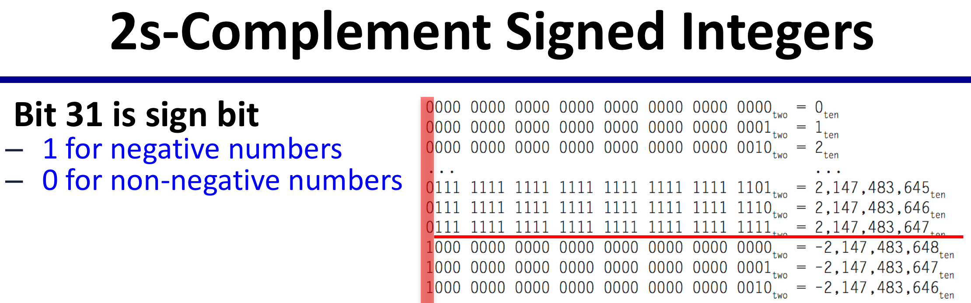
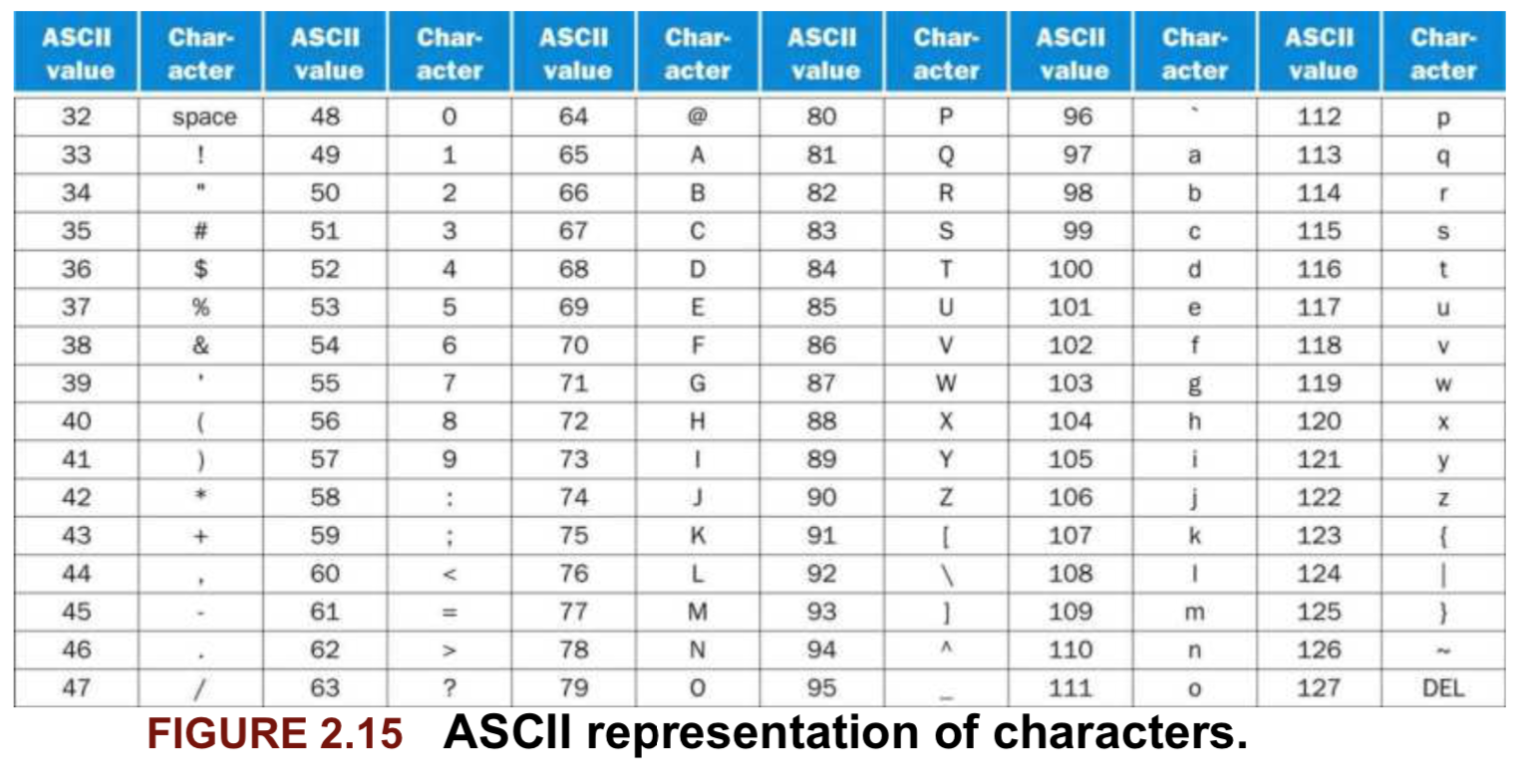
Instruction and Data (1/2)
Are all numbers stored as binary format in memory
  It is up to the CPU on how to interpret and do with them
Each instruction is encoded as 32-bit numbers

Slide 15
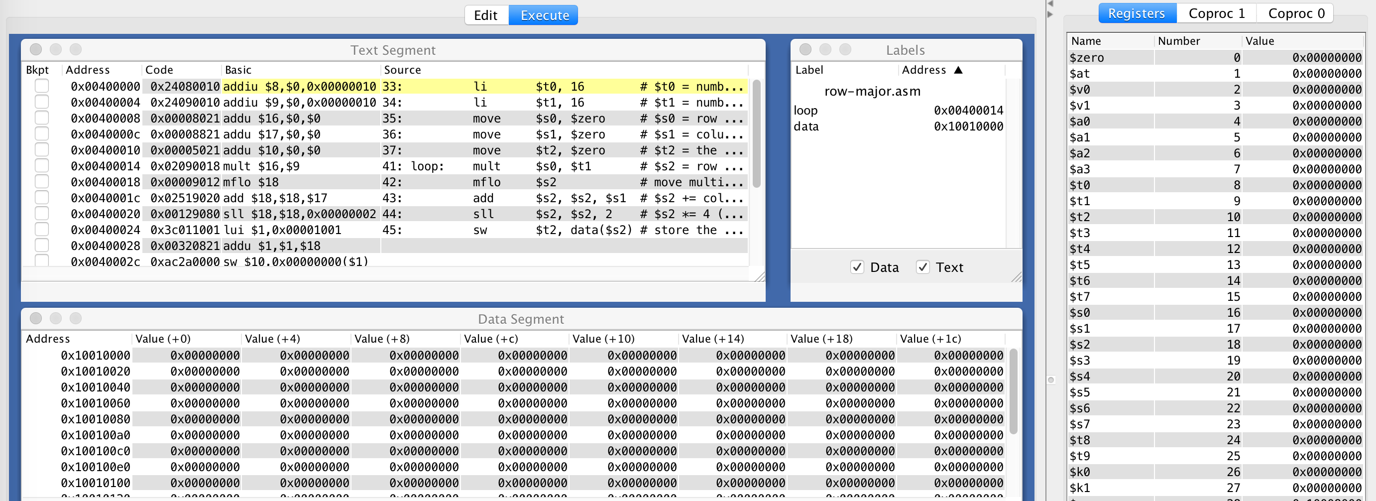
Instruction and Data (2/2)
Are all numbers stored as binary format in memory
  It is up to the CPU on how to interpret and do with them
Each byte/word has its memory address

Slide 16
R-Format Encoding for Arithmetic-Logic Instructions
add x9,x20,x21 (add rd, rs1, rs2)
x21, x20, x9 add
funct7
rs2
rs1
funct3
rd
opcode
7 bits
5 bits
5 bits
3 bits
5 bits
7 bits
0
21
20
0
9
51
0000000
10101
10100
000
01001
0110011
0000 0001 0101 1010 0000 0100 1011 0011_{two} =
015A04B3₁₆
5 bits for rd, rs1 and rs2 because we have 32 registers, thus only needs 5 bit to address a register

Slide 17
RISC-V I-Format Encoding for Instructions That Has Immediate as one of the Operand
I-Format: The second source operand is an Immediate, the first source operand is register, destination operand is register.
Immediate arithmetic/logic, and load instructions (NOT store instruction)
  addi x22, x22, 4; Format: addi rd, rs1, #immediate
  ld x9, 64(x22); Format: ld|lw, rd, #immediate(rs1)
  rs1: source or base address register number
  immediate: constant operand, or offset added to base address
    2s-complement, sign extended
  NOT for store: because destination for store is the memory location (not a register), thus no rd for store.
immediate
rs1
funct3
rd
opcode
12 bits
5 bits
3 bits
5 bits
7 bits

Slide 18
RISC-V S-Format Encoding for Just Store
S-Format: instructions that use two source register operands and NO destination operand register (rd), only store instruction
Format: sd|sw, rs2, #immediate(rs1)
Different immediate format for store instructions
  sd x9, 96(x22);
  rs1: base address register number (x22)
  rs2: source operand register number (x9), which provide the value to be stored to memory
  immediate: offset added to base address
    Split so that rs1 and rs2 fields always in the same place as for R- or I-Format
imm[11:5]
rs2
rs1
funct3
imm[4:0]
opcode
7 bits
5 bits
5 bits
3 bits
5 bits
7 bits

Slide 19
SB-Format Encoding for Branch Instructions
Branch instructions specify
  Opcode, two registers, target address
Most branch targets are near branch
  Forward or backward
SB-Format instructions: beq x8, x9, 4
PC-relative addressing
  Branch target address is encoded as the offset off the the address of the branch instruction itself
  Target address = PC (Branch address) + immediate × 2
imm
[10:5]
rs2
rs1
funct3
imm
[4:1]
opcode
imm[12]
imm[11]

Slide 20
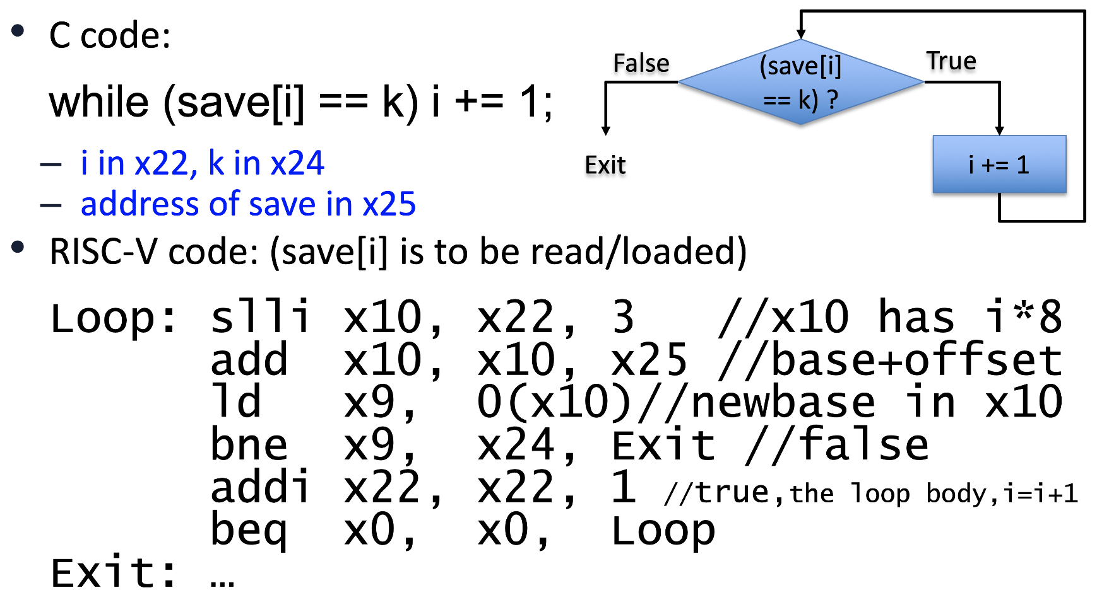
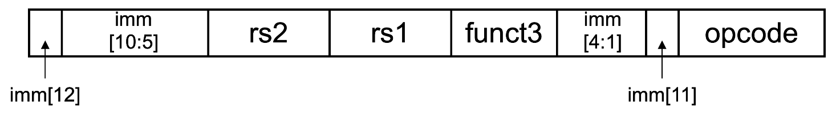
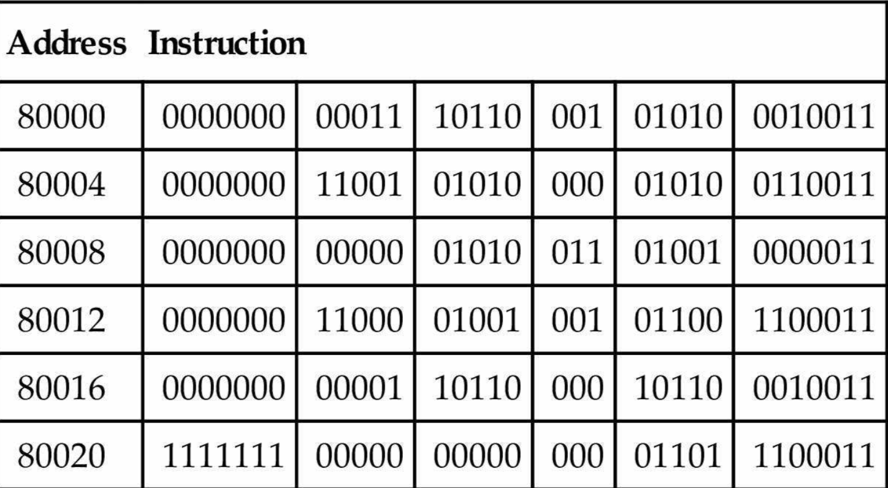
Branch Target Address is Encoded as offset off the branch address
The Exit offset of the bne is encoded as 6 (..0110)
  Offset is 6*2 = 12 bytes, i.e. 3 instr forward
  Exit’s address = bne’s address (8012) + 12 = 80024 (Exit)
The Loop offset of the beq is encoded as -10 (..110110)
  Offset is -10*2 = -20 bytes, i.e. 5 instr backward
  Loop’s address = beq’s address (80020) + -20 = 80000 (Loop)

Slide 21
Components of a Computer
Program instructions and data are all stored in memory
  Instruction need to be loaded from memory in order to be executed
    Processor does this automatically, thus no instruction needed
    Program counter (PC): a register that stores the address of the instruction the process is executing
  Data need to be loaded from memory to register in order to be processed: load and store instructions

Slide 22
Instruction Execution
0x0FFE1230: add x6, x12, x13
0x0FFE1234: lw x6, 24(x12)
0x0FFE1238: sw x13, 24(x12)
0x0FFE123C: beq x12, x13, offset
Processor fetches an instruction word from instruction memory
  PC → register to store address to access instruction memory to fetch instruction
The instruction word is decoded to know the source operands (register numbers), and then registers are read to have source operand values ready
  Register numbers → register file, read registers (rs1 and rs2)
    x12 and x13 for add; x12 for lw, x12 and x13 for sw, x12 and x13 for beq
Use ALU to calculate
  Depending on instruction class
    Arithmetic result: [x12] + [x13]
    Memory address for load/store: 24+[x12], add operation
    Branch condition: x12 ?= x13 ➔[x12]-[x13] and check result is 0 or not
    Branch target address: PC ← target address or PC + 4: pc = [pc]+offset*2 if branch is taken
LW|SW: access data memory:
  load from mem[32+[x12]]
  Store [x13] to mem[32+[x12]]
Write result to register
  Arithmetic (add): write result back to the register file x6
  Load: write to register x6

Slide 23
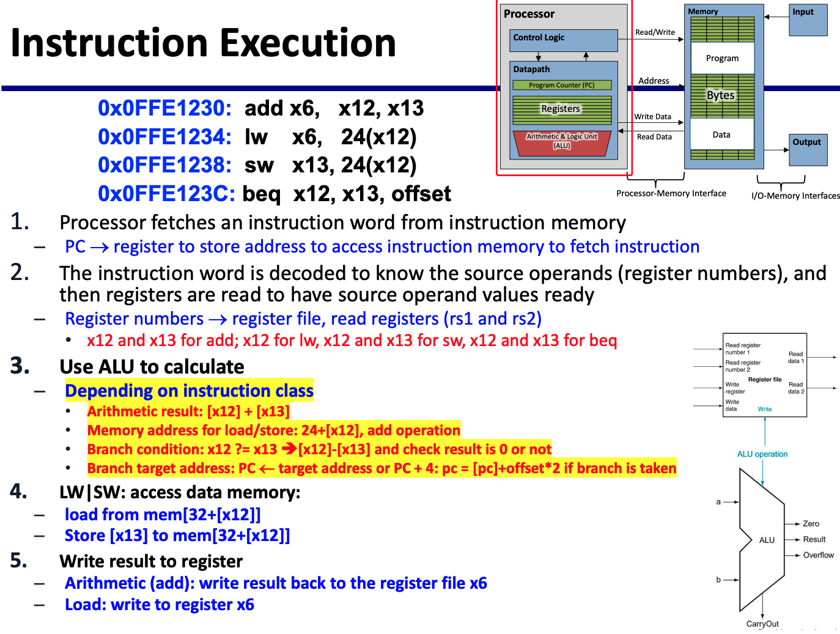
CPU Overview

Slide 24
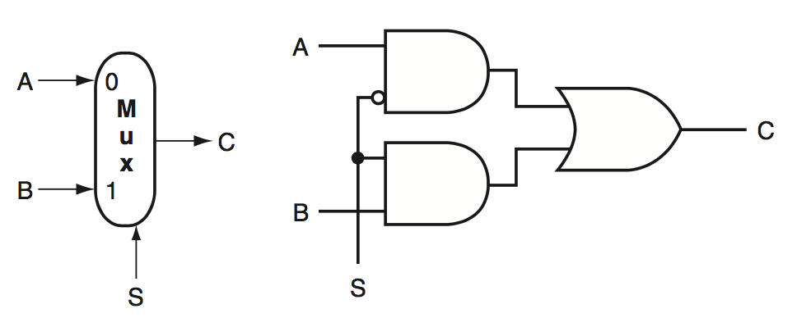
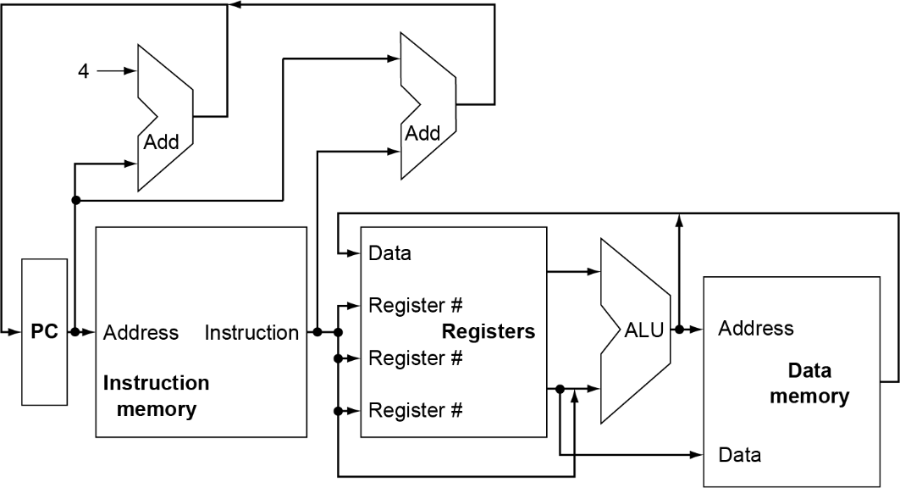
Multiplexers
Can’t just join wires together
  Use multiplexers
Textbook A.3

Slide 25
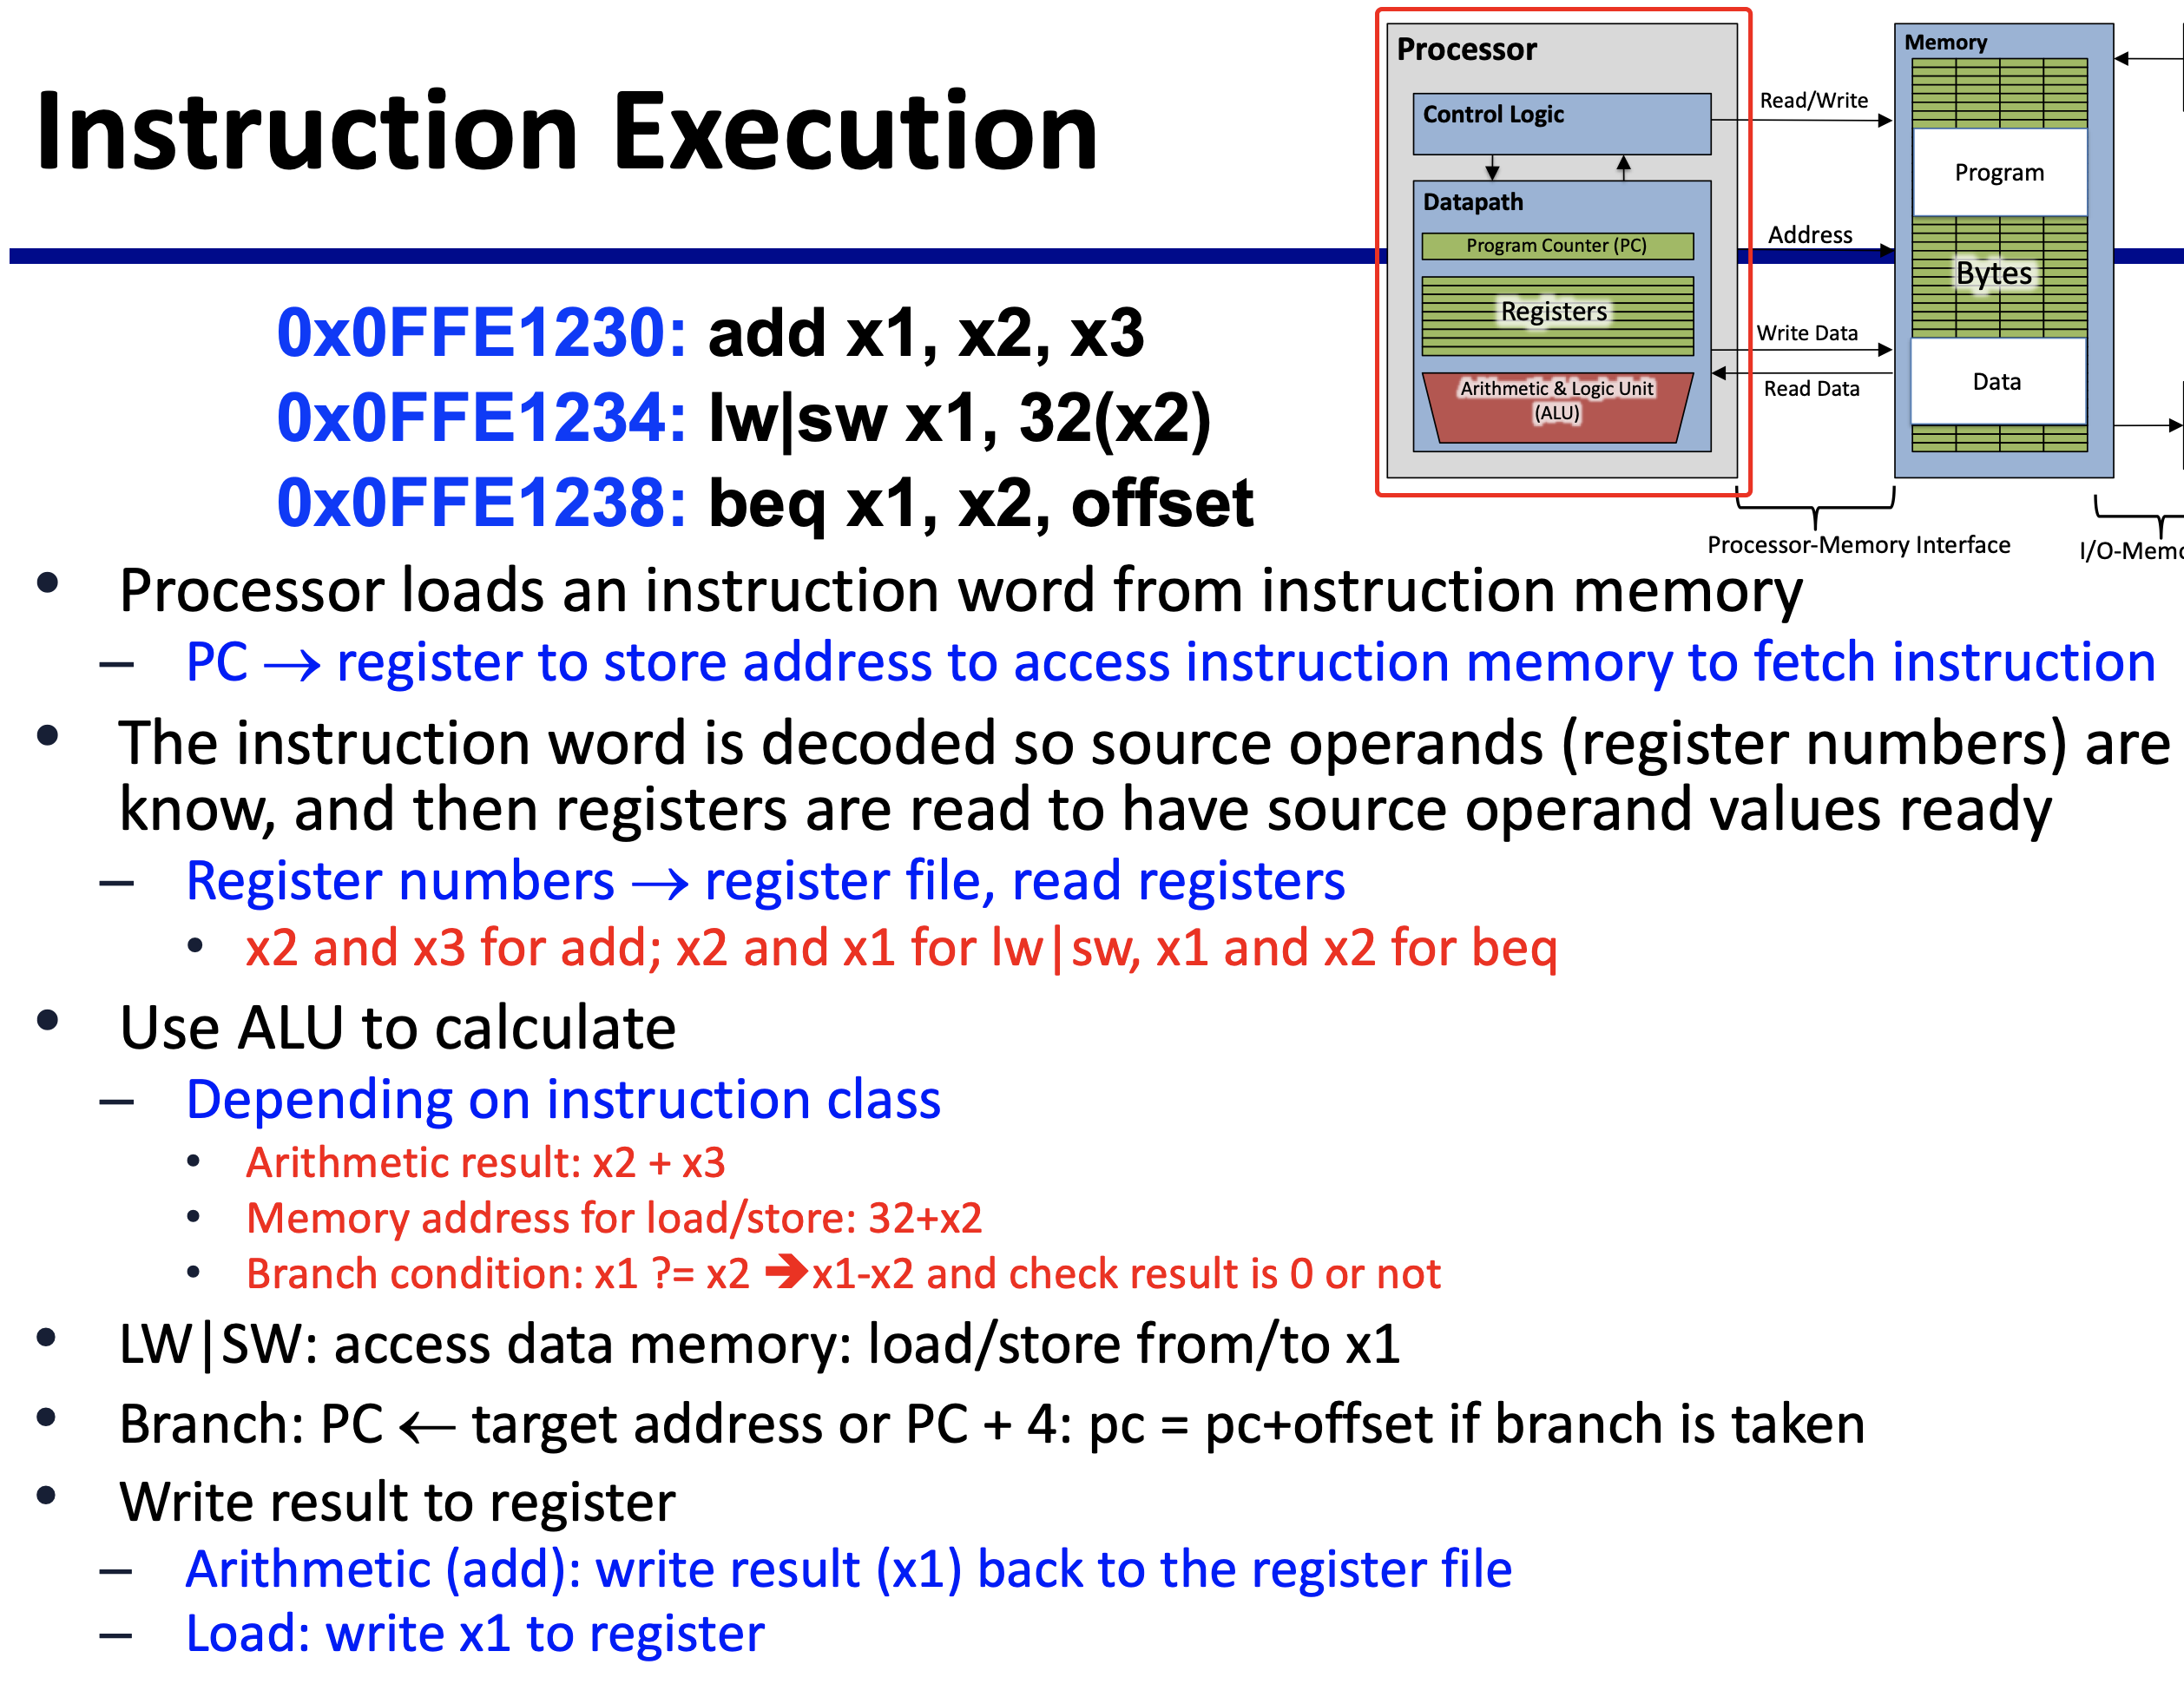
Full CPU with Data and Control Path (Wires)

Slide 26
Logic Design Basics
Information encoded in binary
  Low voltage = 0, High voltage = 1
  One wire per bit
  Multi-bit data encoded on multi-wire buses
Combinational element
  Operate on data
  Output is a function of input
State (sequential) elements
  Store information
§4.2 Logic Design Conventions

Slide 27
Combinational Elements
AND-gate
  Y = A & B
Adder
  Y = A + B
A
+
Y
B
A
Y
B
Arithmetic/Logic Unit
  Y = F(A, B)
Multiplexer
  Y = S ? I1 : I0
OpSelect
- Add, Sub, ...
- And, Or, Xor, Not, ...
- GT, LT, EQ, Zero, ...
I0
Decoder
M
u
x
Y
I1
A
O₀
O₁
O_{n-1}
ALU
Result
.
A
.
Sel
Decoder
Zero?
S
.
B
lg(n)
lg(n)
A₀
A₁
A_{n-1}
.
O
.
Mux
.

Slide 28
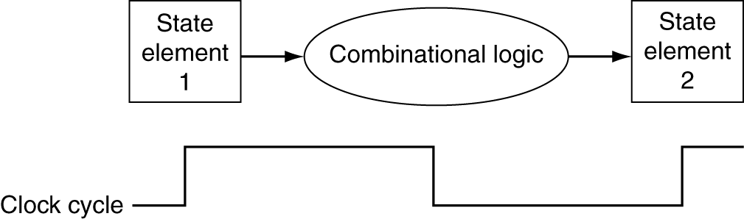
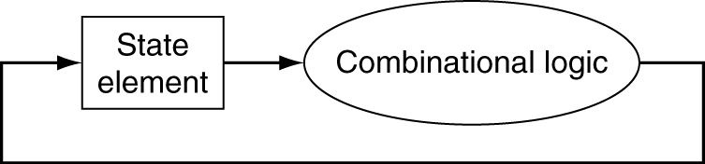
Clocking Methodology
Combinational logic transforms data during clock cycles
  Between clock edges
  Input from state elements, output to state element
  Longest delay determines clock period

Slide 29
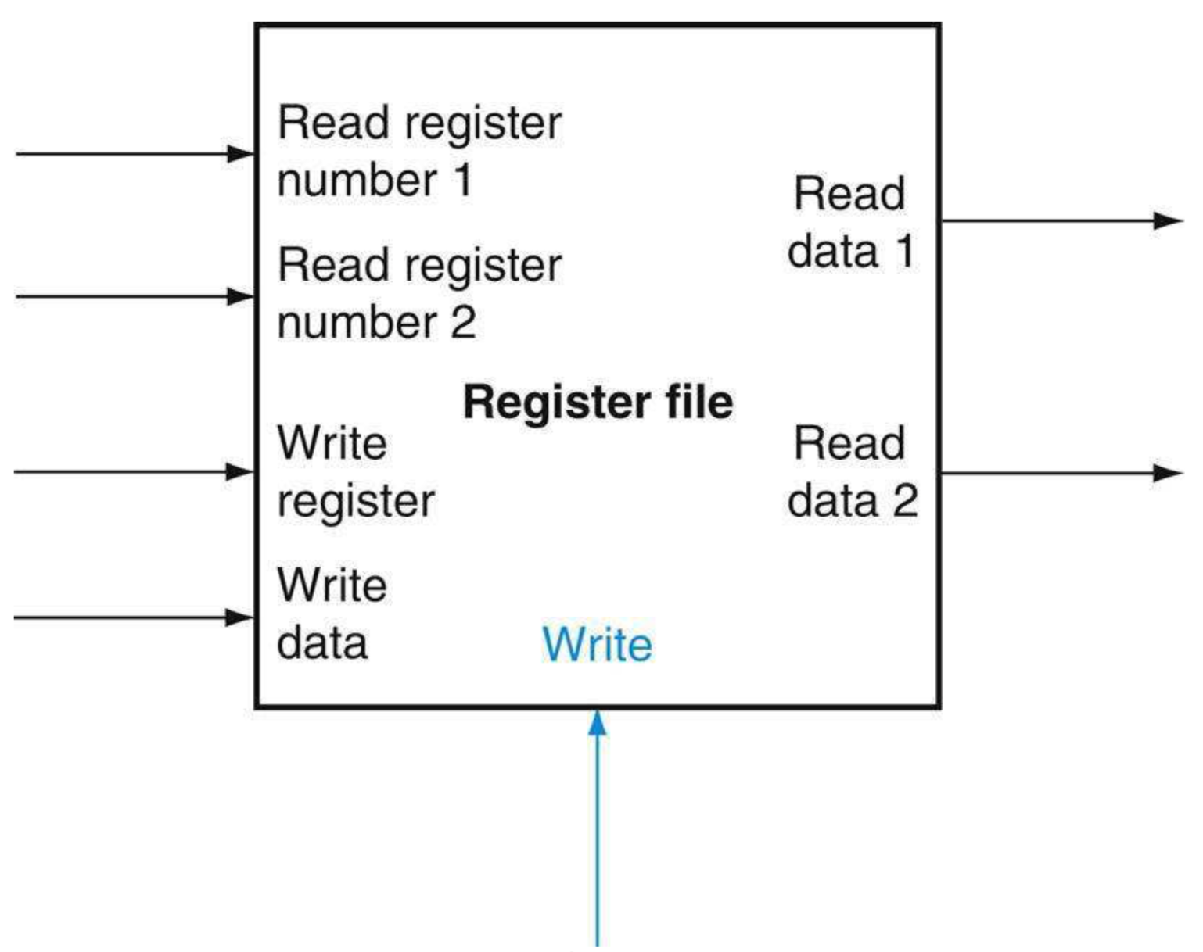
Register Files
D₀
D₁
D₂
...
D_{n-1}
Reads are combinational
  Can read in any cycle and for multiple reads
  Only 2 register source operands needed
Calculate the number of input/output wires of the register file
  Read register 1 , Read register 2 and Write register each needs 5 bits (5 wires) since we have 32 32-bit registers
  Read Data 1, Read Data 2 and Write Data each has 32 bits
  Write needs one wire (one bit each).
En
...
Clk
ff
ff
ff
ff
Q₀
Q₁
Q₂
...
Q_{n-1}

Slide 30
A Simple Memory Model
WriteEnable
Reads and writes are always completed in one cycle
Read can be done any time (i.e. combinational)
Write is performed at the rising clock edge
  if it is enabled
The number of wires for RAM (Random Access Memory)
  Address has 32 bits
  WriteData and ReadData each has 32 bits
  WE and Clock each needs one wire
Clock
Address
RAM
ReadData
WriteData

Slide 31
Building a Datapath
Datapath
  Elements/wires that process data and addresses in the CPU
    Registers, ALUs, mux’s, memories, …
We will build a RISC-V datapath incrementally
  Refining the overview design
§4.3 Building a Datapath

Slide 32
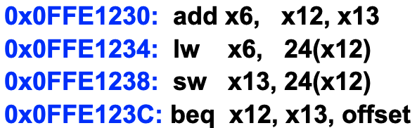
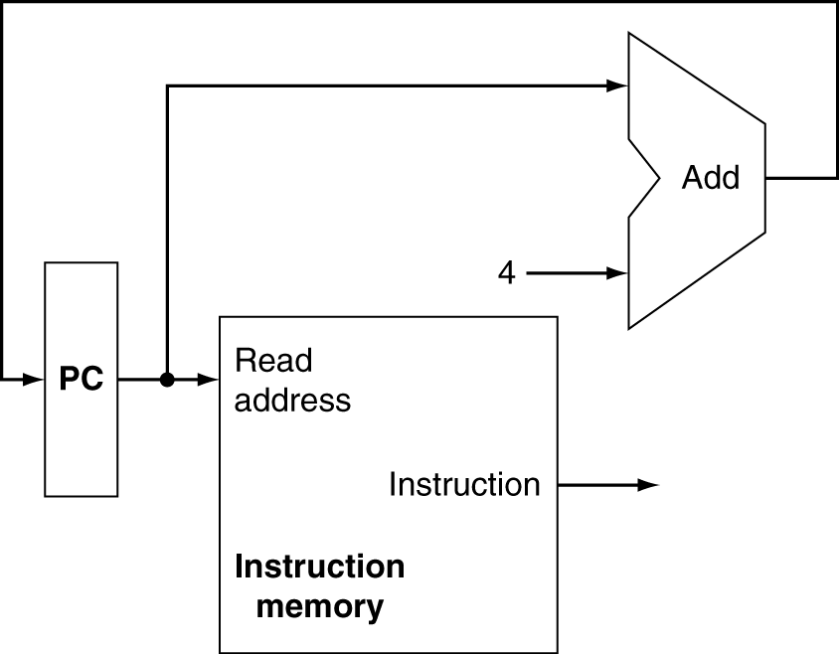
Instruction Fetch
Increment by 4 for next instruction
32-bit register

Slide 33
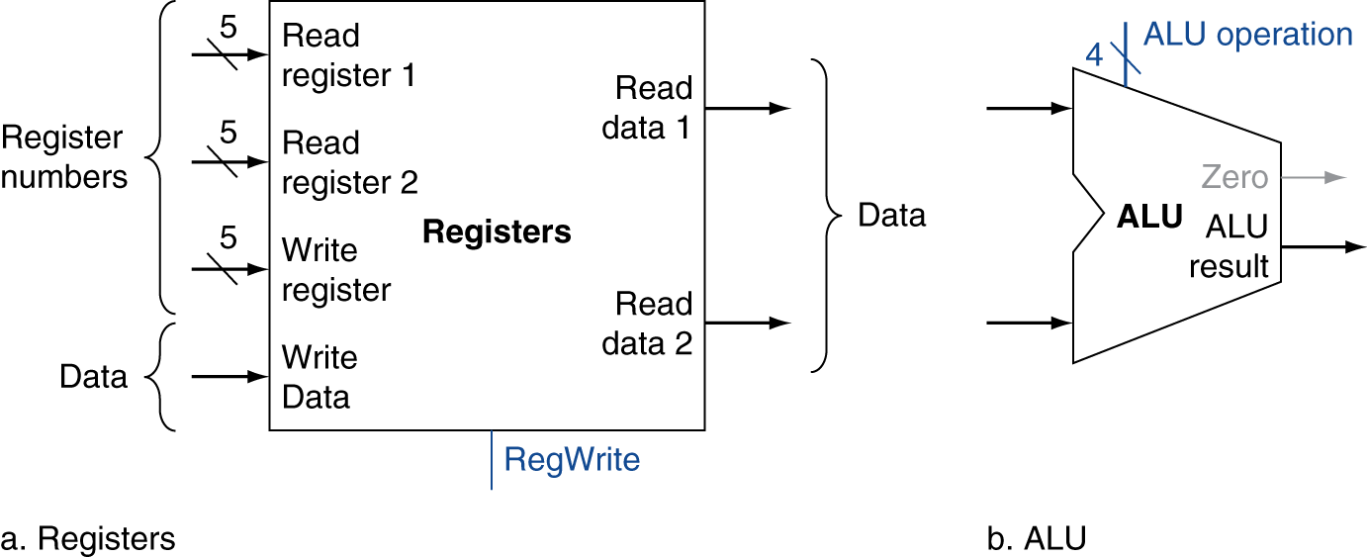
R-Format Instructions
Read two register operands
  x12 and x13
Perform arithmetic/logical ops
  [x12] + [x13], ALU operation is +
Write register result
  x6 ← [x12] + [x13], RegWrite is on

Slide 34
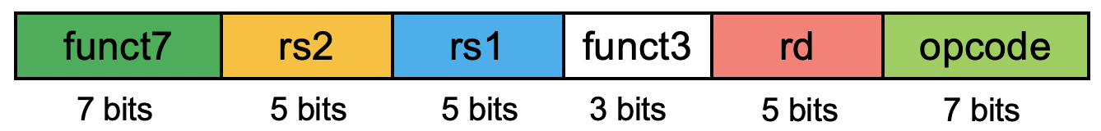
R-Type Datapath
x13 x12 x6 add
12
add
[x12]
13
6
[x13]

Slide 35
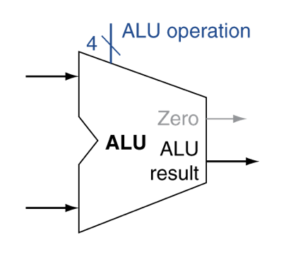
Load/Store Instructions
Fetch source register operands
  Load: x12
  Store: x12 and x13
Calculate address using 12-bit signed offset
  24 + [x12]
  Use ALU, but sign-extend offset
  ALU operation is +
Load: Read memory and update register
  x6 ← MEM(24+[x12])
  MemRead signal is on
Store: Write register value to memory
  [x3] → MEM(24+[x12])
  MemWrite is on
Figure 4.8. Imm Gen: generate 32- or 64-bit immediate value (depending on whether we design 32-bit or 64-bit machine) from an instruction word.
Select the 12-bit from the instruction word and sign-extended to 32- or 64-bit.
Used for for I-, S- and SB-format (I-format ALU, load, store, and beq)

Slide 36
Immediate Generator
Figure 4.8. Imm Gen: generate 32- or 64-bit immediate value (depending on whether we design 32-bit or 64-bit machine) from an instruction word.
  Select the 12-bit from the instruction word and sign-extended to 32- or 64-bit.
  Used for for I-, S- and SB-format (I-format ALU, load, store, and beq)
Elaboration on Imm generation:
  Last paragraph of 4.3, page 251

Slide 37
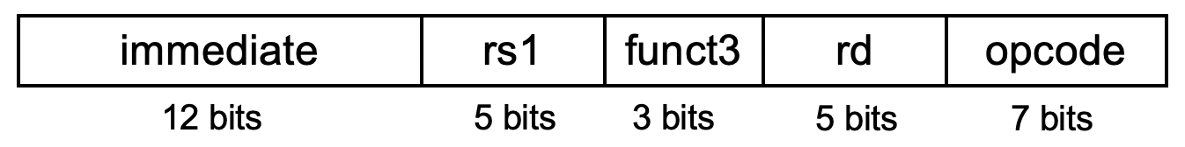
Load Datapath
24 x12 x6 load
12
add
[x12]
6
24

Slide 38
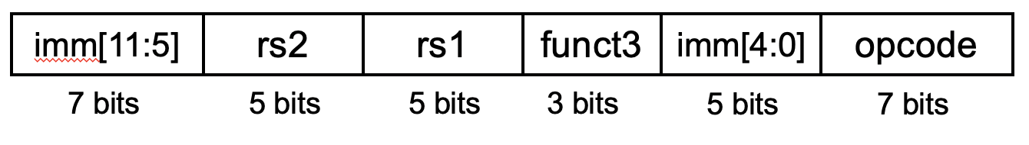
Store Datapath
24 x13 x12 store
x12
add
[x12]
x13
[x13]
IW
24

Slide 39
Andi Datapath
Andi x6, x12, 25
25 x12 x6 andi
x12
and
[x12]
x6
Inst
Word
25
Notes:
25

Slide 40
Branch Instructions
Read register operands
  x12 and x13
Calculate target address (pc + offset * 2)
  Shift left 1 places
    Offset * 2
  Add to PC
Branch condition: Compare operands
  Use ALU, subtract ([x12] – [x13]) and check Zero output
Target address calculation and branch condition check can be performed at the same time

Slide 41
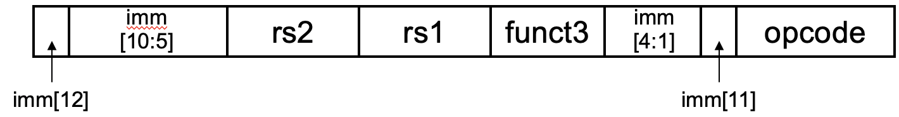
Beq Datapath
offset x13 x12 beq
Branch target address is PC + Imm * 2 (Slide #20)
0
1
sub
x12
[x12]
x13
[x13]
offset
Notes:
Branch target address is PC+4+Offset

Slide 42
Full Datapath

Slide 43
Full Datapath -
Study Goals
Know what each component does
  PC, two adders, IM, Registers, Mux, ALU, DM, Imm-Gen
Know what each line does and their width
  Data path
  Control path
Given an instruction, mark the lines that the inst uses
  Add/andi, etc
  lw and sw
  Beq
Given a control signal, know what instructions assert it
  RegWrite, MemRead, MemWrite, ALUSrc, etc

Slide 44
Chapter 4: The Processor
Lecture
  4.1 Introduction
  4.2 Logic Design Conventions
  4.3 Building a Datapath
Lecture
  4.4 A Simple Implementation Scheme
Lecture
  4.5 An Overview of Pipelining
Lecture (Pipeline implementation), will not be covered!
  4.6 Pipelined Datapath and Control
  4.7 Data Hazards: Forwarding versus Stalling
  4.8 Control Hazards
  4.9 Exceptions
  4.13 Advanced Topic: An Introduction to Digital Design Using a Hardware Design Language to Describe and Model a Pipeline and More Pipelining Illustrations
Lecture (Advanced pipeline techniques and real-world CPU examples)
  4.10 Parallelism via Instructions
  4.11 Real Stuff: The ARM Cortex-A8 and Intel Core i7 Pipelines
  4.12 Going Faster: Instruction-Level Parallelism and Matrix Multiply
  4.14 Fallacies and Pitfalls
  4.15 Concluding Remarks
☛

Slide 45
How Those Control Signals are Set Correctly?
1 4-bit control: ALU operation
6 1-bit control: PCSrc, ALUSrc, RegWrite, MemRead, MemWrite, MemtoReg
§4.4 A Simple Implementation Scheme

Slide 46
ALU Operation Control
ALU used for
  Load/Store: Func = add
  Branch: Func = subtract
  R-type: Func depends on funct field
How to generate those control signals
  Based on the opcode, func3 and func7 fields of an instruction word
  Encoding Review:
ALU operation control | Function
0000 | AND
0001 | OR
0010 | add
0110 | subtract
0111 | set-on-less-than
1100 | NOR

Slide 47
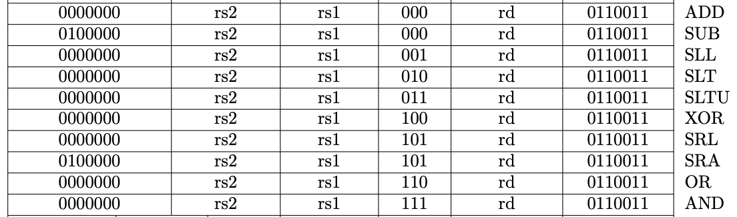
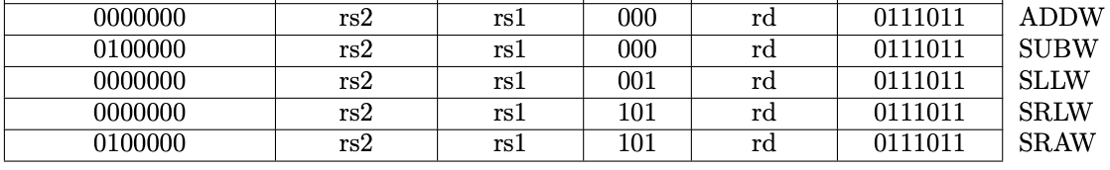
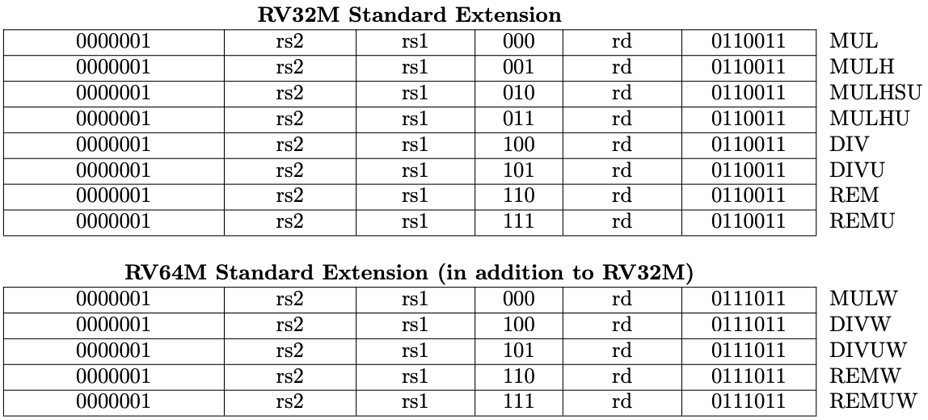
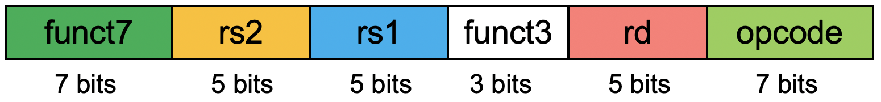
R-Format Instruction Encoding (AL Instructions) http://content.riscv.org/wp-content/uploads/2017/05/riscv-spec-v2.2.pdf#page=116
RV32I Base Instruction Set
Arithmetic instructions
RV64I Base Instruction Set (in addition to RV32I)
Logic instructions

Slide 48
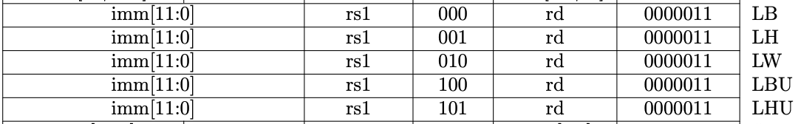
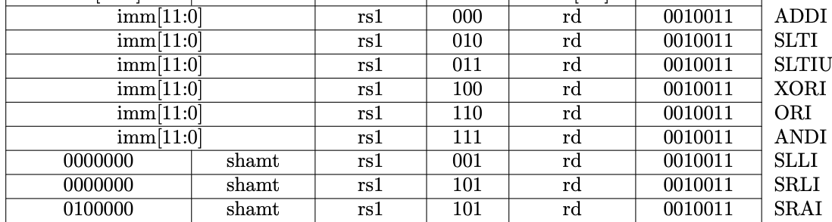
I-Format Instruction Encoding (AL and Load) http://content.riscv.org/wp-content/uploads/2017/05/riscv-spec-v2.2.pdf#page=116
Immediate arithmetic/logic
load instructions
immediate
rs1
funct3
rd
opcode
12 bits
5 bits
3 bits
5 bits
7 bits

Slide 49
S-Format Instruction Encoding (Store) http://content.riscv.org/wp-content/uploads/2017/05/riscv-spec-v2.2.pdf#page=116
Same opcode
Func3 are different for different sizes of data
  Byte, half-word, word, doubleword
imm[11:5]
rs2
rs1
funct3
imm[4:0]
opcode
7 bits
5 bits
5 bits
3 bits
5 bits
7 bits
Store instructions

Slide 50
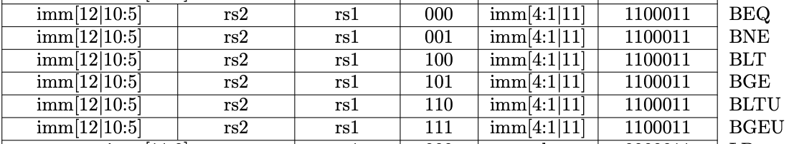
SB-Format Encoding for Branch Instr (e.g. beq) http://content.riscv.org/wp-content/uploads/2017/05/riscv-spec-v2.2.pdf#page=116
Branch instructions specify
  Opcode, two registers, target address
  Most branch targets are near branch, Forward or backward
SB-Format instructions: beq x8, x9, 4
  Same opcode, func3 are different for different branch instr
PC-relative addressing
  Branch target address is encoded as the offset off the the address of the branch instruction itself
  Target address = PC (Branch address) + immediate × 2
imm
[10:5]
rs2
rs1
funct3
imm
[4:1]
opcode
imm[12]
imm[11]

Slide 51
Observation
Opcode are the same for each basic function category
  R-format 32-bit AL
  R-format 64-bit AL
  I-format AL
  Load (I-Format)
  Store (S-Format)
  Branch (SB-Format)
Func3 and func7 are different for different operations with each categories
  To determine the ALU action for the instructions
    Add, sub, AND, or, etc.

Slide 52
Four Formats of Instructions
ALU Control input = ALUOp + ALU action
  2-bit ALUOp determined by opcode
  ALU action determinded by bit[30, 14-12] of func3/func7

Slide 53
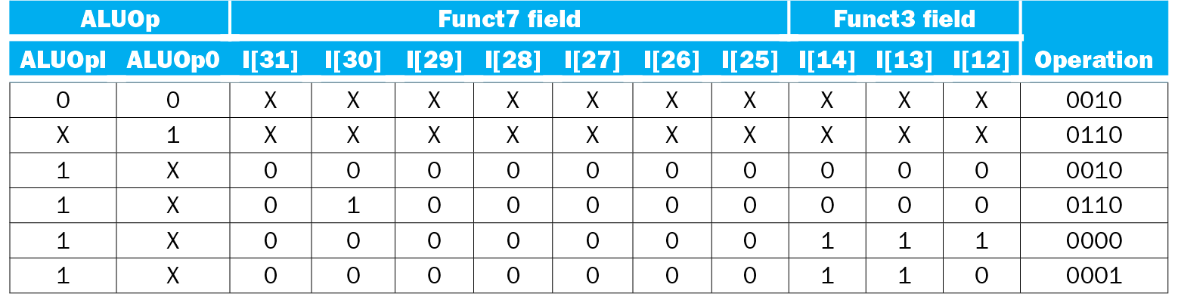
The Truth Table for ALU Operation
Control signals derived from instruction opcode/func3/func7
  Nothing to do with operands (register or immediate)
The design of those logics can be done with PLA

Slide 54
Datapath With
Control

Slide 55
Six Control
Signals

Slide 56
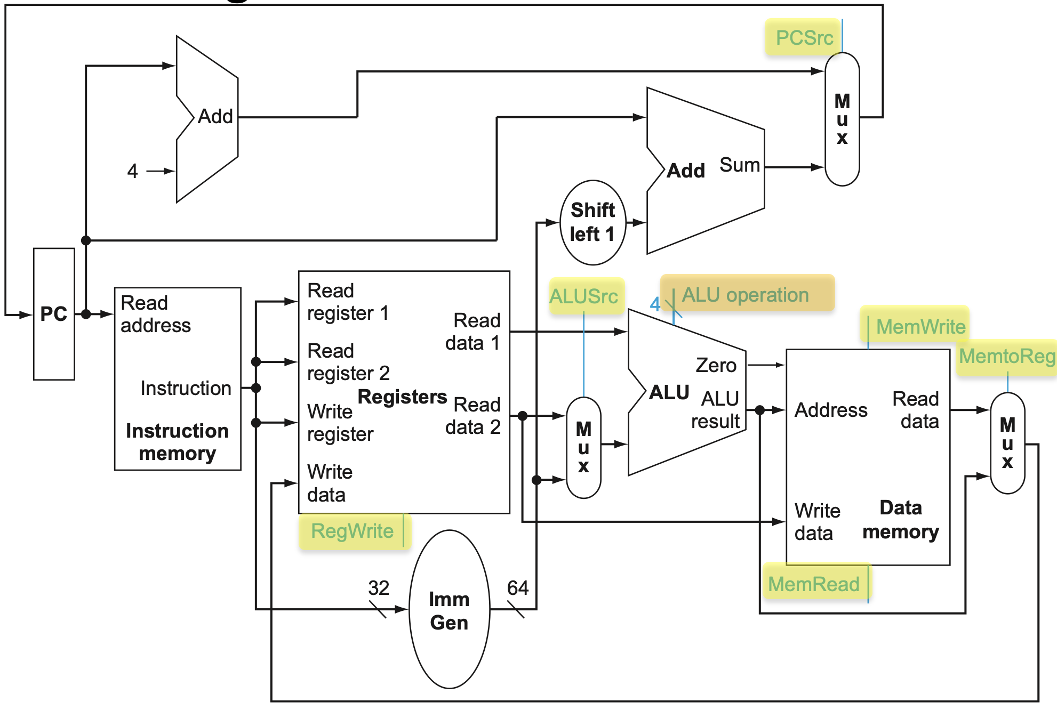
Control Signals
6 1-bit control:
  PCSrc: Mux input to select PC+4 or PC+offset, for beq instruction to select next instruction
  ALUSrc: Mux input to select input from rs2 or immediate, for R/I-type ALU and load instr
  RegWrite: enable signal to enable write to register, for ALU, and load instr (write to register)
  MemRead: enable signal to enable read from memory, for load instr
  MemWrite: enable signal to enable write to memory, for store instr
  MemtoReg: Mux input to select input to write to register from memory or ALU, for ALU and load instr
1 4-bit control: ALU operation
  2-bit ALUOp: for enabling certain input (Ainvert, Binvert, etc) of the ALU
  2-bit ALU Action: AL operation (add, AND, etc) to be performed by ALU

Slide 57
Setting of the 2-Bit ALUOp and the 6 1-bit Controls
Are completely determined by the instruction opcode
  Check Figure 4.18 of the description

Slide 58
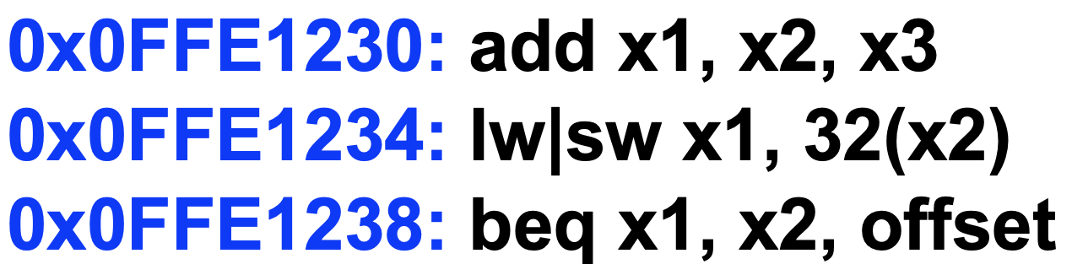
Datapath With
Control
Instruction Word:
Operation: opcode, func3 and func7) ➔ control logic
Operands: register or immediate operands ➔ data path
The “Control” logic derives the 2-bit ALUOp and other six 1-bit control, solely based on Instruction[6-0] bits, which is the opcode of an instruction word.
“ALU Control” logic derives the 2-bit ALU action based on Instruction[30,14-12] bits (func3 and func7) and then combines the 2-bit ALU action with the 2-bit ALUOp to create the 4-bit ALU input control.

Slide 59
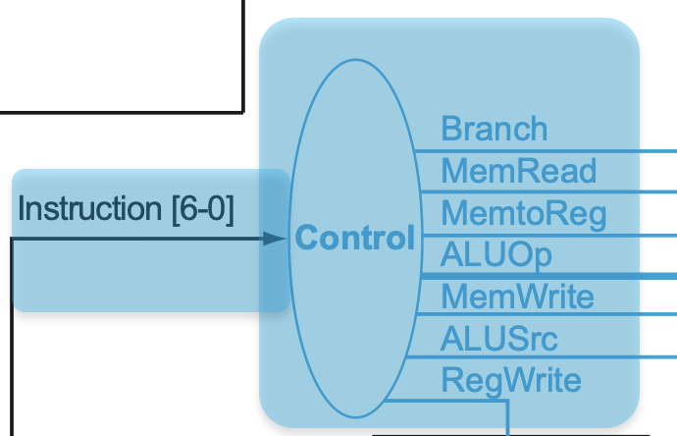
Truth Table for the
Control Logic
The “Control” logic derives the 2-bit ALUOp and other six 1-bit controls, solely based on Instruction[6-0] bits, which is the opcode of an instruction word.

Slide 60
R-, I-, S and SB-
Instruction
Study and test goals:
  Understand the data and control path
  Given an instruction and the processor diagram, specify the values in EACH datapath and control path
    Exercise in HW4 and test questions
  Datapath flow
    Slide 38-42
  Control path
    Slide 46-60
  Exercise today

Slide 61
PCnext
Diagram with datapath and control path labeld
PC+4
PC
BeqOffset*2
IW:Imm, BeqOffset
BeqTarget
PCnext
INS6-0, Opcode
(2 bits)
PC
INS19-15, RS1
RS1Value, ALUin1
INS24-20, RS2
MEMReadData
RS2Value
ALUout, MemAddr
INS11-7, RD
ALUin2
ALUOpCtl (4 bits)
IW
WriteData
IW
IW:Imm
ALUout
INS30,14-12, Func
WriteBackData

Slide 62
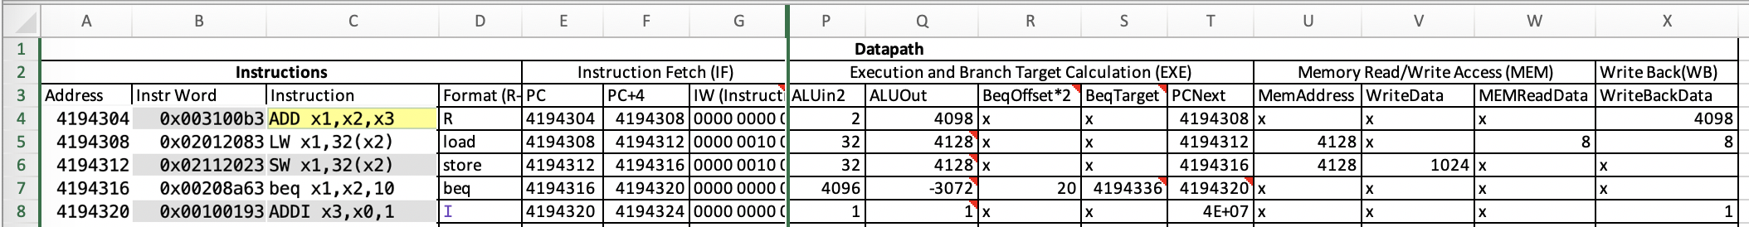
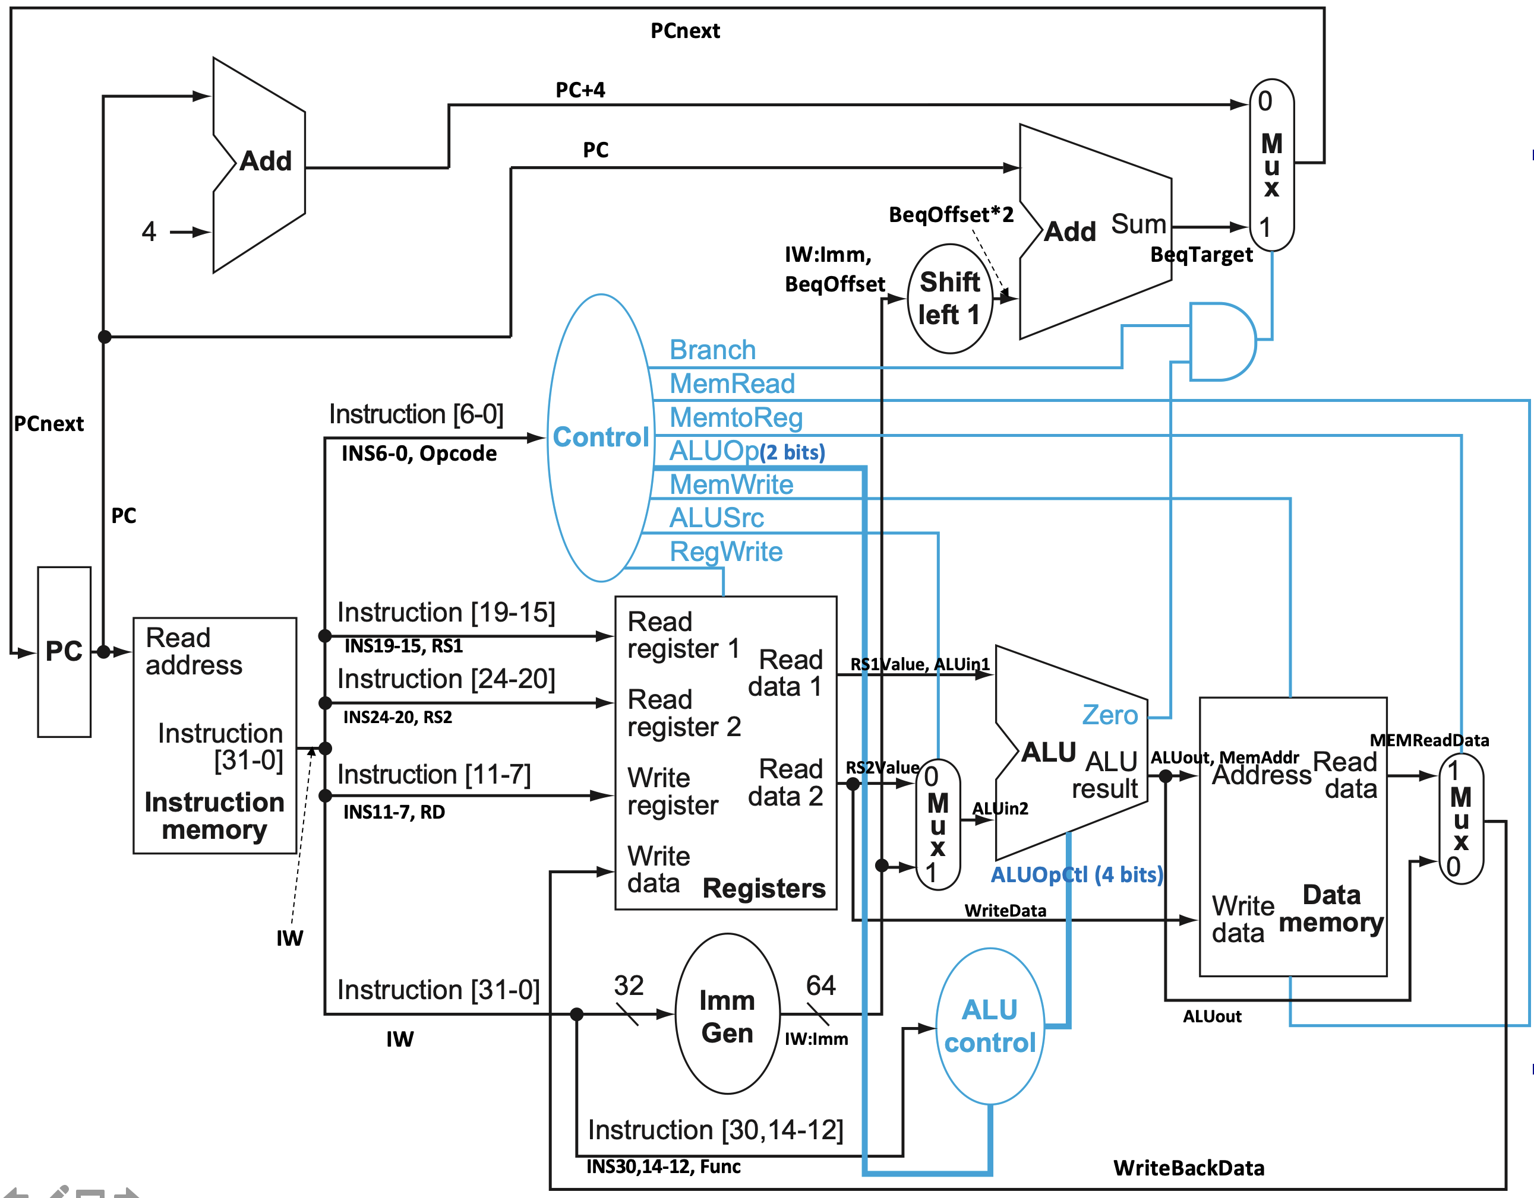
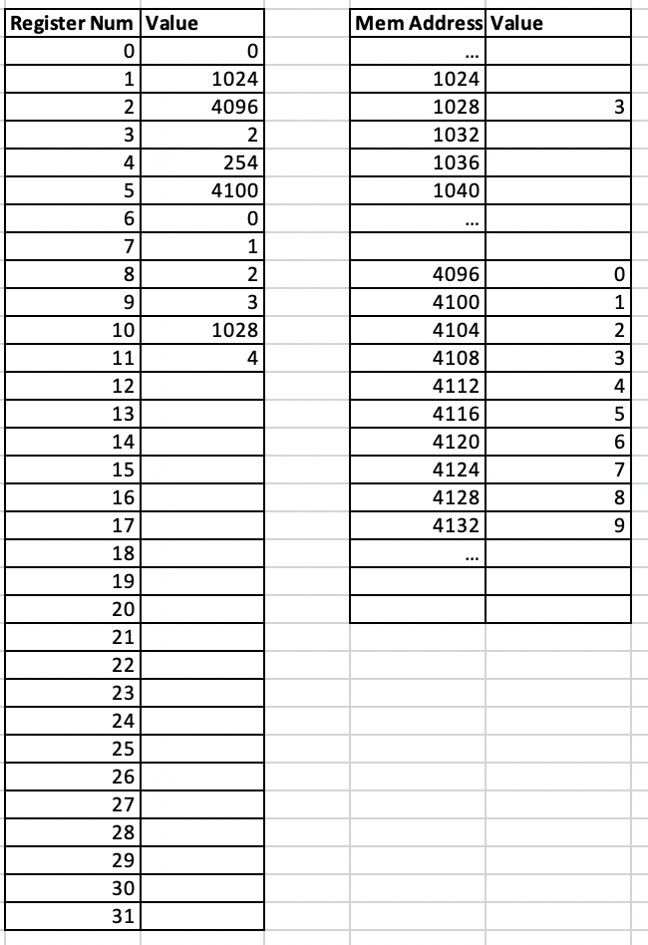
Specifying Values for Each Datapath
Answer sheet: https://passlab.github.io/ITSC3181/HW4/Homework_4_AnswerSheet.xlsx

Slide 63
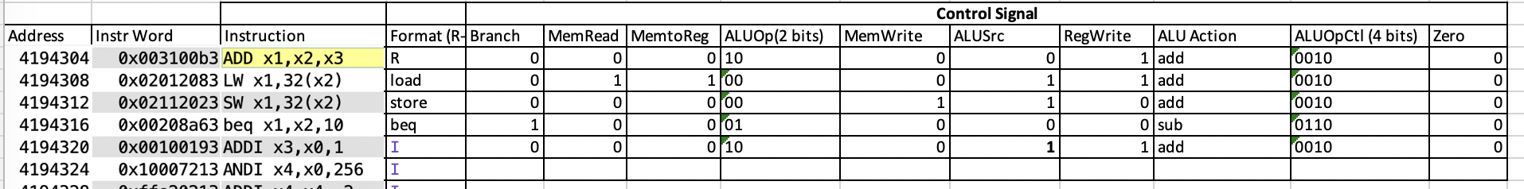
Specifying Values for Each Control
Answer sheet: https://passlab.github.io/ITSC3181/HW4/Homework_4_AnswerSheet.xlsx

Slide 64


Homework 4 https://passlab.github.io/ITSC3181/HW4/Homework_4.pdf
Homework 4
  Work out the datapath and control for I-type AL instruction
    Addi, ANDi
  Fill in the sheet for the datapath and control value for other instructions
  Pipeline execution diagram (following sections)

Slide 65
Lab 11 and 12 https://passlab.github.io/ITSC3181/notes/Lab_11_12_SingleCycleCPU.pdf
Create the processor diagram
using Digital
  Close to realistic design, but not
  need to make it work
  We have most components:
    Instr/Data Mem, ALU, Mux, Register, Adder
  We need to add
    PC: a 32-bit register
    Control, ALU control, Imm Gen, and Shift left 1:
      Create fake logics that have the required input and outputs and use them
      Make sure the bitwidth of the input and output are correctly set
    Decoder: to split 32-bit instruction word into instruction[6-0], instruction[19-15], instruction[24-20], instruction[11-7], instruction[30], and instruction[14-12],

Slide 66
Performance Issues
Longest delay determines clock period
  Critical path: load instruction
  Instruction memory → register file → ALU → data memory → register file
Not feasible to vary period for different instructions
Violates design principle
  Making the common case fast
We will improve performance by pipelining

Slide 67
Chapter 4: The Processor
Lecture
  4.1 Introduction
  4.2 Logic Design Conventions
  4.3 Building a Datapath
Lecture
  4.4 A Simple Implementation Scheme
Lecture
  4.5 An Overview of Pipelining
Lecture (Pipeline implementation), will not be covered!
  4.6 Pipelined Datapath and Control
  4.7 Data Hazards: Forwarding versus Stalling
  4.8 Control Hazards
  4.9 Exceptions
  4.13 Advanced Topic: An Introduction to Digital Design Using a Hardware Design Language to Describe and Model a Pipeline and More Pipelining Illustrations
Lecture (Advanced pipeline techniques and real-world CPU examples)
  4.10 Parallelism via Instructions
  4.11 Real Stuff: The ARM Cortex-A8 and Intel Core i7 Pipelines
  4.12 Going Faster: Instruction-Level Parallelism and Matrix Multiply
  4.14 Fallacies and Pitfalls
  4.15 Concluding Remarks
☛

Slide 68




Pipelining Analogy
Laundry Example
Ann, Brian, Cathy, Dave
each have one load of clothes
to wash, dry, fold, and put away
  Washer takes 30 minutes
  Dryer takes 30 minutes
  ”Folder” takes 30 minutes
  “Putter” takes 30 minutes
One load: 120 minutes
A
B
C
D
§4.5 An Overview of Pipelining
  30 minutes
  30 minutes
  30 minutes
  30 minutes

Slide 69
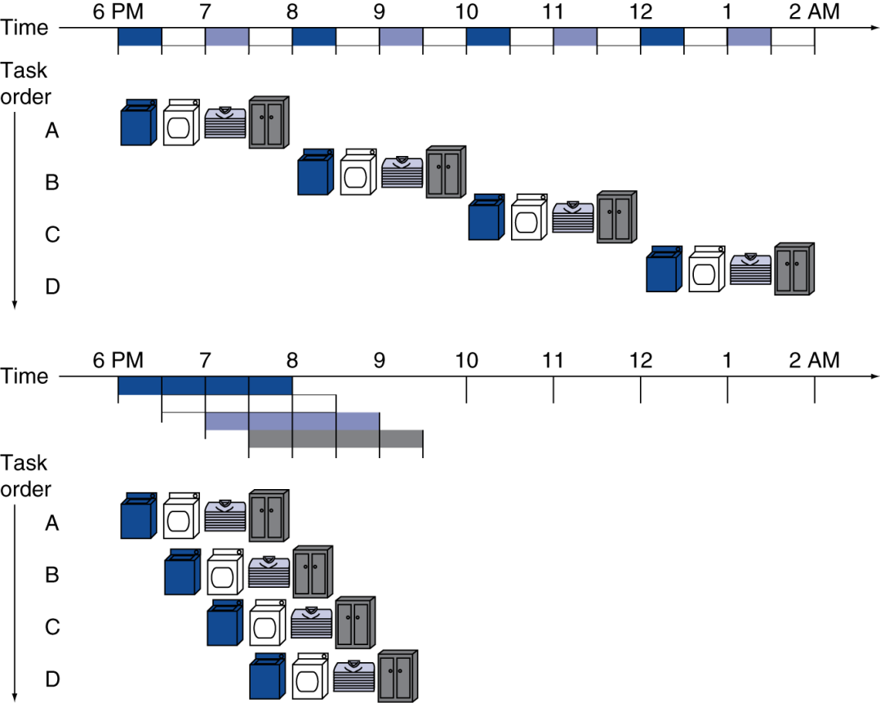
Pipelining: Its Natural!
Pipelined laundry: overlapping execution
  Parallelism improves performance
Four loads:
  Speedup
  = 8/3.5 = 2.3
Non-stop:
  Speedup
  = 2n/0.5n + 1.5 ≈ 4
  = number of stages
Important to note
Each laundry still takes 120 minutes.
Improvement are for 4 load throughput.
More complicated if stages take different amount of time

Slide 70
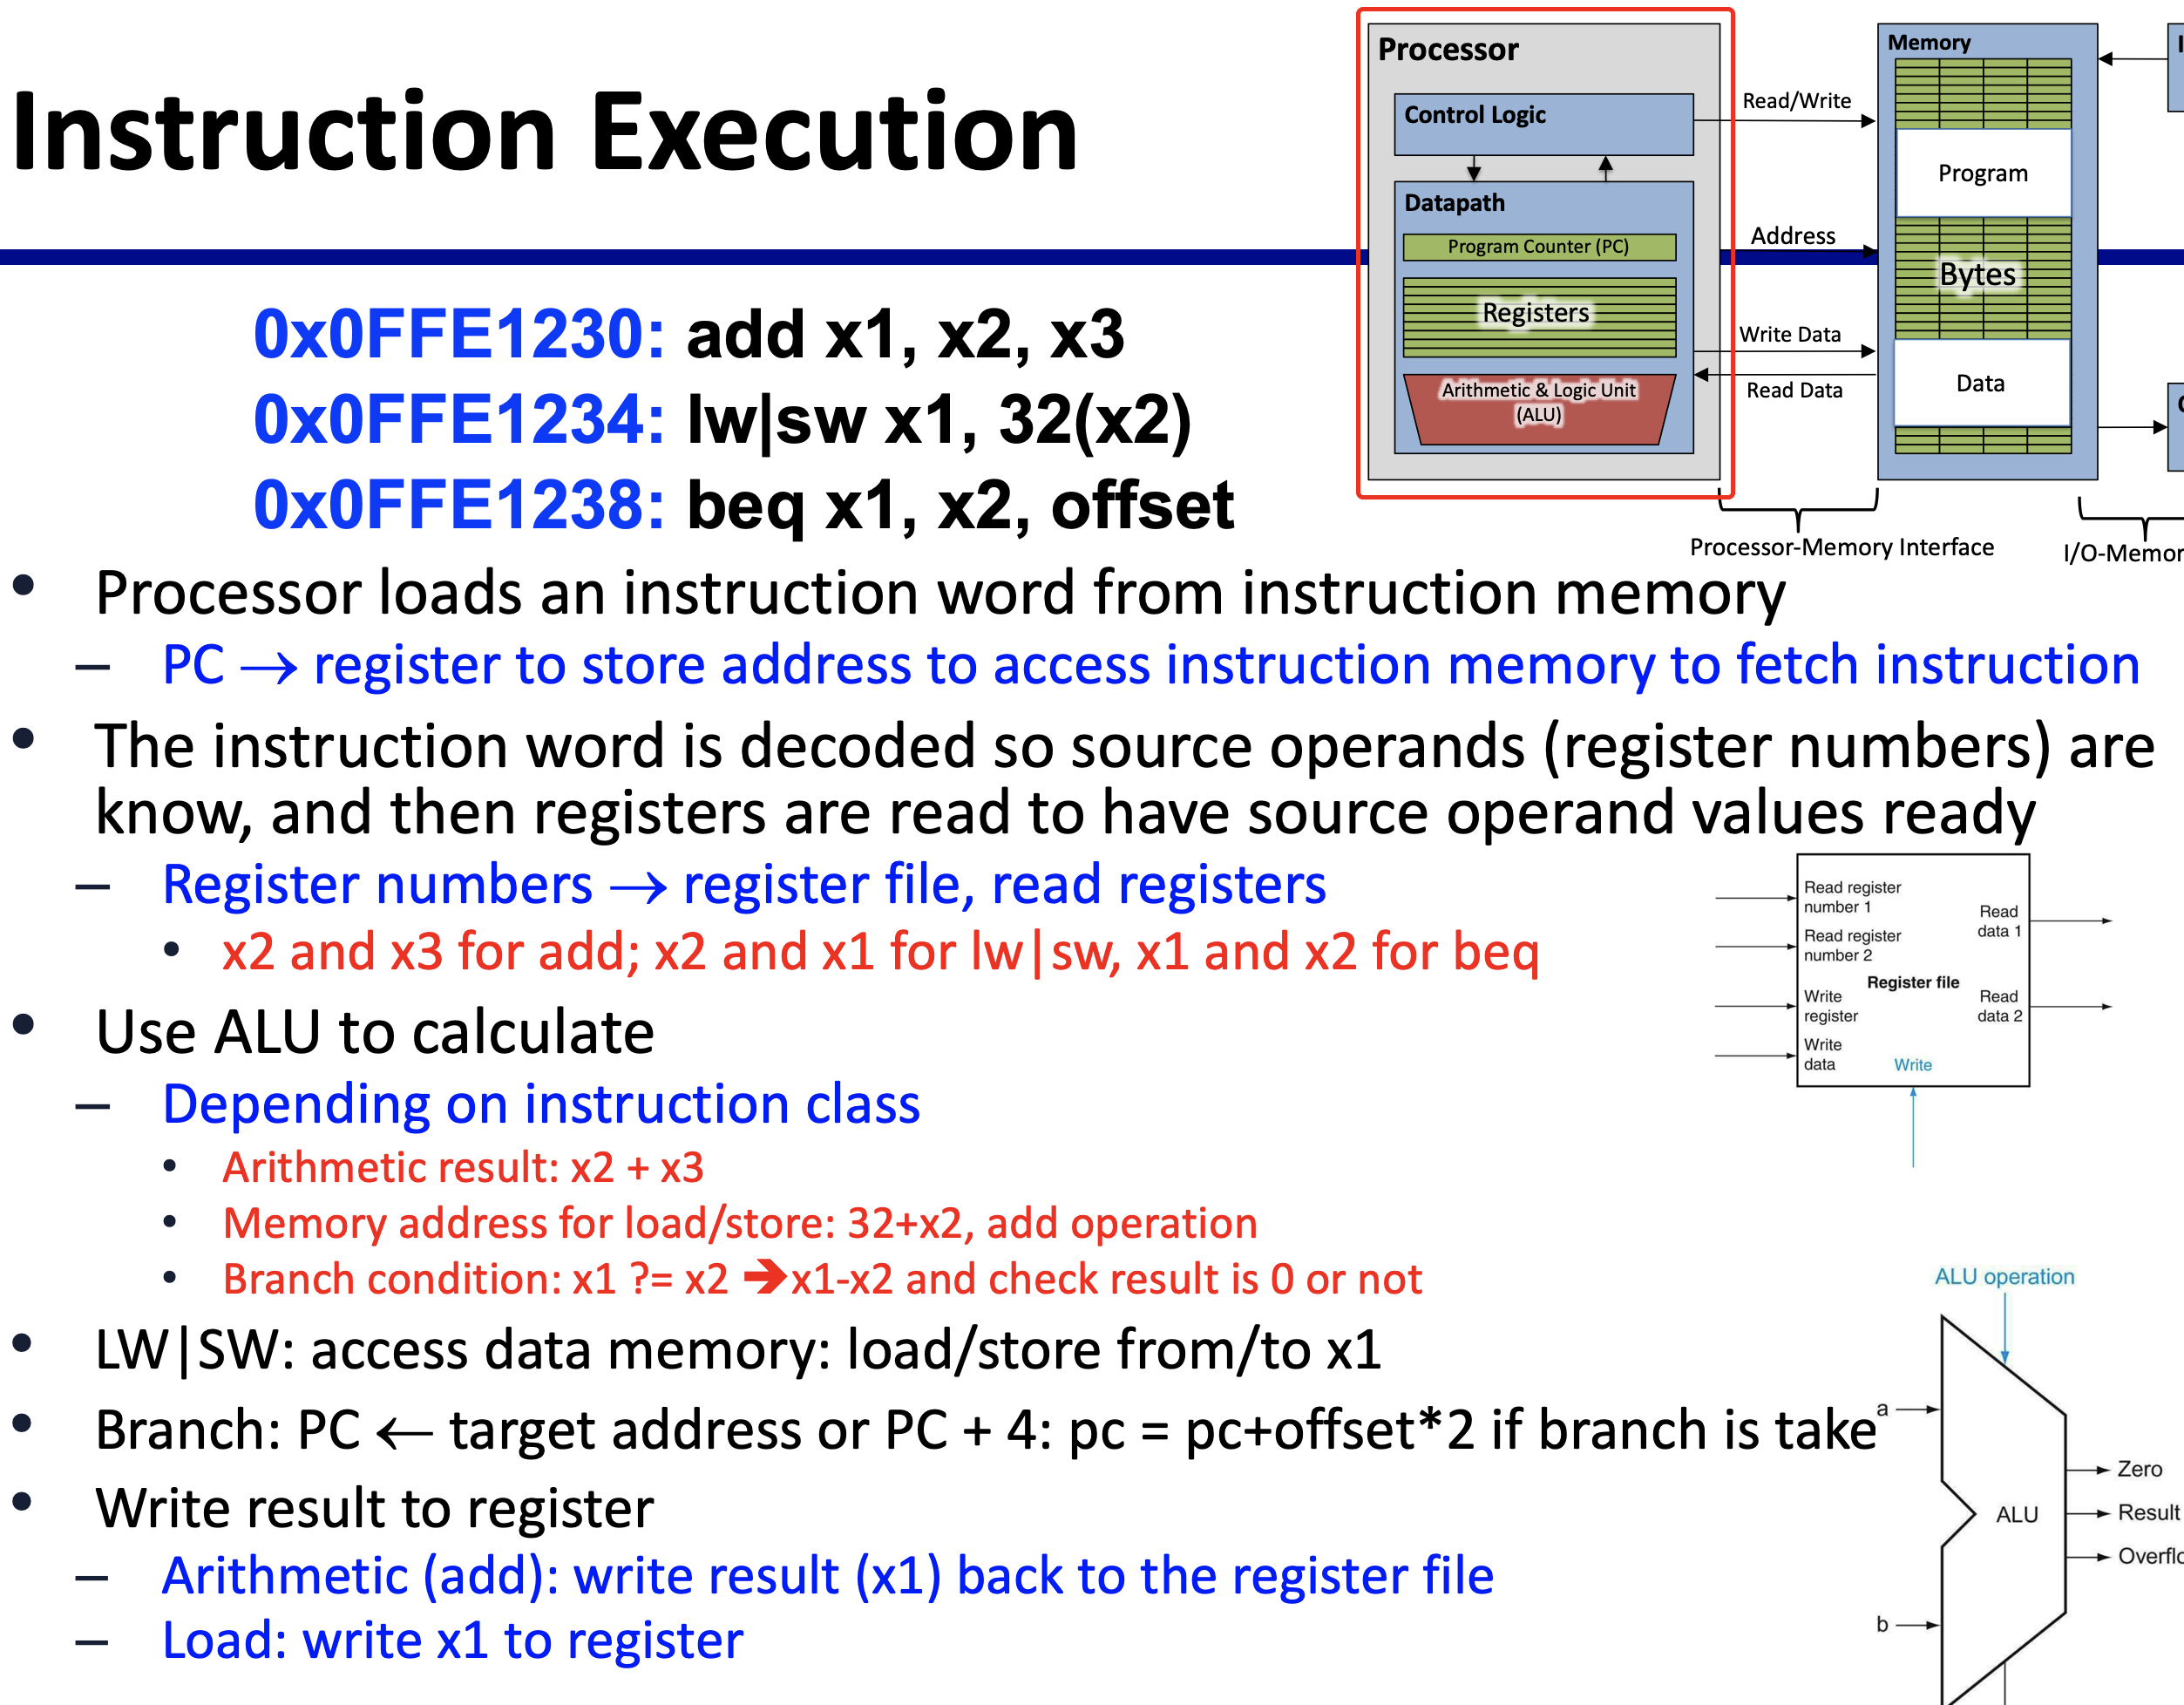
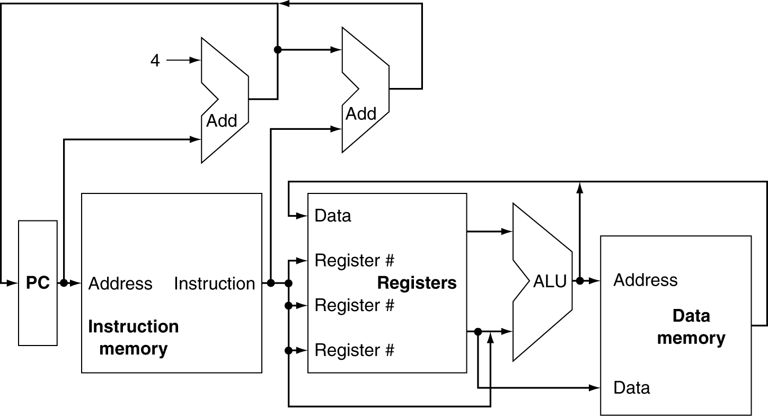
RISC-V Pipeline
Five stages, one step per stage
  IF: Instruction Fetch from memory
  ID: Instruction Decode & register read
  EX: Execute operation or calculate address
  MEM: Access memory operand
  WB: Write result Back to register

Slide 71
Graphical Representation of Instruction Pipeline
IF: Instruction Fetch from memory
  Box representing instruction memory
  Right-half shade representing usage of IM at the second half of the cycle
ID: Instruction Decode & register read
  Box representing register
  Right-half shade representing usage (read) of Register at the second half of the cycle
EX: Execute operation or calculate address
  Shade representing usage
MEM: Access memory operand (only for load/store)
  White background representing NOT used by add instruction in this example
WB: Write result Back to register (only for load and AL instructions)
  Box representing register
  Left-half shade representing write to register at the first half of the cycle

Slide 72
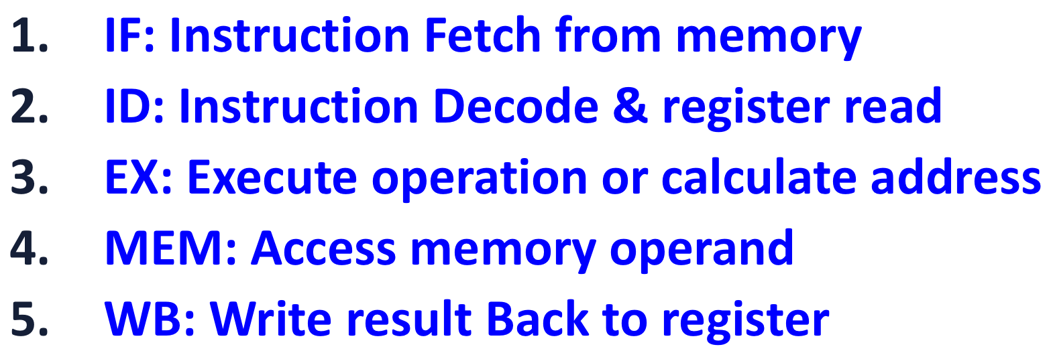
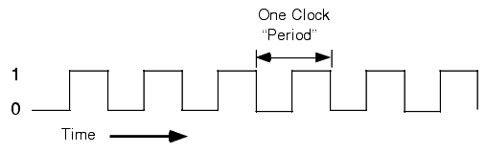
Classic 5-Stage Pipeline for a RISC
In each cycle, hardware initiates a new instruction and executes some part of five different instructions:
  Simple
Clock number
Instruction number | 1 | 2 | 3 | 4 | 5 | 6 | 7 | 8 | 9
Instruction i | IF | ID | EX | MEM | WB
Instruction i+1 |  | IF | ID | EX | MEM | WB
Instruction i+2 |  |  | IF | ID | EX | MEM | WB
Instruction i+3 |  |  |  | IF | ID | EX | MEM | WB
Instruction i+4 |  |  |  |  | IF | ID | EX | MEM | WB
Notes:
Graphical Representation of Instruction Pipeline

Slide 73
Pipeline Performance
Assume time for stages is
  100ps for register read or write
  200ps for other stages
Compare pipelined datapath with single-cycle datapath

Slide 74
Pipeline Performance
Single-cycle (T_{c}= 800ps)
For large number of instructions, say 1M, the speedup will be
  ~= 800ps/200ps = 4
2400ps
vs
1400ps
Pipelined (T_{c}= 200ps)

Slide 75
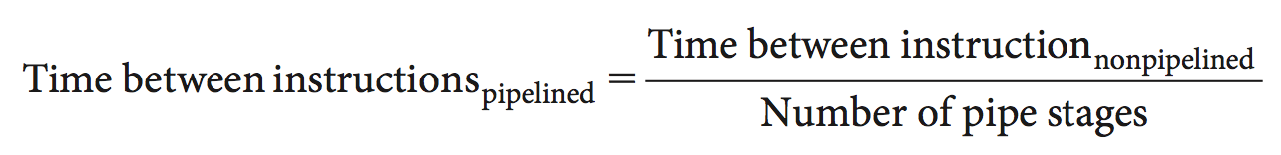
Pipeline Speedup
Execute billions instructions, so throughput is what matters.
Pipelining doesn’t help latency of single instruction
Potential speedup = number pipeline stages;
Unbalanced lengths of pipeline stages reduces speedup;

Slide 76
Pipelining and ISA Design
RISC ISA designed for pipelining
  All instructions are 32-bits
    Easier to fetch and decode in one cycle
    c.f. x86: 1- to 17-byte instructions
  Few and regular instruction formats
    Can decode and read registers in one step
  Load/store addressing
    Can calculate address in 3rd stage, access memory in 4th stage
  Alignment of memory operands
    Memory access takes only one cycle

Slide 77
Hazards
Situations that prevent starting the next instruction in the next cycle
Structure hazards
  A required resource is busy
Data hazard
  Need to wait for previous instruction to complete its data read/write
Control hazard because of branch or jump
  Deciding on control action depends on previous instruction

Slide 78
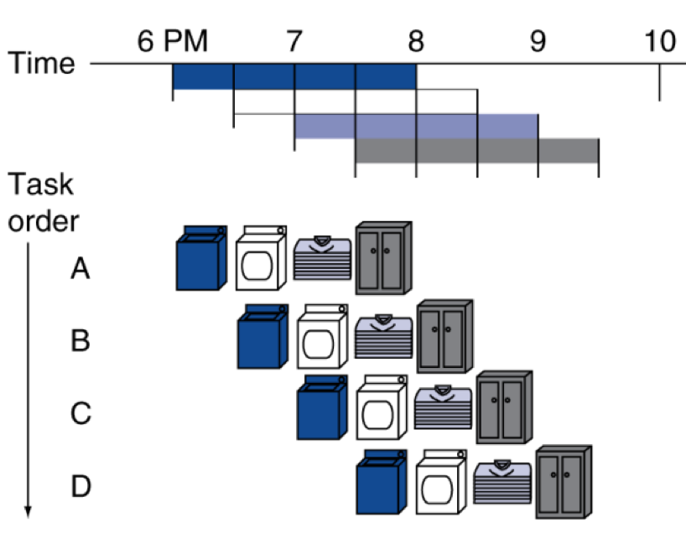
Structure Hazards
Conflict for use of a resource
  Find a situation in laundry example?
In RISC-V pipeline if with a single memory → IF and MEM conflict
  Load/store requires mem access
  Instruction fetch would have to stall for that cycle
    Would cause a pipeline “bubble”
Hence, pipelined datapaths require separate instruction/data memories
  Or separate instruction/data caches
Load or store
Notes:
Load or store

Slide 79
One Memory Port→Structural Hazards
Time (clock cycles)
Cycle 1
Cycle 2
Cycle 3
Cycle 4
Cycle 5
Cycle 6
Cycle 7
I
n
s
t
r.
O
r
d
e
r
Load
Ifetch
Reg
ALU
DMem
Reg
Instr 1
Ifetch
Reg
ALU
DMem
Reg
Instr 2
Ifetch
Reg
ALU
DMem
Reg
Instr 3
Ifetch
Reg
ALU
DMem
Reg
Instr 4
Ifetch
Reg
ALU
DMem
Reg

Slide 80
One Memory Port/Structural Hazards
Time (clock cycles)
Cycle 1
Cycle 2
Cycle 3
Cycle 4
Cycle 5
Cycle 6
Cycle 7
I
n
s
t
r.
O
r
d
e
r
Load
Ifetch
Reg
ALU
DMem
Reg
Instr 1
Ifetch
Reg
ALU
DMem
Reg
One cycle delay!
Instr 2
Ifetch
Reg
ALU
DMem
Reg
Stall
Bubble
Bubble
Bubble
Bubble
Bubble
Instr 3
Ifetch
Reg
ALU
DMem
Reg
How do you “bubble” the pipe? → No-Op

Slide 81
Summary of Structure Hazard
To address structure hazard, have separate memories for instructions and data
However, it will increase cost
  E.g.: pipelining function units or duplicated resources is a high cost;
If the structure hazard is rare, it may not be worth the cost to avoid it.

Slide 82
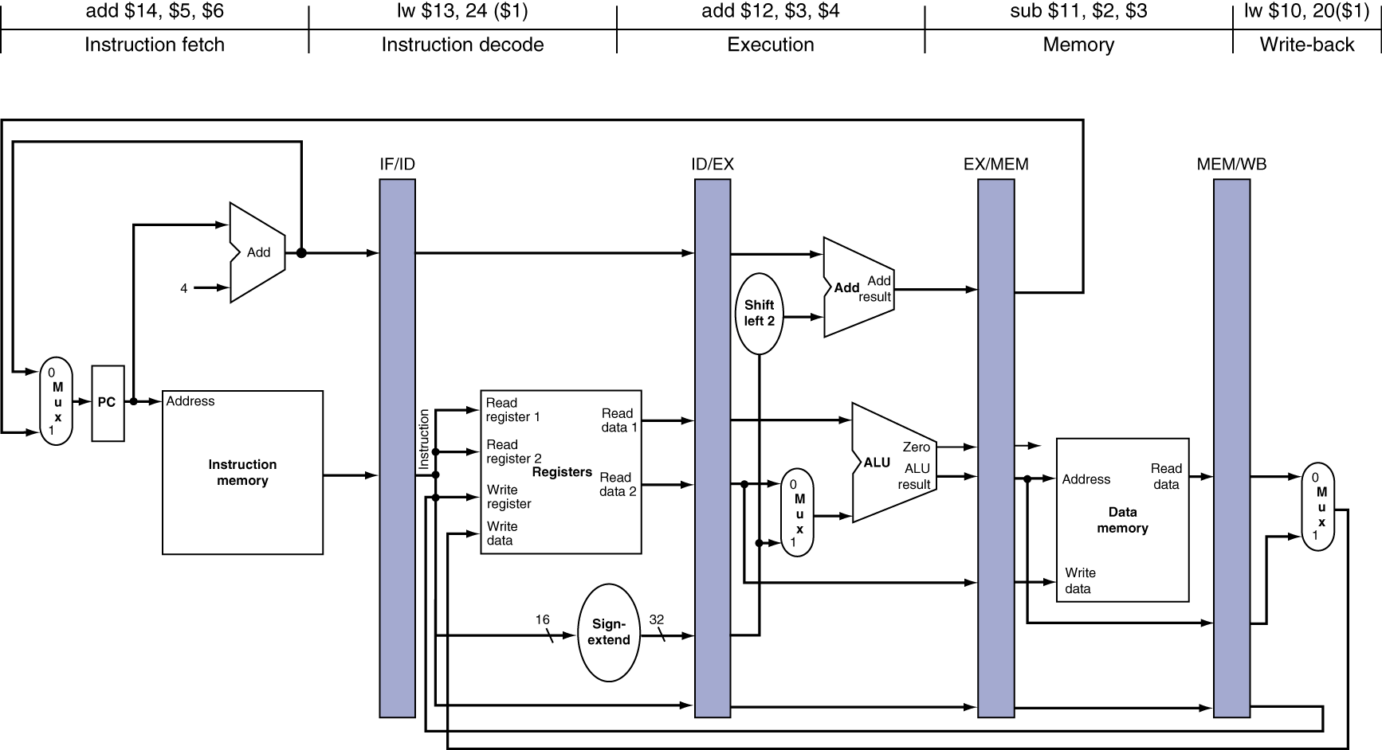
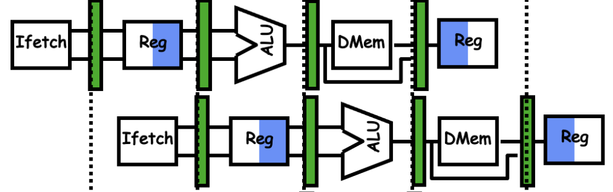
Data Hazards
An instruction needs data produced
by a previous instruction
  Read-After-Write (RAW) data dependency
  add x1, x2, x3
  sub x4, x1, x5
  add x1, x2, x3
  sub x4, x1, x5
  Sub would read old value of x1 at cycle 3

Slide 83

Data Hazards and Solution #1: Interlocking
An instruction needs data produced by a previous instruction
  Read-After-Write (RAW) data dependency
  add x1, x2, x3
  sub x4, x1, x5
Interlock: Hardware detect their dependency, and
  Insert no-op instructions, e.g. “add $0,$0,$0”, as bubble
  Waste 400: two instructions in between since sub needs to wait for two stages for add to write the result x1 to register
add x1, x2, x3
sub x4, x1, x5
Two cycles delay!
x1

Slide 84
Solution #2: Forwarding (aka Bypassing)
Use result right after when it is computed instead of waiting for it to be stored in a register
  add produces the result at the end of its EXE stage
  sub uses the result at the beginning of its EXE stage, which is right after the cycle for add’s EXE
  Requires extra connections in the datapath

Slide 85
Load-Use Data Hazard
Load produce the results after the MEM stage
  Sub use the result at the beginning of the EXE stage, which is in the same cycle as load’s MEM, thus, not possible to forward
Can’t avoid stalls by forwarding for load-use
  If value not computed when needed
  Can’t forward backward in time!
One cycle delay!

Slide 86
Code Scheduling to Avoid Stalls (Software Solution)
Reorder code to avoid use of load result in the next instruction
C code for a = b + e; c = b + f;
ld x1, 0(x31)
ld x2, 8(x31)
add x3, x1, x2
sd x3, 24(x31)
ld x4, 16(x31)
add x5, x1, x4
sd x5, 32(x31)
ld x1, 0(x31)
ld x2, 8(x31)
ld x4, 16(x31)
add x3, x1, x2
sd x3, 24(x31)
add x5, x1, x4
sd x5, 32(x31)
stall
stall
13 cycles
11 cycles

Slide 87

To Check Cycles Delayed and How Forward Works in Different Cases
In the 5-stage pipeline, check whether the results can be generated before it is being used
  If so, forwarding
  If not, stall
Load-Use
Produce-Store
  sw rs2, offset(rs1)
    sw needs rs1 to be ready at the EXE stage
    sw needs rs2 to be ready at the MEM stage
  add x9, x7, x8
  sw x9, 32(x31)
  add x9, x7, x8
  sw x10, 32(x9)
2-cycle delay if no forwarding
No delay with forwarding (Forwarding from EXE to EXE)
2-cycle delay if no forwarding
No delay with forwarding (forwarding from EXE to MEM)

Slide 88
Control Hazards
Branch determines flow of control
  Fetching next instruction depends on branch outcome
  Pipeline might fetch incorrect instruction in the next cycle after a beq instru is fetched
    Still working on ID stage of branch
In RISC-V pipeline
  Need to compare registers and compute target early in the pipeline
  Add hardware to do it in ID stage

Slide 89
Stall on Branch
Wait until branch outcome determined before fetching next instruction
  One cycle stall (bubble) if branch condition is determined at ID stage
  Two cycles stall if branch condition is determined at EXE stage
One cycle delay!

Slide 90
Branch Prediction
Longer pipelines can’t readily determine branch outcome early
  Stall penalty becomes unacceptable
Predict outcome of branch
  Only stall if prediction is wrong
In pipeline
  Can predict branches not taken
  Fetch instruction after branch, with no delay

Slide 91
RISC-V with Predict Not Taken
Prediction correct
Prediction incorrect

Slide 92
More-Realistic Branch Prediction
Static branch prediction
  Based on typical branch behavior
  Example: loop and if-statement branches
    Predict backward branches taken
    Predict forward branches not taken
Dynamic branch prediction
  Hardware measures actual branch behavior
    e.g., record recent history of each branch
  Assume future behavior will continue the trend
    When wrong, stall while re-fetching, and update history

Slide 93
Pipeline Summary
Pipelining improves performance by increasing instruction throughput
  Executes multiple instructions in parallel
  Each instruction has the same latency
Subject to hazards
  Structure, data, control
Instruction set design affects complexity of pipeline implementation
The BIG Picture

Slide 94
Pipeline Execution Diagram: Steps
Identify RAW dependencies between two instructions that are one after the other or there is one instruction in between
  AL-Use: 2-cycle delay without forwarding, no delay with forwarding
  Load-Use: 2-cycle delay without forwarding, 1 cycle delay with forwarding
    With forwarding, we can reschedule load to eliminate the 1 cycle delay even with forwarding
  No need to looking for RAW dependency between instructions that are far from each other (>=1 instructions in between)
    Thus only check for the two instructions that could be executed one after another or has one other instruction in between
Identify branch instruction
  1 cycle delay (or two cycles delay) depending on the implementation (question)
Pipeline diagrams (4 situations)
  a) No pipeline at all, one cycle per stage, no overlap
  b) Pipeline with no forwarding, 2 cycle delay for AL-USE, Load-USE, beq (EXE outcome)
  c) Pipeline with forwarding, 1 cycle delay for Load-use, and 2 cycle-delay for beq
  d) Pipeline with forwarding and load-use rescheduling: reschedule the instruction to eliminate the 1-cycle delay for load-use
No any two instructions can be in the same stage in the same cycle
  Structural hazard

Slide 95
for (i=1; i<M-1; i++) B2[i] = B[i-1] + B[i] + B[i+1];
Base address B and B2 are in register x22 and x23. i is stored in register x5, M is stored in x4.
  add x5, x0, 1 // i=0
  add x22, x4, -1 // loop bound x22 has M-1
  LOOP: beq x5, x22, Exit
  slliw x6, x5, 2 // x6 now store i*4, slliw is i<<2 (shift left logic)
  add x7, x22, x6 // x7 now stores address of B[i].
  lw x9, 0(x7) // load B[i] from memory location (x7+0) to x9
  lw x10, -4(x7) // load B[i-1] to x10
  add x9, x10, x9 // x9 = B[i] + B[i-1]
  lw x10, 4(x7) //load B[i+1] to x10
  add x9, x10, x9 // x9 = B[i-1] + B[i] + B[i+1]
  add x8, x23, x6 // x8 now stores the address of B2[i]
  sw x9, 0(x8) // store value for B2[i] from register x9 to memory (x8+0)
  addi x5, x5, 1 // i++
  beq x0, x0, LOOP
  Exit:
Using beq (==) for (<) to exit

Slide 96
for (i=1; i<M-1; i++) B2[i] = B[i-1] + B[i] + B[i+1];
Base address B and B2 are in register x22 and x23. i is stored in register x5, M is stored in x4.
  add x5, x0, 1
  add x22, x4, -1
  LOOP: beq x5, x22, Exit
  slliw x6, x5, 2
  add x7, x22, x6
  lw x9, 0(x7)
  lw x10, -4(x7)
  add x9, x10, x9
  lw x10, 4(x7)
  add x9, x10, x9
  add x8, x23, x6
  sw x9, 0(x8)
  addi x5, x5, 1
  beq x0, x0, LOOP
  Exit:
Using beq (==) for (<) to exit
RAW Dependencies
Instruction that writes the register | Instruction that reads the register | The register | # instructions in between | Load-use
add x5, x0, 1 | beq x5, x22, Exit | x5 | 1
add x22, x4, -1 | beq x5, x22, Exit | x22 | 0
slliw x6, x5, 2 | add x7, x22, x6 | x6 | 0
add x7, x22, x6 | lw x9, 0(x7) | x7 | 0
add x7, x22, x6 | lw x10, -4(x7) | x7 | 1
lw x9, 0(x7) | add x9, x10, x9 | x9 | 1 | Y
lw x10, -4(x7) | add x9, x10, x9 | x10 | 0 | Y
lw x10, 4(x7) | add x9, x10, x9 | x10 | 0 | Y
add x9, x10, x9 | sw x9, 0(x8) | x9 | 1
add x8, x23, x6 | sw x9, 0(x8) | x8 | 0
addi x5, x5, 1 | beq x5, x22, Exit | x5 | 1

Slide 97

Examples
Instruction that writes the register | Instruction that reads the register | The register | In instructions in between | Load-use
add x5, x0, 1 | beq x5, x22, Exit | x5 | 1
add x22, x4, -1 | beq x5, x22, Exit | x22 | 0
slliw x6, x5, 2 | add x7, x22, x6 | x6 | 0
add x7, x22, x6 | lw x9, 0(x7) | x7 | 0
add x7, x22, x6 | lw x10, -4(x7) | x7 | 1
lw x9, 0(x7) | add x9, x10, x9 | x9 | 1 | Y
lw x10, -4(x7) | add x9, x10, x9 | x10 | 0 | Y
lw x10, 4(x7) | add x9, x10, x9 | x10 | 0 | Y
add x9, x10, x9 | sw x9, 0(x8) | x9 | 1
add x8, x23, x6 | sw x9, 0(x8) | x8 | 0
addi x5, x5, 1 | beq x5, x22, Exit | x5 | 0

Slide 98



Slide 99
Chapter 4: The Processor
Lecture
  4.1 Introduction
  4.2 Logic Design Conventions
  4.3 Building a Datapath
Lecture
  4.4 A Simple Implementation Scheme
Lecture
  4.5 An Overview of Pipelining
Lecture (Pipeline implementation), will not be covered!
  4.6 Pipelined Datapath and Control
  4.7 Data Hazards: Forwarding versus Stalling
  4.8 Control Hazards
  4.9 Exceptions
  4.13 Advanced Topic: An Introduction to Digital Design Using a Hardware Design Language to Describe and Model a Pipeline and More Pipelining Illustrations
Lecture (Advanced pipeline techniques and real-world CPU examples)
  4.10 Parallelism via Instructions
  4.11 Real Stuff: The ARM Cortex-A8 and Intel Core i7 Pipelines
  4.12 Going Faster: Instruction-Level Parallelism and Matrix Multiply
  4.14 Fallacies and Pitfalls
  4.15 Concluding Remarks
☛

Slide 100

Instruction-Level Parallelism (ILP)
Pipelining: executing multiple instructions in parallel
  CPI ~= 1
To increase ILP
  Deeper pipeline by having more stages
    Less work per stage ⇒ shorter clock cycle
  Multiple issue
    Replicate pipeline stages ⇒ multiple pipelines
    Start multiple instructions per clock cycle
Performance of Multiple issue
  E.g., 4GHz 2-way multiple-issue
  IPC (Instruction Per Cycle): 2
    peak CPI = 0.5
    Instr/Second: 4*10⁹ * 2 = 8*10⁹
  But dependencies reduce this in practice
    Pipeline hazards for single issue happen
    Not always have two instruction to be issued per cycle
§4.10 Parallelism via Instructions

Slide 101
Multiple Issue
Static multiple issue
  Compiler groups instructions to be issued together
  Packages them into “issue slots”
  Compiler detects and avoids hazards
Dynamic multiple issue
  CPU examines instruction stream and chooses instructions to issue each cycle
  Compiler can help by reordering instructions
  CPU resolves hazards using advanced techniques at runtime
High-end processors (desktop, server) use dynamic multiple issue
Notes:
High-end (desktop, server, laptop, high-profile pad/phone) use dynamic multiple issue

Slide 102
Speculation
“Guess” what to do with an instruction
  Start operation as soon as possible
  Check whether guess was right
    If so, complete the operation
    If not, roll-back and do the right thing
Common to static and dynamic multiple issue
Examples
  Speculate on branch outcome
    Roll back if path taken is different
  Speculate on load
    Roll back if location is updated
Kill load and roll-back
Notes:
Kill load and roll-back

Slide 103
Speculation
Predict branch and continue issuing
  Don’t commit until branch outcome determined
Load speculation
  Avoid load and cache miss delay
    Predict the effective address
    Predict loaded value
    Load before completing outstanding stores
    Bypass stored values to load unit
  Don’t commit load until speculation cleared

Slide 104

Compiler/Hardware Speculation
Compiler can reorder instructions
  e.g., move load before branch
  Can include “fix-up” instructions to recover from incorrect guess
    Move lw to remove load-use cycle delay in RAW hazards
    Schedule delayed slot
Hardware can look ahead for instructions to execute
  Buffer results until it determines they are actually needed
  Flush buffers on incorrect speculation

Slide 105

Static Multiple Issue
Compiler groups instructions into “issue packets”
  Group of instructions that can be issued on a single cycle
    2 IPC: ALU/BEQ + LW/SW
  Determined by pipeline resources required
Think of an issue packet as a very long instruction
  Specifies multiple concurrent operations
  ⇒ Very Long Instruction Word (VLIW)

Slide 106
Scheduling Static Multiple Issue
Compiler must remove some/all hazards
  Reorder instructions into issue packets
  No dependencies with a packet
  Possibly some dependencies between packets
    Varies between ISAs; compiler must know!
  Pad with nop if necessary

Slide 107
RISC-V with Static Dual Issue
Two-issue packets
  One ALU/branch instruction
  One load/store instruction
  64-bit aligned
    ALU/branch, then load/store
    Pad an unused instruction with nop

Slide 108
RISC-V with Static Dual Issue
Double resources
  2 set of register R/W ports
  2 ALUs
    Top for Load/store
    Bottom for AL and BEQ
Figure 4.66

Slide 109
Hazards in the Dual-Issue RISC-V
More instructions executing in parallel
EX data hazard
  Forwarding avoided stalls with single-issue
  Now can’t use ALU result in load/store in same packet
    add x10, $s0, $s1
    load $s2, 0(x10)
    Split into two packets, effectively a stall
Load-use hazard
  Still one cycle use latency, but now two instructions
More aggressive scheduling required

Slide 110
Scheduling Example
for (i=1000;i!=0;i--)
A[i] += a;
Each element is 8 bytes
Schedule this for dual-issue RISC-V
Loop: ld x31, 0(x20) # x31=array element
add x31, x31, x21 # add scalar in x21
sd x31, 0(x20) # store result
addi $20, x20, –8 # decrement pointer
blt x22, x20, Loop # compare to loop limit
# branch if x20 > x22
A[i] += a;
Figure 4.67
  addi and ld CANNOT be in one cycle
    Load-use (ld-add) hazard: 1 cycle delay
  IPC = 5/4 = 1.25 (c.f. peak IPC = 2)
Notes:
Figure 4.67

Slide 111
Loop Unrolling
Unrolling with factor 2
for (i=1000;i!=0;i-=2) {
A[i] += a;;
A[i-1] += a;
}
for (i=1000;i!=0;i--)
A[i] += a;
Replicate loop body to expose more parallelism
  Reduces loop-control overhead
  For two calculations, e.g. A[i]+=a
    2 beq vs 1 beq; 2 i-1 vs 1 i-2
Use different registers per replication
  Called “register renaming”
  Avoid loop-carried “anti-dependencies”
    Store followed by a load of the same register
    Aka “name dependence”
      Reuse of a register name

Slide 112
Loop Unrolling Example
Unrolling with factor 4
for (i=1000;i!=0;i-=4){
A[i] += a;
A[i-1] += a;
A[i-2] += a;
A[i-3] += a;
}
Load-use hazard
  1 cycle use delay
IPC = 14/8 = 1.75
  Closer to 2, but at cost of registers and code size
A[i] += a;
A[i-1] += a;
A[i-2] += a;
A[i-3] += a;
Figure 4.68

Slide 113

Summary for Four Iterations of the Loop
Unrolling with factor 4
for (i=1000;i!=0;i-=4){
A[i] += a;;
A[i-1] += a;
A[i-2] += a;
A[i-3] += a;
}
Original version + single issue
  Total 20 instructions →
  ~5 cycles/calculation
Original version + multi-issue
  About 4 cycles/calculation
Unrolling by 4 + single issue
  14 instructions → 3.5 cycles/calculation (14/4)
Unrolling + multi-issue
  About 2 clocks/calculation (8/4)
for (i=1000;i!=0;i--)
A[i] += a;

Slide 114
Dynamic Multiple Issue
“Superscalar” processors
CPU decides whether to issue 0, 1, 2, … each cycle
  Avoiding structural and data hazards
Avoids the need for compiler scheduling
  Though it may still help
  Code semantics ensured by the CPU

Slide 115
Dynamic Pipeline Scheduling
Allow the CPU to execute instructions out of order to avoid stalls
  But commit result to registers in order
Example
  ld x31, 0(x21)
  add x1, x31, x2
  sub x23,x23, x3
  andi x5, x23, 20
  Can start sub while add is waiting for lw

Slide 116

Dynamically Scheduled CPU
Preserves dependencies
Hold pending operands
Results also sent to any waiting reservation stations
Reorders buffer for register writes
Can supply operands for issued instructions

Slide 117
Register Renaming
Reservation stations and reorder buffer effectively provide register renaming
On instruction issue to reservation station
  If operand is available in register file or reorder buffer
    Copied to reservation station
    No longer required in the register; can be overwritten
  If operand is not yet available
    It will be provided to the reservation station by a function unit
    Register update may not be required

Slide 118
Why Do Dynamic Scheduling?
Why not just let the compiler schedule code?
Not all stalls are predicable
  e.g., cache misses
Can’t always schedule around branches
  Branch outcome is dynamically determined
Different implementations of an ISA have different latencies and hazards

Slide 119
Does Multiple Issue Work?
The BIG Picture
Yes, but not as much as we’d like
Programs have real dependencies that limit ILP
Some dependencies are hard to eliminate
  e.g., pointer aliasing
Some parallelism is hard to expose
  Limited window size during instruction issue
Memory delays and limited bandwidth
  Hard to keep pipelines full
Speculation can help if done well

Slide 120
Power Efficiency
Complexity of dynamic scheduling and speculations requires power
Multiple simpler cores may be better

Slide 121
Cortex A53 and Intel i7
Processor | ARM A53 | Intel Core i7 920
Market | Personal Mobile Device | Server, cloud
Thermal design power | 100 milliWatts (1 core @ 1 GHz) | 130 Watts
Clock rate | 1.5 GHz | 2.66 GHz
Cores/Chip | 4 (configurable) | 4
Floating point? | Yes | Yes
Multiple issue? | Dynamic | Dynamic
Peak instructions/clock cycle | 2 | 4
Pipeline stages | 8 | 14
Pipeline schedule | Static in-order | Dynamic out-of-order with speculation
Branch prediction | Hybrid | 2-level
1st level caches/core | 16-64 KiB I, 16-64 KiB D | 32 KiB I, 32 KiB D
2nd level caches/core | 128-2048 KiB | 256 KiB (per core)
3rd level caches (shared) | (platform dependent) | 2-8 MB
§4.11 Real Stuff: The ARM Cortex-A53 and Intel Core i7 Pipelines

Slide 122

ARM Cortex-A53 Pipeline
Used as the basis for several tablets and cell phones
  Dual-issue, statically scheduled superscalar with dynamic issue detection → 0.5 CPI ideally
Figure 4.72

Slide 123

ARM Cortex-A53 Performance using SPEC2006
Ideal CPI: 0.5 since it is 2-way multi-issue (IPC=2)
  Best case 1.0, median case 1.3, worst 8.6
  60% stalls due to pipelining hazards
  40% stalls due to the memory hierarchy
Figure 4.73

Slide 124

Intel Core i7
Aggressive out-of-order speculative
14 stages pipeline,
Branch mispredictions costing 17 cycles.
48 load and 32 store buffers.
Six independent functional units
  6-wide superscalar

Slide 125
Core i7 Pipeline: IF
Instruction fetch – Fetch 16 bytes from the I cache
  A multilevel branch target buffer to achieve a balance between speed and prediction accuracy.
  A return address stack to speed up function return.
  Mispredictions cause a penalty of about 15 cycles.

Slide 126
Core i7 Pipeline: Predecode
Predecode –16 bytes instr in the predecode I buffer
  Macro-op fusion: Fuse instr combinations such as compare followed by a branch into a single operation.
  Instr break down: breaks the 16 bytes into individual x86 instructions.
    nontrivial since the length of an x86 instruction can be from 1 to 17 bytes and the predecoder must look through a number of bytes before it knows the instruction length.
  Individual x86 instructions (including some fused instructions) are placed into the 18-entry instruction queue.

Slide 127
Core i7 Pipeline:
Micro-op decode
Micro-op decode – Translate Individual x86 instructions into micro-ops.
  Micro-ops are simple MIPS-like instructions that can be executed directly by the pipeline (RISC style)
    introduced in the Pentium Pro in 1997 and has been used since.
  Three simple micro-op decoders handle x86 instructions that translate directly into one micro-op.
  One complex micro-op decoder produce the micro-op sequence of complex x86 instr;
    produce up to four micro-ops every cycle
  The micro-ops are placed according to the order of the x86 instructions in the 28- entry micro-op buffer.

Slide 128
Core i7 Pipeline: loop stream detection and microfusion
loop stream detection and microfusion by the micro-op buffer preforms
  If there is a sequence of instructions (less than 28 instrs or 256 bytes in length) that comprises a loop, the loop stream detector will find the loop and directly issue the micro-ops from the buffer
    eliminating the need for the instruction fetch and instruction decode stages to be activated.
  Microfusion combines instr pairs such as load/ALU operation and ALU operation/store and issues them to a single reservation station, thus increasing the usage of the buffer.
    Study comparing the microfusion and macrofusion by Bird et al. [2007] discovered that microfusion had little impact on per- formance, while macrofusion appears to have a modest positive impact on integer performance and little impact on FP.

Slide 129

Core i7 Pipeline: Issue
Basic instruction issue
  Looking up the register location in
  the register tables
  renaming the registers
  allocating a reorder buffer entry
  fetching any results from the
  registers or reorder buffer before sending the micro-ops to the reservation stations.
36-entry centralized reservation station shared by six functional units
  Up to six micro-ops may be dispatched to the functional units every clock cycle.

Slide 130
Core i7 Pipeline: EXE and Retirement
Micro-ops are executed by the individual function units
  results are sent back to any waiting reservation station as well as to the register retirement unit, where they will update the register state. The entry corresponding to the instruction in the reorder buffer is marked as complete.
Retirement
  When one or more instructions at the head of the reorder buffer have been marked as complete, the pending writes in the register retirement unit are executed, and the instructions are removed from the reorder buffer.

Slide 131


Core i7 Performance running SPEC2006 INT
Ideal CPI: 0.25
Best 0.44, median 0.79, worst 2.67;

Slide 132
Concluding Remarks
ISA influences design of datapath and control
Datapath and control influence design of ISA
Pipelining improves instruction throughput
using parallelism
  More instructions completed per second
  Latency for each instruction not reduced
Hazards: structural, data, control
Multiple issue and dynamic scheduling (ILP)
  Dependencies limit achievable parallelism
  Complexity leads to the power wall
§4.14 Concluding Remarks

Slide 133
Slides and Chapter Sections that are not covered for Fall 2020.

Slide 134
Chapter 4: The Processor
Lecture
  4.1 Introduction
  4.2 Logic Design Conventions
  4.3 Building a Datapath
Lecture
  4.4 A Simple Implementation Scheme
Lecture
  4.5 An Overview of Pipelining
Lecture (Pipeline implementation), will not be covered!
  4.6 Pipelined Datapath and Control
  4.7 Data Hazards: Forwarding versus Stalling
  4.8 Control Hazards
  4.9 Exceptions
  4.13 Advanced Topic: An Introduction to Digital Design Using a Hardware Design Language to Describe and Model a Pipeline and More Pipelining Illustrations
Lecture (Advanced pipeline techniques and real-world CPU examples)
  4.10 Parallelism via Instructions
  4.11 Real Stuff: The ARM Cortex-A8 and Intel Core i7 Pipelines
  4.12 Going Faster: Instruction-Level Parallelism and Matrix Multiply
  4.14 Fallacies and Pitfalls
  4.15 Concluding Remarks
☛

Slide 135
Pipelined Datapath
§4.6 Pipelined Datapath and Control
MEM
Right-to-left flow leads to hazards
WB

Slide 136
Pipeline registers
Registers between stages
  For each instruction, hold information produced in previous stage/cycle and pass on
  Each register set (IF/ID, ID/EX, EX/MEM, MEM/WB) has the information for each of the instructions that are in the pipeline

Slide 137
Pipeline Operation
Cycle-by-cycle flow of instructions through the pipelined datapath
  “Single-clock-cycle” pipeline diagram
    Shows pipeline usage in a single cycle
    Highlight resources used
  c.f. “multi-clock-cycle” diagram
    Graph of operation over time
We’ll look at “single-clock-cycle” diagrams for load & store

Slide 138

IF for Load, Store, …
LW $4, 32($5)
Instruction word and PC+4 are in the IF/ID pipeline register

Slide 139

ID for Load, Store, …
LW $4, 32($5)
Value of $5, 32, and others are in ID|EX pipeline register
Similar info of the following instruction are now in IF|ID register

Slide 140

EX for Load
LW $4, 32($5)
Value of $5+32, and others are in EX|MEM pipeline register

Slide 141

MEM for Load
LW $4, 32($5)
Value of MEM[$5+32], and others are in MEM|WB pipeline register for WB

Slide 142

WB for Load
LW $4, 32($5)
Wrong
register number, which is from one of the following instructions that is in the ID stage.
Value of MEM[$5+32], and others are in MEM|WB pipeline register for WB

Slide 143

Corrected Datapath for Load
LW $4, 32($5)
LW completes and exits from the pipeline.

Slide 144

EX for Store
SW $6, 64($5)
Value of $5+64 and $6 are in EX|MEM pipeline register

Slide 145

MEM for Store
SW $6, 64($5)
$6 is written to MEM[$5+64]

Slide 146

WB for Store
SW $6, 64($5)
Nothing to do for SW in WB stage and SW completes

Slide 147

Multi-Cycle Pipeline Diagram
Traditional form

Slide 148
Single-Cycle Pipeline Diagram
State of pipeline in a given cycle

Slide 149

Multi-Cycle Pipeline Diagram
Form showing resource usage

Slide 150

Pipelined Control (Simplified)

Slide 151

Pipelined Control
Control signals derived from instruction
  As in single-cycle implementation

Slide 152

Pipelined Control

Slide 153
Data Hazards in ALU Instructions
Consider this sequence:
  sub $2, $1,$3
  and $12,$2,$5
  or $13,$6,$2
  add $14,$2,$2
  sw $15,100($2)
Called Read After Write (RAW) hazards
We can resolve hazards with forwarding
  How do we detect when to forward?
§4.7 Data Hazards: Forwarding vs. Stalling

Slide 154

Data Dependency → Data Hazards
Read old value of $2 from register file

Slide 155
Solution #1: Handling RAW Hazards by Forwarding
Forward the latest $2 via data path

Slide 156





Solution #2: Insert stalls
Time (clock cycles)
IF
ID/RF
EX
MEM
WB
Two cycles delay!
Ifetch
Reg
ALU
DMem
Reg
Bubble
Bubble
Bubble
Ifetch
Reg
Bubble
Bubble
Bubble
Ifetch
Reg
Ifetch
Reg
ALU
DMem
Reg
Ifetch
Reg
ALU
DMem
Reg
Ifetch
Reg
ALU
DMem
Reg
Ifetch
Reg
ALU
DMem
Reg

Slide 157


Datapath for Forwarding
Forwarding happens in two consecutive cycles

Slide 158

Detecting RAW Hazards
Current instruction being executed in ID/EX register
Previous instruction is in the EX/MEM register
2nd Previous is in the MEM/WB register
Forwarding happens in the same cycle
IF ID EX MEM WB
    ADD R1, R2, R3 #2nd Previous in MEM/WB
    SUB R6, R4, R5 #Previous in EX/MEM
    AND R7, R1, R6 #Current in ID/EX

Slide 159
Detecting RAW Hazards
IF ID EX MEM WB
    ADD R1, R2, R3 #2nd Previous in MEM/WB
    SUB R6, R4, R5 #Previous in EX/MEM
    AND R7, R1, R6 #Current in ID/EX

Slide 160
Detecting RAW Hazards
    ADD R1, R2, R3 #2nd Previous in MEM/WB
    SUB R6, R4, R5 #Previous in EX/MEM
    AND R7, R1, R6 #Current in ID/EX
Pass register numbers along pipeline
  ID/EX.RegisterRs = register number for Rs in ID/EX (Rs1)
  ID/EX.RegisterRt = register number for Rt in ID/EX (Rs2)
  ID/EX.RegisterRd = register number for Rd in ID/EX
RAW Data hazards when
  1a. EX/MEM.RegisterRd = ID/EX.RegisterRs
  1b. EX/MEM.RegisterRd = ID/EX.RegisterRt
  2a. MEM/WB.RegisterRd = ID/EX.RegisterRs
  2b. MEM/WB.RegisterRd = ID/EX.RegisterRt
Fwd from
EX/MEM
pipeline reg
Fwd from
MEM/WB
pipeline reg

Slide 161
Detecting the Need to Forward
But only if forwarding instruction will write to a register!
  EX/MEM.RegWrite, MEM/WB.RegWrite
And only if Rd for that instruction is not R0
  EX/MEM.RegisterRd ≠ 0
  MEM/WB.RegisterRd ≠ 0
IF ID EX MEM WB
    ADD R1, R2, R3 #2nd Previous in MEM/WB
    SUB R6, R4, R5 #Previous in EX/MEM
    AND R7, R1, R6 #Current in ID/EX

Slide 162
Forwarding Conditions
Detecting RAW hazard with Previous Instruction
  if (EX/MEM.RegWrite and (EX/MEM.RegisterRd ≠ 0)
  and (EX/MEM.RegisterRd = ID/EX.RegisterRs))
  ForwardA = 01 (Forward from EX/MEM pipe stage)
  if (EX/MEM.RegWrite and (EX/MEM.RegisterRd ≠ 0)
  and (EX/MEM.RegisterRd = ID/EX.RegisterRt))
  ForwardB = 01 (Forward from EX/MEM pipe stage)

Slide 163
Forwarding Conditions
Detecting RAW hazard with Second Previous
  if (MEM/WB.RegWrite and (MEM/WB.RegisterRd ≠ 0)
  and (MEM/WB.RegisterRd = ID/EX.RegisterRs))
  ForwardA = 10 (Forward from MEM/WB pipe stage)
  if (MEM/WB.RegWrite and (MEM/WB.RegisterRd ≠ 0)
  and (MEM/WB.RegisterRd = ID/EX.RegisterRt))
  ForwardB = 10 (Forward from MEM/WB pipe stage)

Slide 164
Control Signals During Forwarding:
Those Light Blue lines
    ADD R1, R2, R3 #2nd Previous in MEM/WB
    SUB R6, R4, R5 #Previous in EX/MEM
    AND R7, R1, R6 #Current in ID/EX

Slide 165
RAW Hazards with Load/Store
LW Rt, 20(Rs): load a word from memory @ [Rs]+20 into Rt
  ID/RF: Read register Rs: [Rs] (rs select)
  EX: Calculate effective address: [Rs] + 20
  MEM: Memory read from [Rs]+20
    Data is available in MEM|WB
    Unlike ALU: data is available in EX|MEM
  WB: data write back to Rt (rt select)
SW Rt,12(Rs): store a word in Rt in the memory @ [Rs]+12
  ID/RF: Read register Rs and Rt (rs and rt select, no rd)
    Rs is needed in EX, and Rt is needed in MEM
  EX: Calculate effective address: [Rs] + 12
  MEM: Memory write to [Rs]+12
    Need Rt to be available
    Unlike ALU, data needs to be available in ID|EX
  No need WB
IF
ID/RF
EX
MEM
WB
Ifetch
Reg
ALU
DMem
Reg

Slide 166

Load-Use RAW Data Hazard
Data for $2 is only available after MEM stage, forwarding from MEM to EXE between two instructions will not work.

Slide 167

Stall/Bubble in the Pipeline
Stall inserted here

Slide 168

Stall/Bubble in the Pipeline
Or, more accurately…

Slide 169
Load-Use Hazard Detection
Check when using instruction is decoded in ID stage
ALU operand register numbers in ID stage are given by
  IF/ID.RegisterRs, IF/ID.RegisterRt
Load-use hazard when
  ID/EX.MemRead and
  ((ID/EX.RegisterRt = IF/ID.RegisterRs) or
  (ID/EX.RegisterRt = IF/ID.RegisterRt))
If detected, stall and insert bubble

Slide 170
How to Stall the Pipeline
Force control values in ID/EX register to 0
  EX, MEM and WB do nop (no-operation)
Prevent update of PC and IF/ID register
  Using instruction is decoded again
  Following instruction is fetched again
  1-cycle stall allows MEM to read data for lw
    Can subsequently forward to EX stage

Slide 171

Datapath with Hazard Detection

Slide 172
Compiler Scheduling for Removing Load-Use Stall
Compilers can schedule code in a way to avoid load → ALU-use stalls
  a = b + c; d = e – f;
Slow code: 2 stall cycles
  lw r10, (r1) # r1 = addr b
  lw r11, (r2) # r2 = addr c
  # stall
  add r12, r10, r11 # b + c
  sw r12, (r3) # r3 = addr a
  lw r13, (r4) # r4 = addr e
  lw r14, (r5) # r5 = addr f
  # stall
  sub r15, r13, r14 # e - f
  sw r15, (r6) # r6 = addr d
Fast code: No Stalls
  lw r10, 0(r1)
  lw r11, 0(r2)
  lw r13, 0(r4)
  lw r14, 0(r5)
  add r12, r10, r11
  sw r12, 0(r3)
  sub r15, r13, r14
  sw r15, 0(r6)

Slide 173
Stalls and Performance
The BIG Picture
Stalls reduce performance
  But are required to get correct results
Compiler can arrange code to avoid hazards and stalls
  Requires knowledge of the pipeline structure

Slide 174
Control Hazards Because of Branches
§4.8 Control Hazards
Branch outcome determined in MEM
40 beq $1, $3, 28
44 and $12, $2, $5
48 or $13, $6, $2
52 add $14, $2, $2
…
72 lw $4, 50($7)

Slide 175

Control Hazards
Branch outcome determined in MEM
Flush these three
instructions
(Set control
values to 0)
PC

Slide 176

Reducing Branch Delay
In general, branch could cause 3 cycle delay
  Since branch outcome is determined at MEM stage
Move hardware to determine outcome at ID stage → 1 cycle delay
  BEQZ instruction
  For BEQ: add target address adder and Register comparator in the ID stage

Slide 177

Reducing Branch Delay
Move hardware to determine outcome to ID stage → 1 cycle delay
  Add Target address adder and Register comparator
Example: branch taken

Slide 178

Example: Branch Taken
Add is already fetched when beq outcome is determined

Slide 179

Example: Branch Taken
Add won’t enter ID stage and branch target (lw) is fetched
Still one cycle delay!
Notes:
Still one cycle delay

Slide 180
Four Branch Hazard Alternatives
#1: Stall until branch direction is clear
#2: Predict Branch Not Taken
  Execute successor instructions in sequence
  “Squash” instructions in pipeline if branch actually taken
  Advantage of late pipeline state update
  47% MIPS branches not taken on average
  PC+4 already calculated, so use it to get next instruction
#3: Predict Branch Taken
  53% MIPS branches taken on average
  But haven’t calculated branch target address in MIPS
    MIPS still incurs 1 cycle branch penalty
    Other machines: branch target known before outcome

Slide 181
Four Branch Hazard Alternatives
#4: Schedule Branch Delay Slots
  Exec an instruction in that delay slot regardless whether branch will be taken or not
A. From before branch
B. From branch target
C. From fall through
add $1,$2,$3
if $2=0 then
sub $4,$5,$6
add $1,$2,$3
if $1=0 then
delay slot
delay slot
add $1,$2,$3
if $1=0 then
delay slot
sub $4,$5,$6
becomes
becomes
becomes
if $2=0 then
add $1,$2,$3
if $1=0 then
add $1,$2,$3
sub $4,$5,$6
add $1,$2,$3
if $1=0 then
sub $4,$5,$6

Slide 182
Exceptions and Interrupts
§4.9 Exceptions
“Unexpected” events requiring change
in flow of control
  Different ISAs use the terms differently
Exception
  Arises within the CPU
    e.g., undefined opcode, overflow, syscall, …
Interrupt
  From an external I/O controller
Dealing with them without sacrificing performance is hard

Slide 183
Handling Exceptions
In MIPS, exceptions managed by a System Control Coprocessor (CP0)
Save PC of offending (or interrupted) instruction
  In MIPS: Exception Program Counter (EPC)
Save indication of the problem
  In MIPS: Cause register
  We’ll assume 1-bit
    0 for undefined opcode, 1 for overflow
Jump to handler at 8000 00180

Slide 184
An Alternate Mechanism
Vectored Interrupts
  Handler address determined by the cause
Example:
  Undefined opcode: C000 0000
  Overflow: C000 0020
  …: C000 0040
Instructions either
  Deal with the interrupt, or
  Jump to real handler

Slide 185
Handler Actions
Read cause, and transfer to relevant handler
Determine action required
If restartable
  Take corrective action
  use EPC to return to program
Otherwise
  Terminate program
  Report error using EPC, cause, …

Slide 186
Exceptions in a Pipeline
Another form of control hazard
Consider overflow on add in EX stage
  add $1, $2, $1
  Prevent $1 from being clobbered
  Complete previous instructions
  Flush add and subsequent instructions
  Set Cause and EPC register values
  Transfer control to handler
Similar to mispredicted branch
  Use much of the same hardware

Slide 187

Pipeline with Exceptions

Slide 188
Exception Properties
Restartable exceptions
  Pipeline can flush the instruction
  Handler executes, then returns to the instruction
    Refetched and executed from scratch
PC saved in EPC register
  Identifies causing instruction
  Actually PC + 4 is saved
    Handler must adjust

Slide 189
Exception Example
Exception on add in
  40 sub $11, $2, $4
  44 and $12, $2, $5
  48 or $13, $2, $6
  4C add $1, $2, $1
  50 slt $15, $6, $7
  54 lw $16, 50($7)
  …
Handler
  80000180 sw $25, 1000($0)
  80000184 sw $26, 1004($0)
  …

Slide 190

Exception Example

Slide 191

Exception Example

Slide 192
Multiple Exceptions
Pipelining overlaps multiple instructions
  Could have multiple exceptions at once
Simple approach: deal with exception from earliest instruction
  Flush subsequent instructions
  “Precise” exceptions
In complex pipelines
  Multiple instructions issued per cycle
  Out-of-order completion
  Maintaining precise exceptions is difficult!

Slide 193
Imprecise Exceptions
Just stop pipeline and save state
  Including exception cause(s)
Let the handler work out
  Which instruction(s) had exceptions
  Which to complete or flush
    May require “manual” completion
Simplifies hardware, but more complex handler software
Not feasible for complex multiple-issue
out-of-order pipelines

Slide 194
Data Hazards for Branches
If a comparison register is a destination of 2nd or 3rd preceding ALU instruction
add $1, $2, $3
IF
ID
EX
MEM
WB
add $4, $5, $6
IF
ID
EX
MEM
WB
…
IF
ID
EX
MEM
WB
beq $1, $4, target
IF
ID
EX
MEM
WB
Can resolve using forwarding

Slide 195
Data Hazards for Branches
If a comparison register is a destination of preceding ALU instruction or 2nd preceding load instruction
  Need 1 stall cycle
lw $1, addr
IF
ID
EX
MEM
WB
add $4, $5, $6
IF
ID
EX
MEM
WB
beq stalled
IF
ID
beq $1, $4, target
ID
EX
MEM
WB

Slide 196
Data Hazards for Branches
If a comparison register is a destination of immediately preceding load instruction
  Need 2 stall cycles
lw $1, addr
IF
ID
EX
MEM
WB
beq stalled
IF
ID
beq stalled
ID
beq $1, $0, target
ID
EX
MEM
WB

Slide 197
1-Bit Predictor: Shortcoming
Inner loop branches mispredicted twice!
outer: …
…
inner: …
…
beq …, …, inner
…
beq …, …, outer
  Mispredict as taken on last iteration of inner loop
  Then mispredict as not taken on first iteration of inner loop next time around

Slide 198

2-Bit Predictor
Only change prediction on two successive mispredictions

Slide 199
Calculating the Branch Target
Even with predictor, still need to calculate the target address
  1-cycle penalty for a taken branch
Branch target buffer
  Cache of target addresses
  Indexed by PC when instruction fetched
    If hit and instruction is branch predicted taken, can fetch target immediately

Slide 200
Dynamic Branch Prediction
In deeper and superscalar pipelines, branch penalty is more significant
Use dynamic prediction
  Branch prediction buffer (aka branch history table)
  Indexed by recent branch instruction addresses
  Stores outcome (taken/not taken)
  To execute a branch
    Check table, expect the same outcome
    Start fetching from fall-through or target
    If wrong, flush pipeline and flip prediction

Slide 201
Speculation and Exceptions
What if exception occurs on a speculatively executed instruction?
  e.g., speculative load before null-pointer check
Static speculation
  Can add ISA support for deferring exceptions
Dynamic speculation
  Can buffer exceptions until instruction completion (which may not occur)

Slide 202
Matrix Multiply
Unrolled C code
1 #include <x86intrin.h>
2 #define UNROLL (4)
3
4 void dgemm (int n, double* A, double* B, double* C)
5 {
6 for ( int i = 0; i < n; i+=UNROLL*4 )
7 for ( int j = 0; j < n; j++ ) {
8 __m256d c[4];
9 for ( int x = 0; x < UNROLL; x++ )
10 c[x] = _mm256_load_pd(C+i+x*4+j*n);
11
12 for( int k = 0; k < n; k++ )
13 {
14 __m256d b = _mm256_broadcast_sd(B+k+j*n);
15 for (int x = 0; x < UNROLL; x++)
16 c[x] = _mm256_add_pd(c[x],
17 _mm256_mul_pd(_mm256_load_pd(A+n*k+x*4+i), b));
18 }
19
20 for ( int x = 0; x < UNROLL; x++ )
21 _mm256_store_pd(C+i+x*4+j*n, c[x]);
22 }
23 }
§4.12 Instruction-Level Parallelism and Matrix Multiply

Slide 203
Matrix Multiply
Assembly code:
1 vmovapd (%r11),%ymm4 # Load 4 elements of C into %ymm4
2 mov %rbx,%rax # register %rax = %rbx
3 xor %ecx,%ecx # register %ecx = 0
4 vmovapd 0x20(%r11),%ymm3 # Load 4 elements of C into %ymm3
5 vmovapd 0x40(%r11),%ymm2 # Load 4 elements of C into %ymm2
6 vmovapd 0x60(%r11),%ymm1 # Load 4 elements of C into %ymm1
7 vbroadcastsd (%rcx,%r9,1),%ymm0 # Make 4 copies of B element
8 add $0x8,%rcx # register %rcx = %rcx + 8
9 vmulpd (%rax),%ymm0,%ymm5 # Parallel mul %ymm1,4 A elements
10 vaddpd %ymm5,%ymm4,%ymm4 # Parallel add %ymm5, %ymm4
11 vmulpd 0x20(%rax),%ymm0,%ymm5 # Parallel mul %ymm1,4 A elements
12 vaddpd %ymm5,%ymm3,%ymm3 # Parallel add %ymm5, %ymm3
13 vmulpd 0x40(%rax),%ymm0,%ymm5 # Parallel mul %ymm1,4 A elements
14 vmulpd 0x60(%rax),%ymm0,%ymm0 # Parallel mul %ymm1,4 A elements
15 add %r8,%rax # register %rax = %rax + %r8
16 cmp %r10,%rcx # compare %r8 to %rax
17 vaddpd %ymm5,%ymm2,%ymm2 # Parallel add %ymm5, %ymm2
18 vaddpd %ymm0,%ymm1,%ymm1 # Parallel add %ymm0, %ymm1
19 jne 68 <dgemm+0x68> # jump if not %r8 != %rax
20 add $0x1,%esi # register % esi = % esi + 1
21 vmovapd %ymm4,(%r11) # Store %ymm4 into 4 C elements
22 vmovapd %ymm3,0x20(%r11) # Store %ymm3 into 4 C elements
23 vmovapd %ymm2,0x40(%r11) # Store %ymm2 into 4 C elements
24 vmovapd %ymm1,0x60(%r11) # Store %ymm1 into 4 C elements
§4.12 Instruction-Level Parallelism and Matrix Multiply

Slide 204

Performance Impact

Slide 205
Concluding Remarks
ISA influences design of datapath and control
Datapath and control influence design of ISA
Pipelining improves instruction throughput
using parallelism
  More instructions completed per second
  Latency for each instruction not reduced
Hazards: structural, data, control
Multiple issue and dynamic scheduling (ILP)
  Dependencies limit achievable parallelism
  Complexity leads to the power wall
§4.14 Concluding Remarks

Slide 206
Fallacies
Pipelining is easy (!)
  The basic idea is easy
  The devil is in the details
    e.g., detecting data hazards
Pipelining is independent of technology
  So why haven’t we always done pipelining?
  More transistors make more advanced techniques feasible
  Pipeline-related ISA design needs to take account of technology trends
    e.g., predicated instructions
§4.14 Fallacies and Pitfalls

Slide 207
Pitfalls
Poor ISA design can make pipelining harder
  e.g., complex instruction sets (VAX, IA-32)
    Significant overhead to make pipelining work
    IA-32 micro-op approach
  e.g., complex addressing modes
    Register update side effects, memory indirection
  e.g., delayed branches
    Advanced pipelines have long delay slots

Slide 208
End of Chapter 4

Slide 209
Sequential Elements
Register: stores data in a circuit
  Uses a clock signal to determine when to update the stored value
  Edge-triggered: update when Clk changes from 0 to 1
Clk
D
Q
D
Clk
Q

Slide 210
Sequential Elements
Register with write control
  Only updates on clock edge when write control input is 1
  Used when stored value is required later
Clk
D
Q
Write
Write
D
Clk
Q

