Slide 1
Lecture 12: Manycore GPU Architectures and Programming, Part 2
CSCE 790: Parallel Programming Models for Multicore and Manycore Processors
Department of Computer Science and Engineering
Yonghong Yan
yanyh@cse.sc.edu
http://cse.sc.edu/~yanyh

Slide 2
How is the GPU controlled?
The CUDA API is split into:
The CUDA Management API
The CUDA Kernel API
The CUDA Management API is for a variety of operations
GPU memory allocation, data transfer, execution, resource creation
Mostly regular C function and calls
The CUDA Kernel API is used to define the computation to be performed by the GPU
C extensions

Slide 3
How is the GPU controlled?
A CUDA kernel:
Defines the operations to be performed by a single thread on the GPU
Just as a C/C++ function defines work to be done on the CPU
Syntactically, a kernel looks like C/C++ with some extensions
__global__ void kernel(...) {
...
}
Every CUDA thread executes the same kernel logic (SIMT)
Initially, the only difference between threads are their thread coordinates

Slide 4
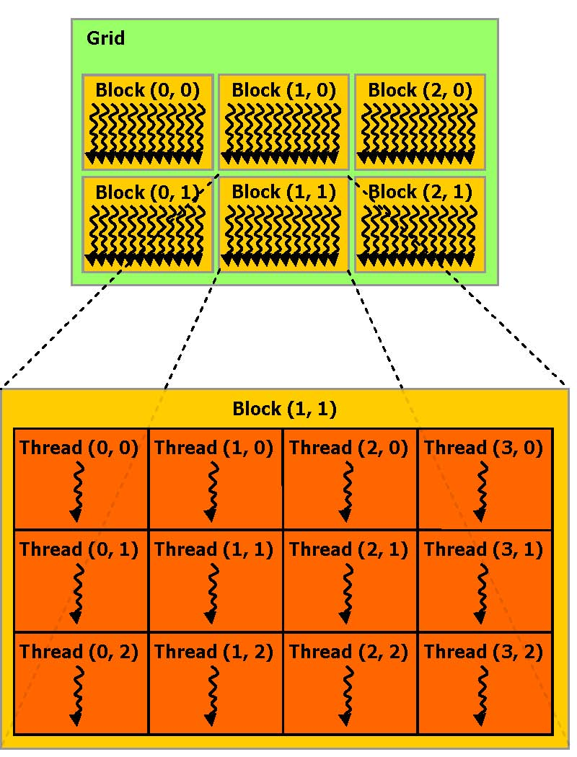
How are GPU threads organized?
CUDA thread hierarchy
Warp = SIMT Group
Thread Block = SIMT Groups that run concurrently on an SM
Grid = All Thread Blocks created by the same kernel launch
Launching a kernel is simple and similar to a function call.
kernel name and arguments
# of thread blocks/grid and # of threads/block to create:
kernel<<<nblocks,
threads_per_block>>>(arg1, arg2, ...);

Slide 5
How are GPU threads organized?
In CUDA, only thread blocks and grids are first-class citizens of the programming model.
The number of warps created and their organization are implicitly controlled by the kernel launch configuration, but never set explicitly.
kernel<<<nblocks, threads_per_block>>>(arg1, arg2, ...);
kernel launch configuration

Slide 6
How are GPU threads organized?
GPU threads can be configured in one-, two-, or three-dimensional layouts
One-dimensional blocks and grids:
int nblocks = 4;
int threads_per_block = 8;
kernel<<<nblocks, threads_per_block>>>(...);
Block 0
Block 1
Block 2
Block 3

Slide 7
How are GPU threads organized?
GPU threads can be configured in one-, two-, or three-dimensional layouts
Two-dimensional blocks and grids:
dim3 nblocks(2,2)
dim3 threads_per_block(4,2);
kernel<<<nblocks, threads_per_block>>>(...);

Slide 8
How are GPU threads organized?
GPU threads can be configured in one-, two-, or three-dimensional layouts
Two-dimensional grid and one-dimensional blocks:
dim3 nblocks(2,2);
int threads_per_block = 8;
kernel<<<nblocks, threads_per_block>>>(...);

Slide 9
How are GPU threads organized?
On the GPU, the number of blocks and threads per block is exposed through intrinsic thread coordinate variables:
Dimensions
IDs
Variable | Meaning
gridDim.x, gridDim.y, gridDim.z | Number of blocks in a kernel launch.
blockIdx.x, blockIdx.y, blockIdx.z | Unique ID of the block that contains the current thread.
blockDim.x, blockDim.y, blockDim.z | Number of threads in each block.
threadIdx.x, threadIdx.y, threadIdx.z | Unique ID of the current thread within its block.

Slide 10
How are GPU threads organized?
to calculate a globally unique ID for a thread on the GPU inside a one-dimensional grid and one-dimensional block:
kernel<<<4, 8>>>(...);
__global__ void kernel(...) {
int tid = blockIdx.x * blockDim.x + threadIdx.x;
...
}
blockIdx.x = 2;
blockDim.x = 8;
threadIdx.x = 2;
Block 0
Block 1
Block 2
Block 3
0 1 2 3 4 5 6 7
8

Slide 11
How are GPU threads organized?
Thread coordinates offer a way to differentiate threads and identify thread-specific input data or code paths.
Link data and computation, a mapping
__global__ void kernel(int *arr) {
int tid = blockIdx.x * blockDim.x + threadIdx.x;
if (tid < 32) {
arr[tid] = f(arr[tid]);
} else {
arr[tid] = g(arr[tid]);
}
code path for threads with tid < 32
code path for threads with tid >= 32
Thread Divergence: recall that useless code path is executed, but then disabled in SIMT execution model

Slide 12
How is GPU memory managed?
CUDA Memory Management API
Allocation of GPU memory
Transfer of data from the host to GPU memory
Free-ing GPU memory
Foo(int A[][N]) { }
Host Function | CUDA Analogue
malloc | cudaMalloc
memcpy | cudaMemcpy
free | cudaFree

Slide 13
How is GPU memory managed?
cudaError_t cudaMalloc(void **devPtr, size_t size);
Allocate size bytes of GPU memory and store their address at *devPtr
cudaError_t cudaFree(void *devPtr);
Release the device memory allocation stored at devPtr
Must be an allocation that was created using cudaMalloc

Slide 14
How is GPU memory managed?
cudaError_t cudaMemcpy(
void *dst, const void *src, size_t count,
enum cudaMemcpyKind kind);
Transfers count bytes from the memory pointed to by src to dst
kind can be:
cudaMemcpyHostToHost,
cudaMemcpyHostToDevice,
cudaMemcpyDeviceToHost,
cudaMemcpyDeviceToDevice
The locations of dst and src must match kind, e.g. if kind is cudaMemcpyHostToDevice then src must be a host array and dst must be a device array

Slide 15
How is GPU memory managed?
void *d_arr, *h_arr;
h_addr = … ; /* init host memory and data */
// Allocate memory on GPU and its address is in d_arr
cudaMalloc((void **)&d_arr, nbytes);
// Transfer data from host to device
cudaMemcpy(d_arr, h_arr, nbytes,
cudaMemcpyHostToDevice);
// Transfer data from a device to a host
cudaMemcpy(h_arr, d_arr, nbytes,
cudaMemcpyDeviceToHost);
// Free the allocated memory
cudaFree(d_arr);

Slide 16
CUDA Program Flow
At its most basic, the flow of a CUDA program is as follows:
Allocate GPU memory
Populate GPU memory with inputs from the host
Execute a GPU kernel on those inputs
Transfer outputs from the GPU back to the host
Free GPU memory
Let’s take a look at a simple example that manipulates data

Slide 17
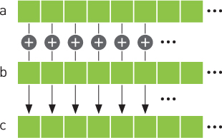
AXPY Example with OpenMP: Multicore
y = α·x + y
x and y are vectors of size n
α is scalar
Data (x, y and a) are shared
Parallelization is relatively easy

Slide 18
CUDA Program Flow
AXPY is an embarrassingly parallel problem
How can vector addition be parallelized?
How can we map this to GPUs?
Each thread does one element
A
B
C

Slide 19
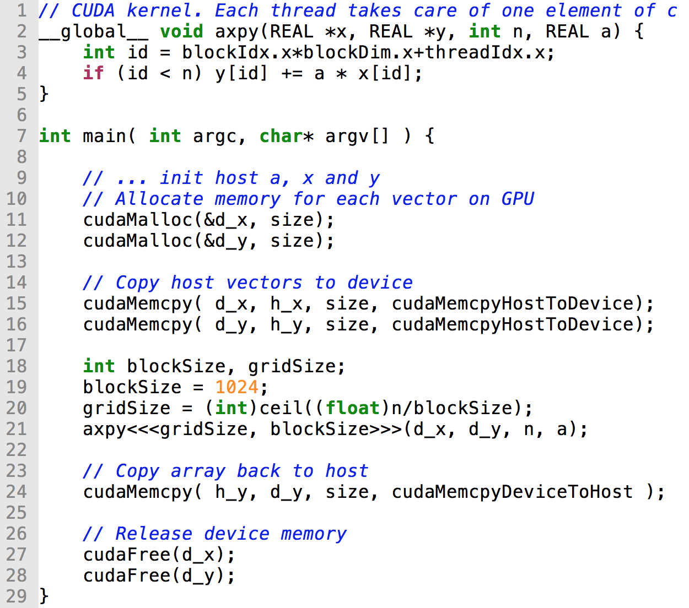
AXPY Offloading To a GPU using CUDA
Memory allocation on device
Memcpy from host to device
Launch parallel execution
Memcpy from device to host
Deallocation of dev memory

Slide 20
CUDA Program Flow
Consider the workflow of the example vector addition vecAdd.cu:
Allocate space for A, B, and C on the GPU
Transfer the initial contents of A and B to the GPU
Execute a kernel in which each thread sums A_{i} and B_{i}, and stores the result in C_{i}
Transfer the final contents of C back to the host
Free A, B, and C on the GPU
Modify to C = A+B+C
A = B*C;
we will need both C and A in the host side after GPU computation.
Compile and running
Use codd from gpu_code_examples folder
$nvcc –Xcompiler –fopenmp vectorAdd.cu
$./a.out
Notes:
By analyzing the input and out data for each kernel, we know which array should be copied in and which one should be copied out before and after the kernel execution.

Slide 21
More Examples and Exercises
Matvec:
Version 1: each thread computes one element of the final vector
Version 2:
Matmul:
Version 1: each thread computes one row of the final matrix C

Slide 22
CUDA SDK Examples
CUDA Programming Manual:
http://docs.nvidia.com/cuda/cuda-c-programming-guide
CUDA SDK Examples on CUDA installation folder
E.g. /usr/local/cuda-8.0/samples/
Copy to your home folder
cp –r /usr/local/cuda-8.0/samples ~/CUDA_samples
Do a “make” in the folder, and it will build all the sources
Or go to a specific example folder and make, it will build only the binary
Find ones you are interested in and run to see

Slide 23
Inspecting CUDA Programs
Debugging CUDA program:
cuda-gdb debugging tool, like gdb
Profiling a program to examine the performance
Nvprof tool, like gprof
Nvprof ./vecAdd
Notes:
For instructor: example walkthrough of cuda-gdb applied to sumArraysOnGPU-small-case.cu

Slide 24
Manycore GPU Architectures and Programming: Outline
Introduction
GPU architectures, GPGPUs, and CUDA
GPU Execution model
CUDA Programming model
Working with Memory in CUDA
Global memory, shared and constant memory
Streams and concurrency
CUDA instruction intrinsic and library
Performance, profiling, debugging, and error handling
Directive-based high-level programming model
OpenACC and OpenMP
Notes:
GPUs have developed from graphics cards into a platform for high performance computing and perhaps the most important development in HPC for many years.

Slide 25
Storing Data on the GPU
A memory hierarchy emulates a large amount of low-latency memory
Cache data from a large, high-latency memory bank in a small low-latency memory bank
DRAM
L2 Cache
CPU Memory Hierarchy
L1 Cache

Slide 26
Storing Data on the GPU
The CUDA Memory Hierarchy is more complex than the CPU memory hierarchy
Many different types of memory, each with special-purpose characteristics
More explicit control over data movement
SIMT Thread Groups on a GPU
SIMT Thread Groups on an SM
SIMT Thread Group
Registers
Local Memory
On-Chip Shared Memory
Global Memory
Constant Memory
Texture Memory

Slide 27
Storing Data on the GPU
Registers
Lowest latency memory space on the GPU
Private to each CUDA thread
Constant pool of registers per-SM divided among threads in resident thread blocks
Architecture-dependent limit on number of registers per thread
Registers are not explicitly used by the programmer, implicitly allocated by the compiler
-maxrregcount compiler option allows you to limit # registers per thread

Slide 28
Storing Data on the GPU
GPU Caches
Behaviour of GPU caches is architecture-dependent
Per-SM L1 cache stored on-chip
Per-GPU L2 cache stored off-chip, caches values for all SMs
Due to parallelism of accesses, GPU caches do not follow the same LRU rules as CPU caches
Global Memory
L2 Cache
L1 Cache

Slide 29
Storing Data on the GPU
Shared Memory
Declared with the __shared__ keyword
Low-latency, high bandwidth
Shared by all threads in a thread block
Explicitly allocated and managed by the programmer, manual L1 cache
Stored on-SM, same physical memory as the GPU L1 cache
On-SM memory is statically partitioned between L1 cache and shared memory
Shared Memory
Transfer

Slide 30
Storing Data on the GPU
Constant Memory
Declared with the __constant__ keyword
Read-only
Limited in size: 64KB
Stored in device memory (same physical location as Global Memory)
Cached in a per-SM constant cache
Optimized for all threads in a warp accessing the same memory cell
Constant Memory
Constant Cache

Slide 31
Storing Data on the GPU
Texture Memory
Read-only
Stored in device memory (same physical location as Global Memory)
Cached in a texture-only on-SM cache
Optimized for 2D spatial locality (caches commonly only optimized for 1D locality)
Explicitly used by the programmer
Special-purpose memory
Texture Memory
Texture Memory Read-Only Cache

Slide 32
Storing Data on the GPU
Global Memory
Large, high-latency memory
Stored in device memory (along with constant and texture memory)
Can be declared statically with __device__
Can be allocated dynamically with cudaMalloc
Explicitly managed by the programmer
Optimized for all threads in a warp accessing neighbouring memory cells
Global Memory
L2 Cache
L1 Cache

Slide 33
Storing Data on the GPU

Slide 34
Storing Data on the GPU

Slide 35
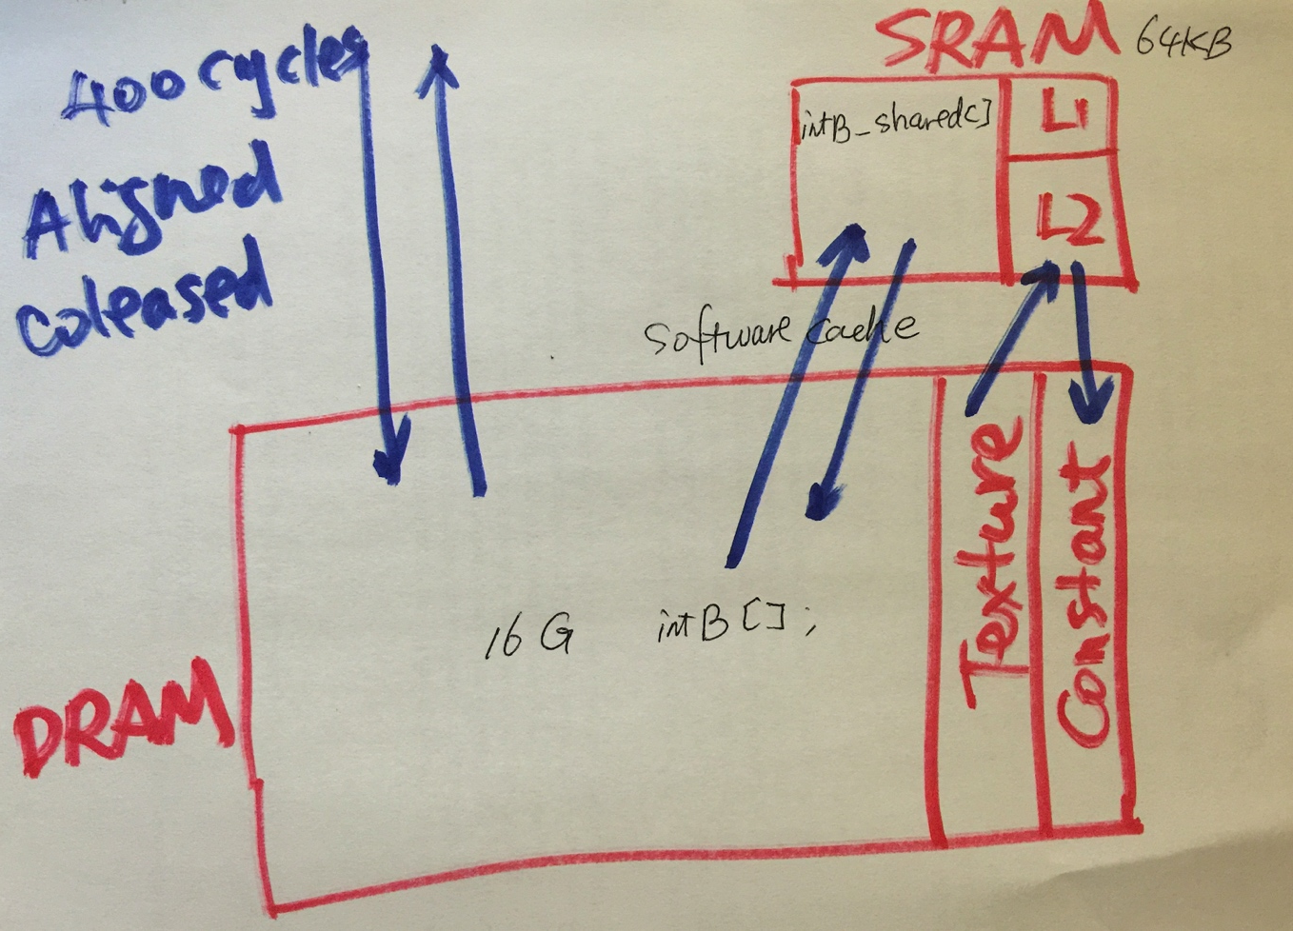
Concentrate On:
Global memory
Shared memory
Constant memory

Slide 36
Static Global Memory
Static Global Memory has a fixed size throughout execution time:
__device__ float devData;
__global__ void checkGlobalVariable()
printf(“devData has value %f\n”, devData);
}
Initialized using cudaMemcpyToSymbol:
cudaMemcpyToSymbol(devData, &hostData,sizeof(float));
Fetched using cudaMemcpyFromSymbol:
cudaMemcpyFromSymbol(&hostData, devData, sizeof(float));
Notes:
Instructor note: you can choose to use globalVariable.cu from Chapter 4 here as an illustrative example. In general, static global memory has limited usefulness so don’t feel the need to spend a large amount of time on the topic.

Slide 37
Dynamic Global Memory
We have already seen dynamic global memory
cudaMalloc dynamically allocates global memory
cudaMemcpy transfers to/from global memory
cudaFree frees global memory allocated by cudaMalloc
cudaMemcpy supports 4 types of transfer:
cudaMemcpyHostToHost, cudaMemcpyHostToDevice, cudaMemcpyDeviceToHost, cudaMemcpyDeviceToDevice
You can also memset global memory
cudaError_t cudaMemset(void *devPtr, int value, size_t count);
Notes:
Instructor note: use the memTransfer.cu example from Chapter 4 to illustrate dynamic global memory allocation, transfer, freeing.

Slide 38
Global Memory Access Patterns
CPU caches are optimized for linear, iterative memory accesses
Cache lines ensure that accessing one memory cell brings neighbouring memory cells into cache
If an application exhibits good spatial or temporal locality (which many do), later references will also hit in cache
Cache
System Memory
CPU

Slide 39
Global Memory Access Patterns
GPU caching is a more challenging problem
Thousands of threads cooperating on a problem
Difficult to predict the next round of accesses for all threads
For efficient global memory access, GPUs instead rely on:
Large device memory bandwidth
Aligned and coalesced memory access patterns
Maintaining sufficient pending I/O operations to keep the memory bus saturated and hide global memory latency

Slide 40
Global Memory Access Patterns
Achieving aligned and coalesced global memory accesses is key to optimizing an application’s use of global memory bandwidth
Coalesced: the threads within a warp reference memory addresses that can all be serviced by a single global memory transaction (think of a memory transaction as the process of bring a cache line into the cache)
Aligned: the global memory accesses by threads within a warp start at an address boundary that is an even multiple of the size of a global memory transaction

Slide 41
Global Memory Access Patterns
A global memory transaction is either 32 or 128 bytes
The size of a memory transaction depends on which caches it passes through
If L1 + L2: 128 byte
If L2 only: 32 bytes
Which caches a global memory transaction passes through depends on GPU architecture and the type of access (read vs. write)

Slide 42
Global Memory Access Patterns
When is a global memory read cached in L1?
If the L1 cache is not used for global memory reads, the L2 cache is always used
Compute Capability | Reads Cacheable in L1? | Cached by Default?
Fermi (2.x) | Yes | Yes
Kepler (3.x) | No | No
Kepler K40 and later (3.5 and up) | Yes | No

Slide 43
Global Memory Access Patterns
When is a global memory write cached in L1? Never
Global memory writes are cached in the L2 cache
Compute Capability | Reads Cacheable in L1? | Cached by Default?
Fermi (2.x) | No | No
Kepler (3.x) | No | No
Kepler K40 and later (3.5 and up) | No | No

Slide 44
Global Memory Access Patterns
Aligned and Coalesced Memory Access (w/ L1 cache)
With 128-byte access, a single transaction is required and all of the loaded bytes are used

Slide 45
Global Memory Access Patterns
Misaligned and Coalesced Memory Access (w/ L1 cache)
With 128-byte access, two memory transactions are required to load all requested bytes. Only half of the loaded bytes are used.

Slide 46
Global Memory Access Patterns
Misaligned and Uncoalesced Memory Access (w/ L1 cache)
With uncoalesced loads, many more bytes loaded than requested

Slide 47
Global Memory Access Patterns
Misaligned and Uncoalesced Memory Access (w/ L1 cache)
One factor to consider with uncoalesced loads: while the efficiency of this access is very low it may bring many cache lines into L1/L2 cache which are used by later memory accesses. The GPU is flexible enough to perform well, even for applications that present suboptimal access patterns.

Slide 48
Global Memory Access Patterns
Memory accesses that are not cached in L1 cache are serviced by 32-byte transactions
This can improve memory bandwidth utilization
However, the L2 cache is device-wide, higher latency than L1, and still relatively small ➔ many applications may take a performance hit if L1 cache is not used for reads

Slide 49
Global Memory Access Patterns
Aligned and Coalesced Memory Access (w/o L1 cache)
With 32-byte transactions, four transactions are required and all of the loaded bytes are used

Slide 50
Global Memory Access Patterns
Misaligned and Coalesced Memory Access (w/o L1 cache)
With 32-byte transactions, extra memory transactions are still required to load all requested bytes but the number of wasted bytes is likely reduced, compared to 128-byte transactions.

Slide 51
Global Memory Access Patterns
Misaligned and Uncoalesced Memory Access (w/o L1 cache)
With uncoalesced loads, more bytes loaded than requested but better efficiency than with 128-byte transactions
Notes:
Instructor Note: At this point, walk through the readSegment.cu example on pgs 165-168 in the book to demonstrate the actual performance implications of misaligned reads using nvprof.

Slide 52
Global Memory Access Patterns
Global Memory Writes are always serviced by 32-byte transactions
Notes:
Instructor Note: At this point, walk through the writeSegment.cu example on pgs 170-171 in the book to demonstrate the actual performance implications of misaligned writes using nvprof.

Slide 53
Global Memory and Special-Purpose Memory
Global memory is widely useful and as easy to use as CPU DRAM
Limitations
Easy to find applications with memory access patterns that are intrinsically poor for global memory
Many threads accessing the same memory cell ➔ poor global memory efficiency
Many threads accessing sparse memory cells ➔ poor global memory efficiency
Special-purpose memory spaces to address these deficiencies in global memory
Specialized for different types of data, different access patterns
Give more control over data movement and data placement than CPU architectures do

Slide 54
Shared Memory
Declared with the __shared__ keyword
Low-latency, high bandwidth
Shared by all threads in a thread block
Explicitly allocated and managed by the programmer, manual L1 cache
Stored on-SM, same physical memory as the GPU L1 cache
On-SM memory is statically partitioned between L1 cache and shared memory
Shared Memory
Transfer

Slide 55
Shared Memory Allocation
Shared memory can be allocated statically or dynamically
Statically Allocated Shared Memory
Size is fixed at compile-time
Can declare many statically allocated shared memory variables
Can be declared globally or inside a device function
Can be multi-dimensional arrays
__shared__ int s_arr[256][256];

Slide 56
Shared Memory Allocation
Dynamically Allocated Shared Memory
Size in bytes is set at kernel launch with a third kernel launch configurable
Can only have one dynamically allocated shared memory array per kernel
Must be one-dimensional arrays
__global__ void kernel(...) { extern __shared__ int s_arr[];
...
}
kernel<<<nblocks, threads_per_block, shared_memory_bytes>>>(...);

Slide 57
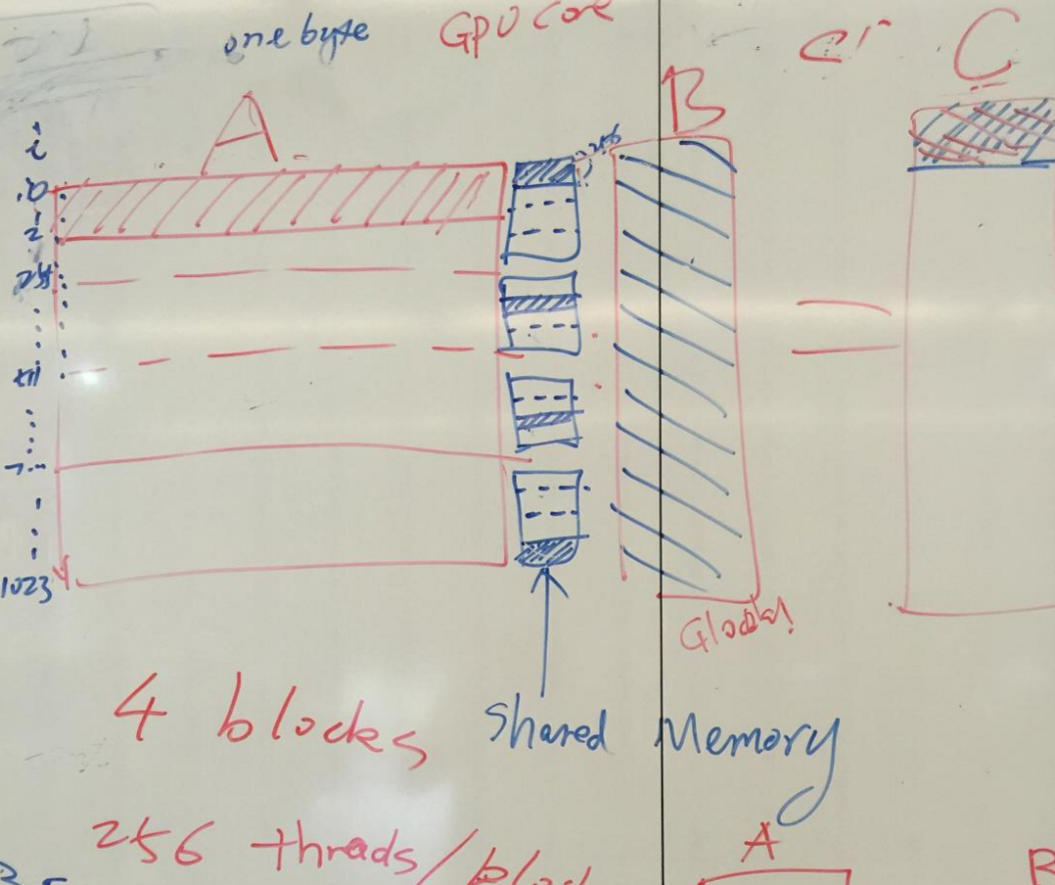
Matvec using shared memory

Slide 58
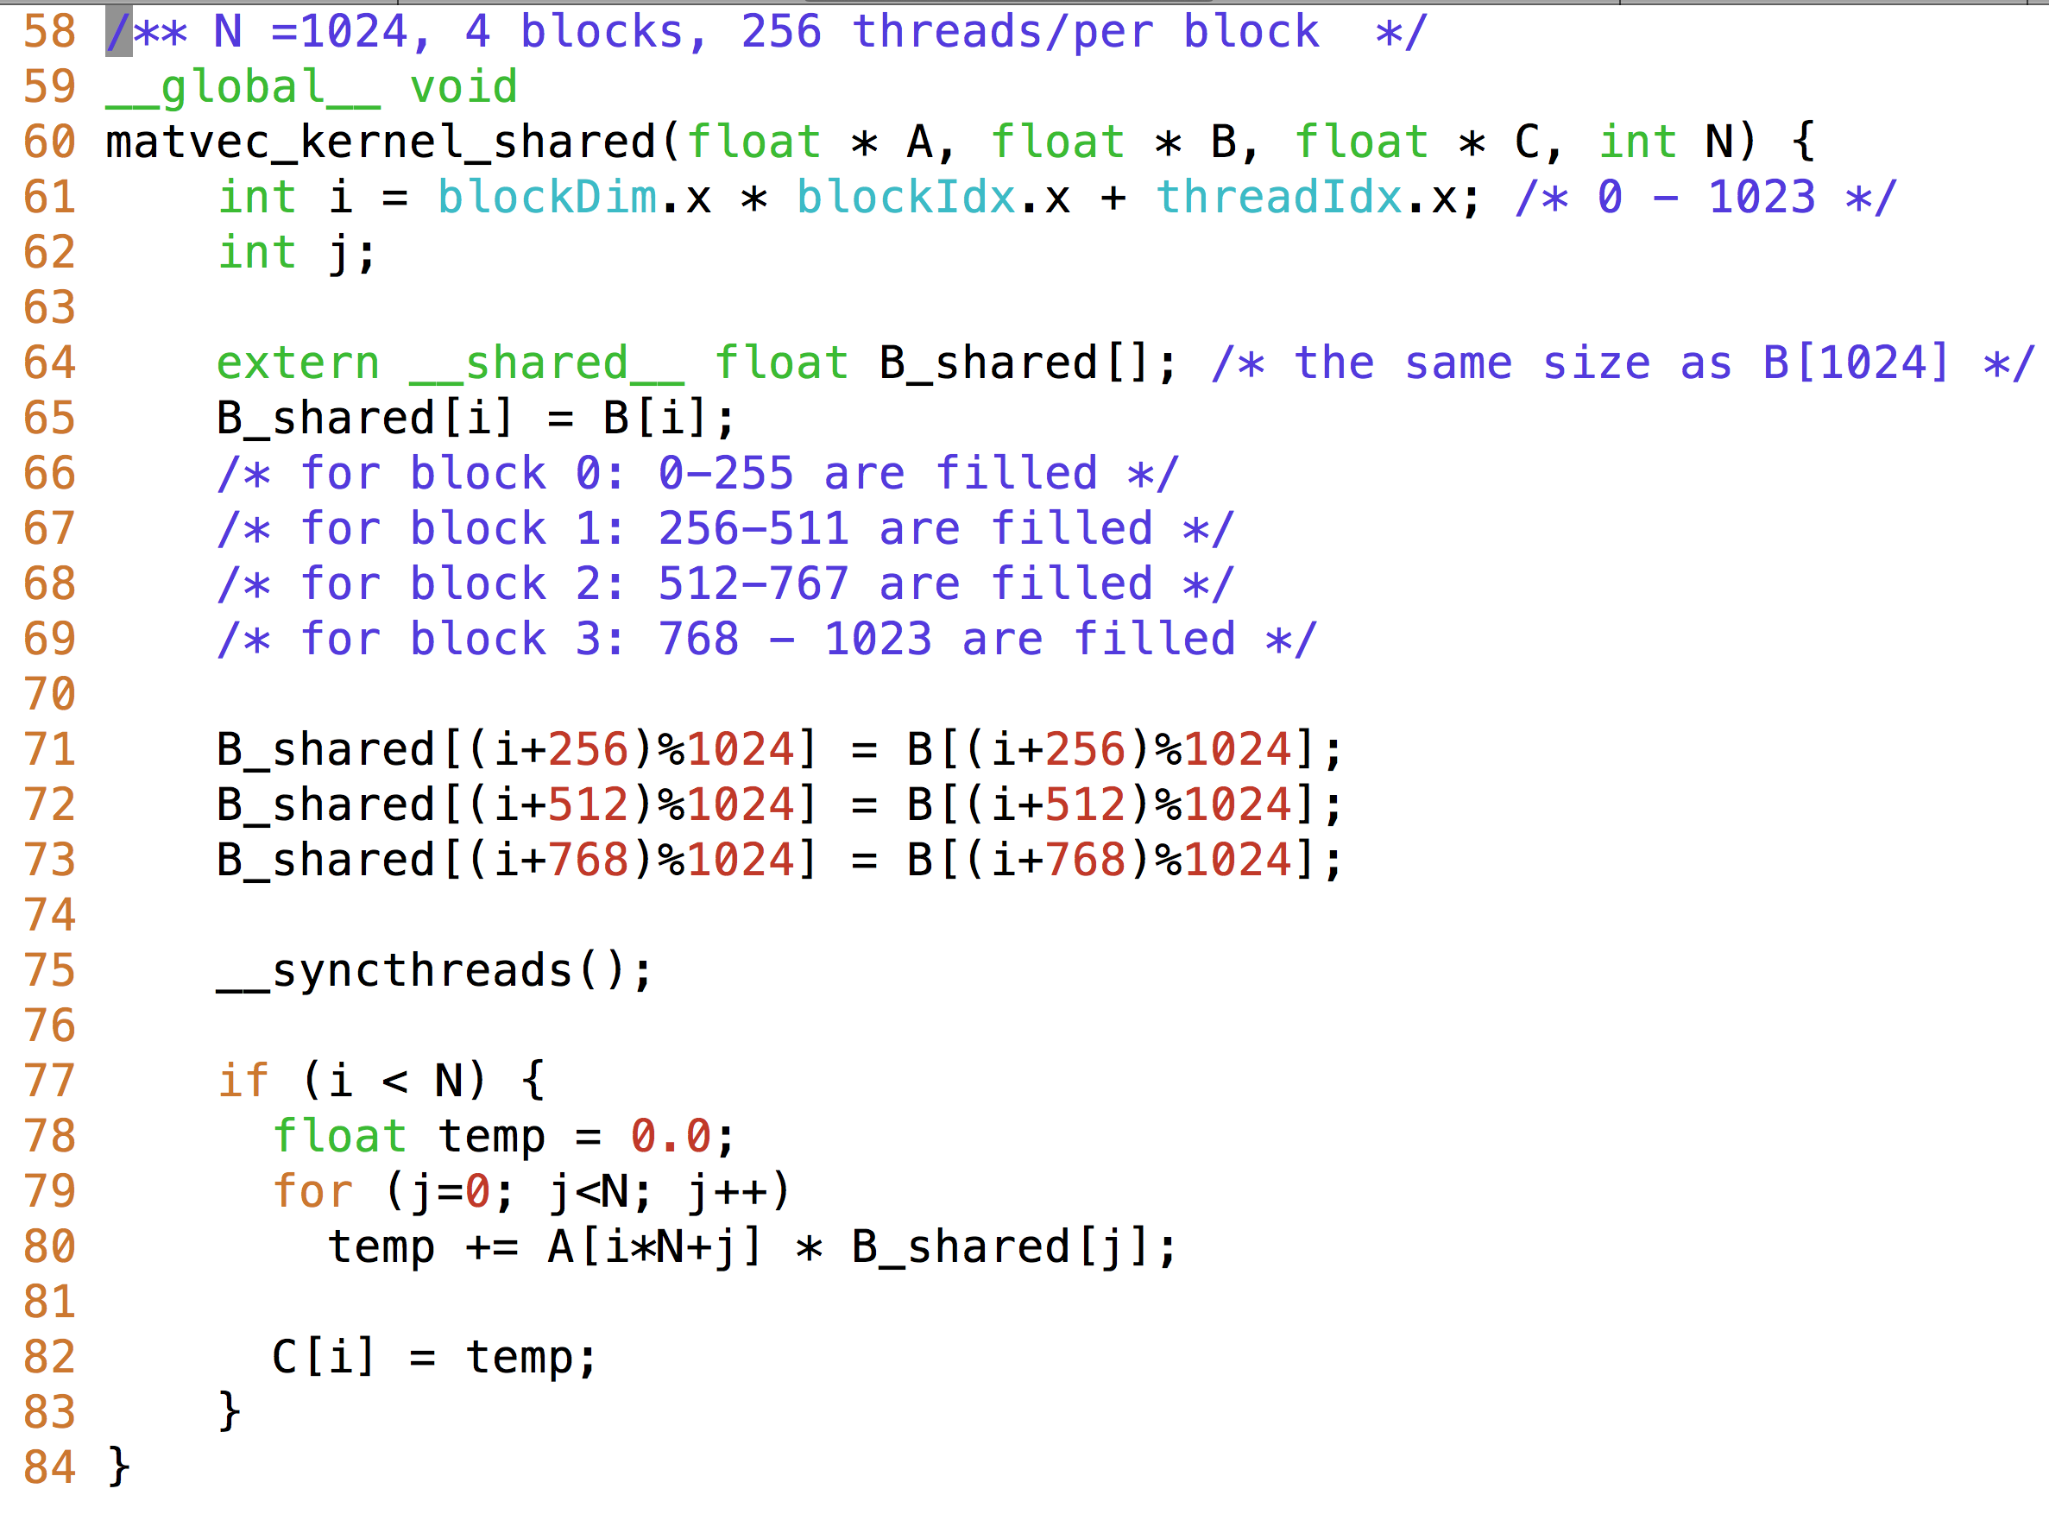
Matrix Vector Multiplication

Slide 59
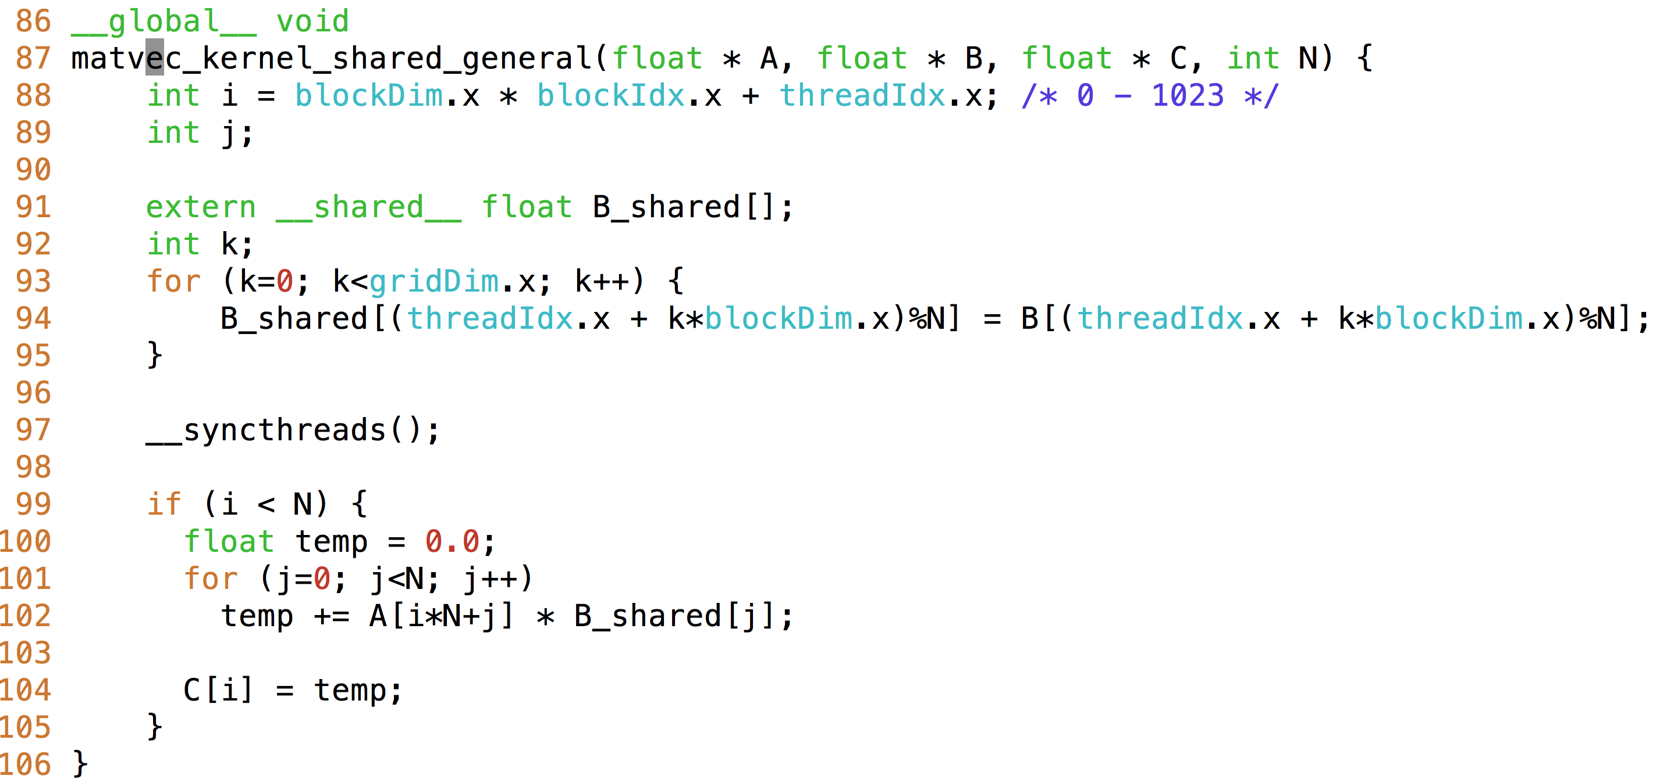
Matrix Vector Multiplication

Slide 60
Shared Memory Example: Sum

Slide 61
Shared Memory as a Managed Cache
Shared memory is explicitly managed and low-latency
Enables programmer optimizations not possible on CPU architectures
Reduction is a common pattern in computational science that can benefit from manual caching
1
7
4
13
Example: Sum Reduction
+
+
+
25

Slide 62
Shared Memory as a Managed Cache
Implementation 1 of parallel sum reduction
Note that the global array can be partitioned into subarrays which are themselves independent sequential sum reduction problems
Thread 0
Thread 1
Step 1
1
7
4
13
Step 2
8
17
Step 3
25

Slide 63
Shared Memory as a Managed Cache
Implementation 2 of parallel sum reduction
On the GPU, we change the memory access patterns to improve global memory access coalescing
Thread 1
Thread 1
1
7
4
13
Thread 0
Thread 0
Step 1
1
7
4
13
+
+
Step 2
5
20
+
Step 3
25
25

Slide 64
Shared Memory as a Managed Cache
__global__ void reduce(int *g_idata, int *g_odata, unsigned int n) {
if (blockIdx.x * blockDim.x + threadIdx.x >= n) return;
int *idata = g_idata + blockIdx.x * blockDim.x; // per-block data
for (int stride = blockDim.x / 2; stride > 0; stride >>= 1) {
// stride accesses from threads in the same thread block
if (tid < stride) idata[tid] += idata[threadIdx.x + stride];
__syncthreads();
}
// output intermediate result from this thread block
if (tid == 0) g_odata[blockIdx.x] = idata[0];
}
global memory access

Slide 65
Shared Memory as a Managed Cache
__global__ void reduceSmem(int *g_idata, int *g_odata, unsigned int n)
{
__shared__ int smem[DIM];
// set thread ID
unsigned int tid = threadIdx.x;
// boundary check
unsigned int idx = blockIdx.x * blockDim.x + threadIdx.x;
if (idx >= n) return;
// convert global data pointer to local pointer of this block
int *idata = g_idata + blockIdx.x * blockDim.x;
// set to smem by each threads
smem[tid] = idata[tid];
Cache in shared memory

Slide 66
Shared Memory as a Managed Cache
Shared memory can be used to cache per-block data as a thread block operates on it, rather than going out to global memory every time
Take a look at reduceInteger.cu
Build and run the code with nvprof
Which kernels perform best? Which perform worst?
Use kernel metrics from nvprof to explain performance gains or losses

Slide 67
Constant Memory
Declared with the __constant__ keyword
Read-only
Limited in size: 64KB
Stored in device memory (same physical location as Global Memory)
Cached in a per-SM constant cache
Optimized for all threads in a warp accessing the same memory cell
Constant Memory
Constant Cache

Slide 68
Constant Memory
As its name suggests, constant memory is best used for storing constants
Values which are read-only
Values that are accessed identically by all threads
For example: suppose all threads are evaluating the equation
y = mx + b
for different values of x, but identical values of m and b
All threads would reference m and b with the same memory operation
This broadcast access pattern is optimal for constant memory

Slide 69
Constant Memory
A simple 1D stencil
target cell is updated based on its 8 neighbors, weighted by some constants c0, c1, c2, c3

Slide 70
Constant Memory
constantStencil.cu contains an example 1D stencil that uses constant memory
__constant__ float coef[RADIUS + 1];
cudaMemcpyToSymbol(coef, h_coef, (RADIUS + 1) * sizeof(float));
__global__ void stencil_1d(float *in, float *out, int N) {
...
for (int i = 1; i <= RADIUS; i++) {
tmp += coef[i] * (smem[sidx + i] - smem[sidx - i]);
}
}
Notes:
Instructor note: You can build and run constantStencil.cu to show that it works, but we don’t provide a baseline with global memory with the book so it’s hard to show the improvement. Constant memory performance improvement can be illustrated on the next slides using the wavefront propagation example.

Slide 71
CUDA Synchronization
When using shared memory, you often must coordinate accesses by multiple threads to the same data
CUDA offers synchronization primitives that allow you to synchronize among threads

Slide 72
CUDA Synchronization
__syncthreads
Synchronizes execution across all threads in a thread block
No thread in a thread block can progress past a __syncthreads before all other threads have reached it
__syncthreads ensures that all changes to shared and global memory by threads in this block are visible to all other threads in this block
__threadfence_block
All writes to shared and global memory by the calling thread are visible to all other threads in its block after this fence
Does not block thread execution

Slide 73
CUDA Synchronization
__threadfence
All writes to global memory by the calling thread are visible to all other threads in its grid after this fence
Does not block thread execution
__threadfence_system
All writes to global memory, page-locked host memory, and memory of other CUDA devices by the calling thread are visible to all other threads on all CUDA devices and all host threads after this fence
Does not block thread execution

Slide 74
Suggested Readings
Chapter 2, 4, 5 in Professional CUDA C Programming
Cliff Woolley. GPU Optimization Fundamentals. 2013. https://www.olcf.ornl.gov/ wp-content/uploads/2013/02/GPU_Opt_Fund-CW1.pdf
Mark Harris. Using Shared Memory in CUDA C/C++. http://devblogs.nvidia.com/ parallelforall/using-shared-memory-cuda-cc/
Mark Harris. Optimizing Parallel Reduction in CUDA. http://developer.download.nvidia .com/assets/cuda/files/reduction.pdf

