Slide 1
Lecture 11: Manycore GPU Architectures and Programming, Part 1
CSCE 790: Parallel Programming Models for Multicore and Manycore Processors
Department of Computer Science and Engineering
Yonghong Yan
yanyh@cse.sc.edu
http://cse.sc.edu/~yanyh

Slide 2
Manycore GPU Architectures and Programming: Outline
Introduction
GPU architectures, GPGPUs, and CUDA
GPU Execution model
CUDA Programming model
Working with Memory in CUDA
Global memory, shared and constant memory
Streams and concurrency
CUDA instruction intrinsic and library
Performance, profiling, debugging, and error handling
Directive-based high-level programming model
OpenACC and OpenMP
Notes:
GPUs have developed from graphics cards into a platform for high performance computing and perhaps the most important development in HPC for many years.

Slide 3
Computer Graphics
GPU: Graphics Processing Unit

Slide 4
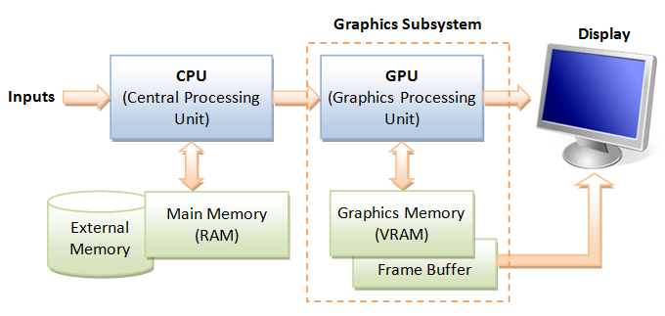
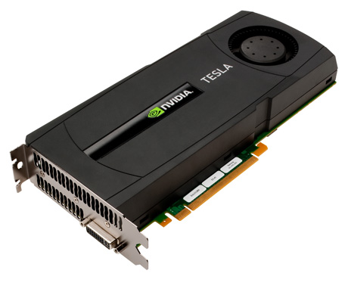
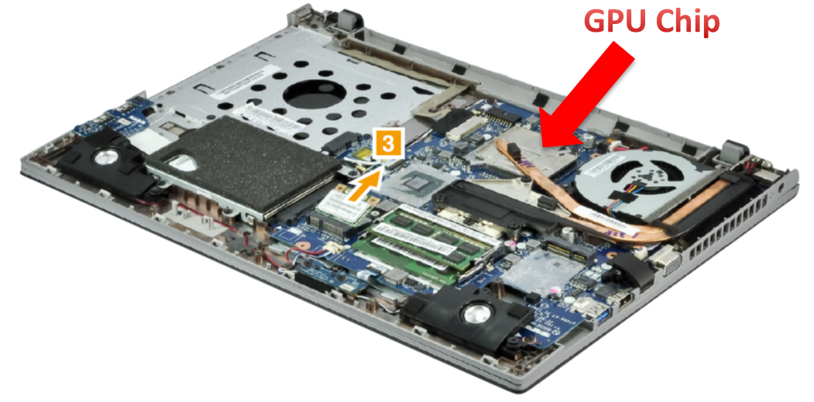
Graphics Processing Unit (GPU)
Image: http://www.ntu.edu.sg/home/ehchua/programming/opengl/CG_BasicsTheory.html

Slide 5
Graphics Processing Unit (GPU)
Enriching user visual experience
Delivering energy-efficient computing
Unlocking potentials of complex apps
Enabling Deeper scientific discovery

Slide 6
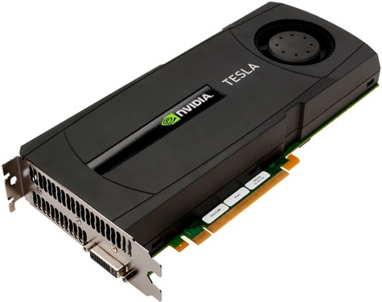
GPU Computing – General Purpose GPUs (GPGPUs)
Use GPU for more than just generating graphics
The computational resources are there, they are most of the time underutilized
6
Notes:
Vertex shader
Geometry shader
Pixel shader

Slide 7
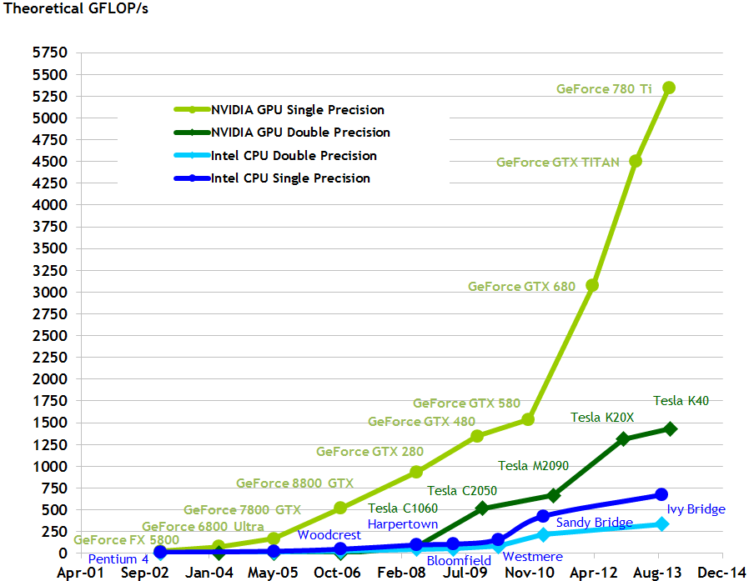
GPU Performance Gains Over CPU
http://docs.nvidia.com/cuda/cuda-c-programming-guide

Slide 8
GPU Performance Gains Over CPU

Slide 9
Graphics Processing Units (GPUs): Brief History
GPU Computing
General-purpose computing on graphics processing units (GPGPUs)
GPUs with programmable shading
Nvidia GeForce
GE 3 (2001) with programmable shading
DirectX graphics API
OpenGL graphics API
Hardware-accelerated 3D graphics
S3 graphics cards-
single chip 2D accelerator
Atari 8-bit computer text/graphics chip
IBM PC Professional Graphics Controller card
Playstation
1970
1980
1990
2000
2010
Source of information http://en.wikipedia.org/wiki/Graphics_Processing_Unit

Slide 10
NVIDIA Products
NVIDIA Corp. is the leader in GPUs for HPC
We will concentrate on NVIDIA GPU
Others AMD, ARM, etc
Maxwell (2013)
Tesla 2050 GPU has 448 thread processors
Kepler
(2011)
Fermi
NVIDIA's first GPU with general purpose processors
Tesla
C870, S870, C1060, S1070, C2050, …
GeForce 400 series
GTX460/465/470/475/480/485
Quadro
Established by Jen-Hsun Huang, Chris Malachowsky, Curtis Priem
GT 80
GeForce 200 series
GeForce 8800
GTX260/275/280/285/295
GeForce 8 series
GeForce 2 series
GeForce FX series
NV1
GeForce 1
1993
1995
1999
2000
2001
2002
2003
2004
2005
2006
2007
2008
2009
2010
http://en.wikipedia.org/wiki/GeForce

Slide 11
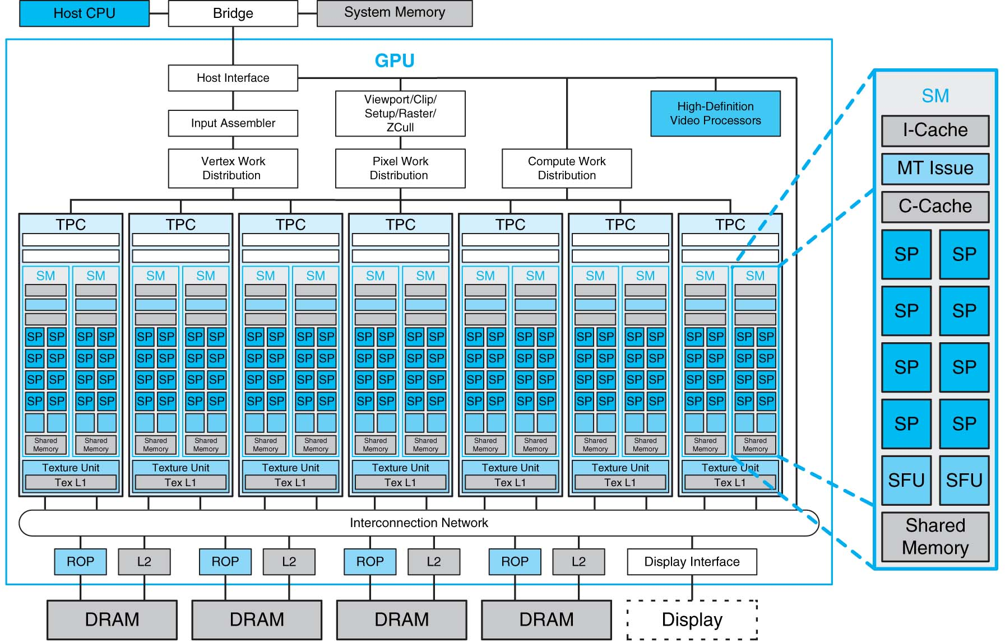
Unified Shader Architecture
FIGURE A.2.5 Basic unified GPU architecture. Example GPU with 112 streaming processor (SP) cores organized in 14 streaming multiprocessors (SMs); the cores are highly multithreaded. It has the basic Tesla architecture of an NVIDIA GeForce 8800. The processors connect with four 64-bit-wide DRAM partitions via an interconnection network. Each SM has eight SP cores, two special function units (SFUs), instruction and constant caches, a multithreaded instruction unit, and a shared memory. Copyright © 2009 Elsevier, Inc. All rights reserved.

Slide 12
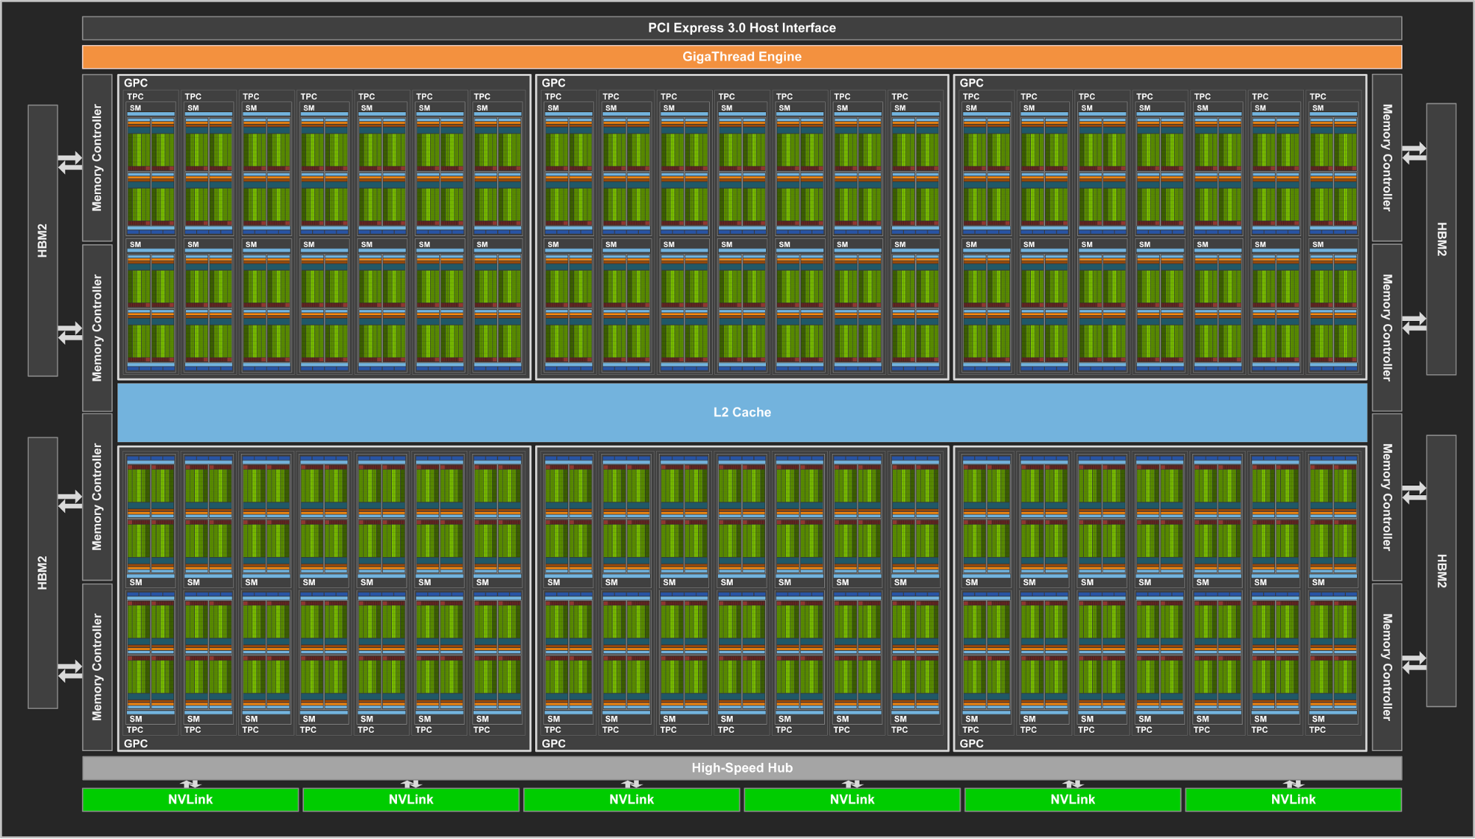
Latest NVIDIA Volta GV100 GPU
Released May 2017
Total 80 SM (Stream Multiprocessors)
Cores
5120 FP32 cores
Can do FP16 also
2560 FP64 cores
640 Tensor cores
Memory
16G HBM2
L2: 6144 KB
Shared memory: 96KB * 80 (SM)
Register File: 20,480 KB (Huge)
https://devblogs.nvidia.com/parallelforall/inside-volta/

Slide 13
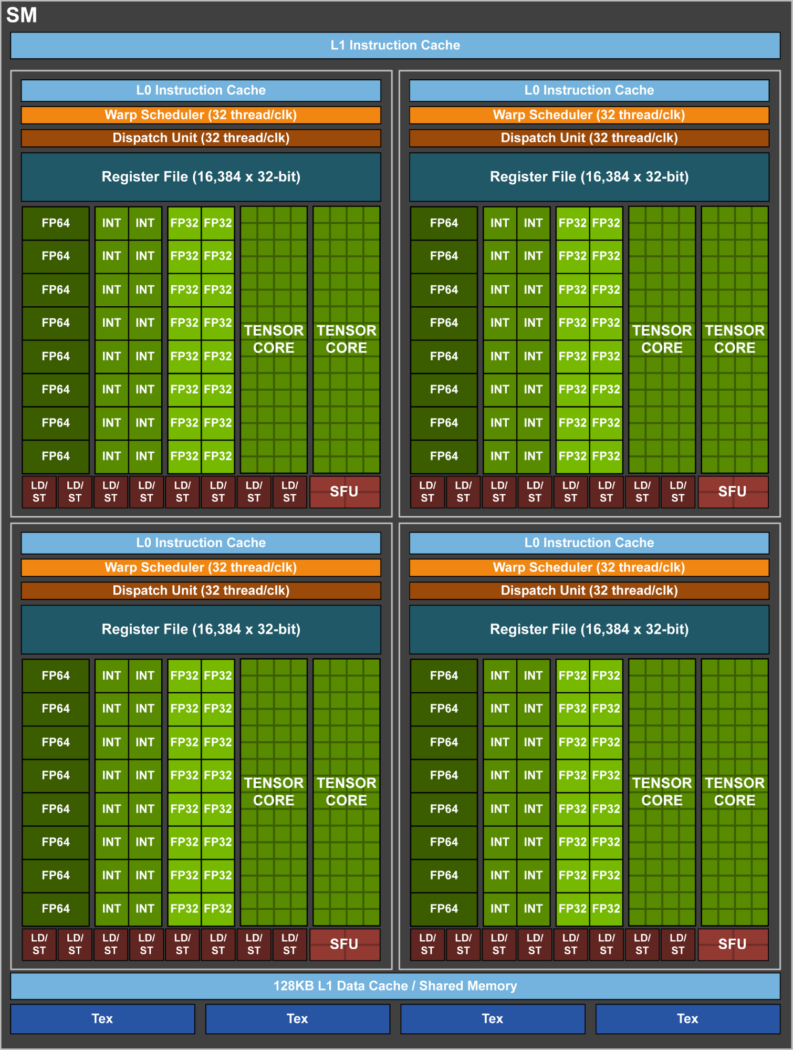
SM of Volta GPU
Released May 2017
Total 80 SM
Cores
5120 FP32 cores
Can do FP16 also
2560 FP64 cores
640 Tensor cores
Memory
16G HBM2
L2: 6144 KB
Shared memory: 96KB * 80 (SM)
Register File: 20,480 KB (Huge)

Slide 14
What is GPU Today?
It is a processor optimized for 2D/3D graphics, video, visual computing, and display.
It is highly parallel, highly multithreaded multiprocessor optimized for visual computing.
It provide real-time visual interaction with computed objects via graphics images, and video.
It serves as both a programmable graphics processor and a scalable parallel computing platform.
Heterogeneous systems: combine a GPU with a CPU
It is called as Many-core

Slide 15
Programming for NVIDIA GPUs
http://docs.nvidia.com/cuda/cuda-c-programming-guide/

Slide 16
CUDA(Compute Unified Device Architecture)
Both an architecture and programming model
Architecture and execution model
Introduced in NVIDIA in 2007
Get highest possible execution performance requires understanding of hardware architecture
Programming model
Small set of extensions to C
Enables GPUs to execute programs written in C
Within C programs, call SIMT “kernel” routines that are executed on GPU.

Slide 17
GPU CUDA Programming
Four important things
Offloading computation
Single Instruction Multiple Threads (SIMT):
Streaming and massively-parallel multithreading
Work well with the memory
Both between host memory and GPU memory
Make use of CUDA library

Slide 18
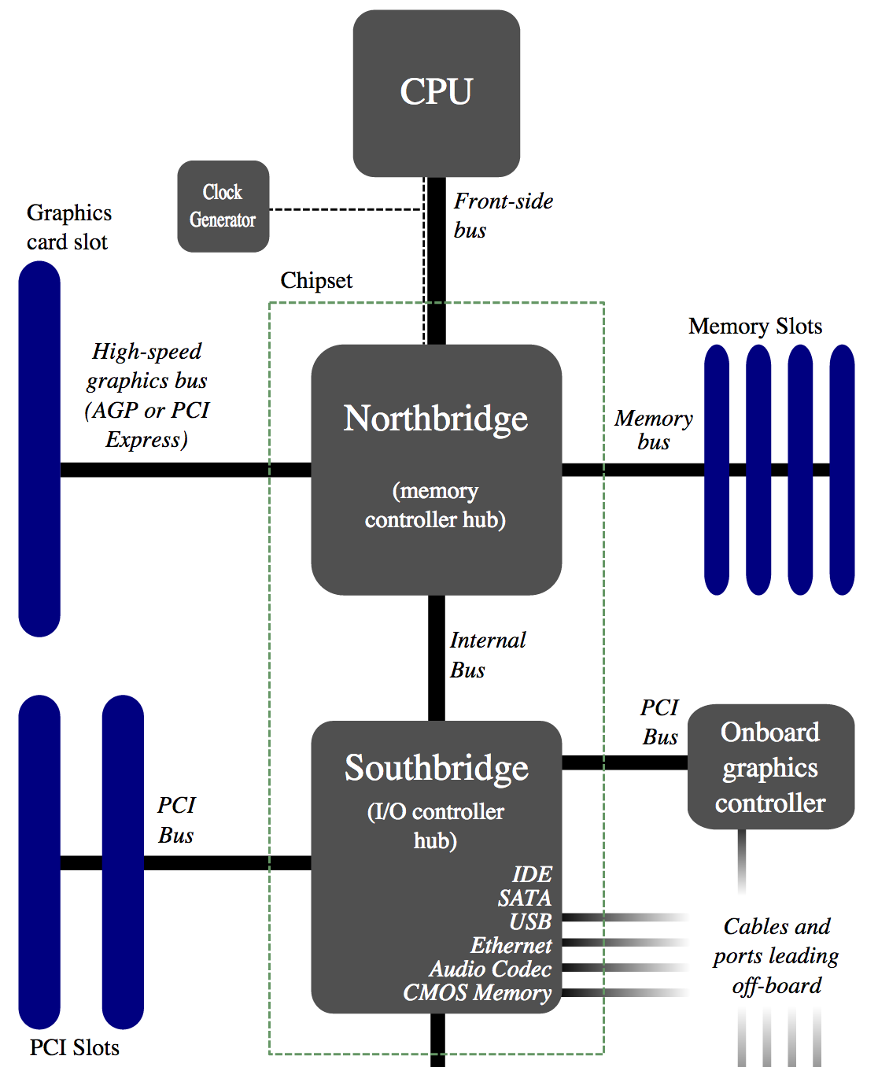
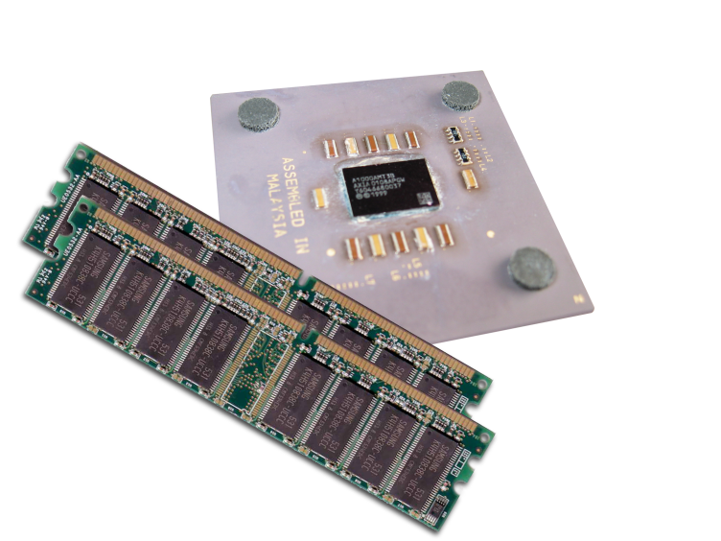
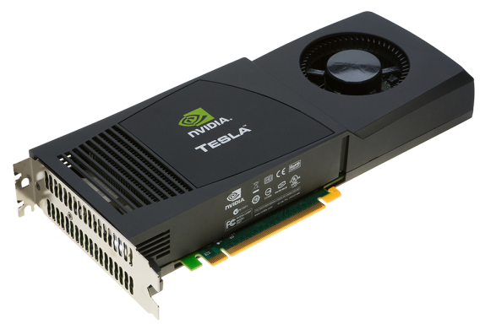
GPU Computing – Offloading Computation
The GPU is connected to the CPU by a reasonable fast bus (8 GB/s is typical today): PCIe
Terminology
Host: The CPU and its memory (host memory)
Device: The GPU and its memory (device memory)

Slide 19
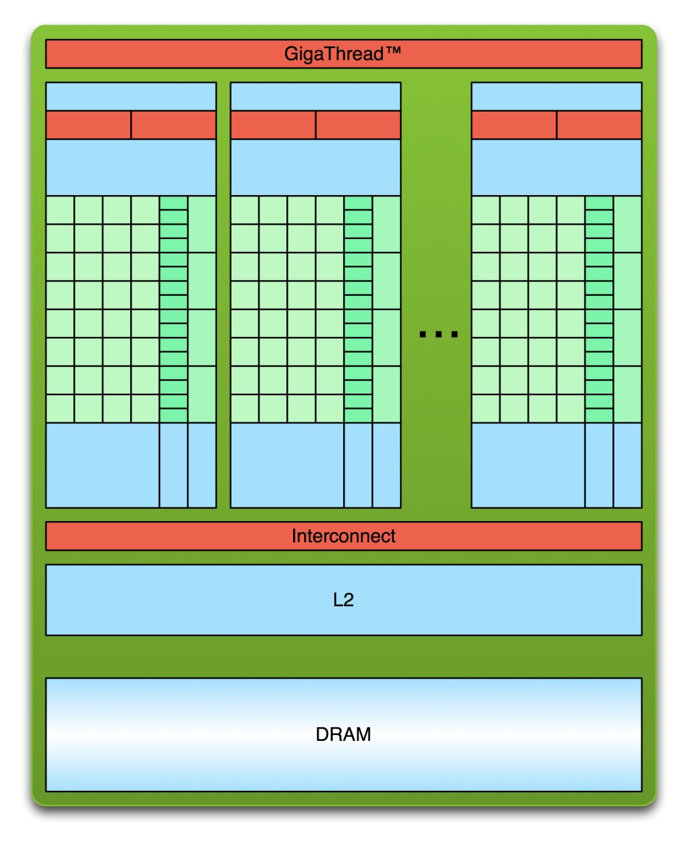
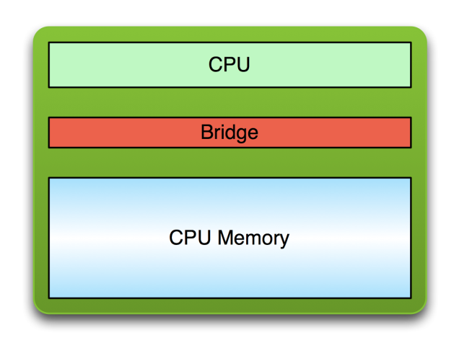
Simple Processing Flow
PCI Bus
Copy input data from CPU memory to GPU memory

Slide 20
Simple Processing Flow
PCI Bus
Copy input data from CPU memory to GPU memory
Load GPU program and execute, caching data on chip for performance

Slide 21
Simple Processing Flow
PCI Bus
Copy input data from CPU memory to GPU memory
Load GPU program and execute, caching data on chip for performance
Copy results from GPU memory to CPU memory

Slide 22
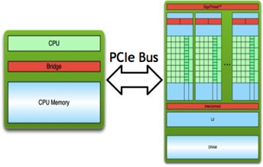
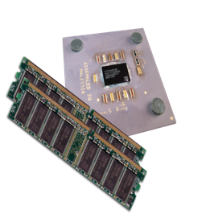
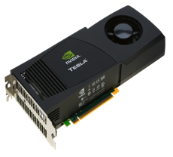
Offloading Computation
// DAXPY in CUDA
__global__
void daxpy(int n, double a, double *x, double *y) {
int i = blockIdx.x*blockDim.x + threadIdx.x;
if (i < n) y[i] = a*x[i] + y[i];
}
int main(void) {
int n = 1024;
double a;
double *x, *y; /* host copy of x and y */
double *x_d; *y_d; /* device copy of x and y */
int size = n * sizeof(double)
// Alloc space for host copies and setup values
x = (double *)malloc(size); fill_doubles(x, n);
y = (double *)malloc(size); fill_doubles(y, n);
// Alloc space for device copies
cudaMalloc((void **)&d_x, size);
cudaMalloc((void **)&d_y, size);
// Copy to device
cudaMemcpy(d_x, x, size, cudaMemcpyHostToDevice);
cudaMemcpy(d_y, y, size, cudaMemcpyHostToDevice);
// Invoke DAXPY with 256 threads per Block
int nblocks = (n+ 255) / 256;
daxpy<<<nblocks, 256>>>(n, 2.0, x_d, y_d);
// Copy result back to host
cudaMemcpy(y, d_y, size, cudaMemcpyDeviceToHost);
// Cleanup
free(x); free(y);
cudaFree(d_x); cudaFree(d_y);
return 0;
}
CUDA kernel
Memory allocation and data copy-in
serial code
Offloading computation
parallel exe on GPU
serial code
Data copy-out and deallocation

Slide 23
Streaming Processing
To be efficient, GPUs must have high throughput, i.e. processing millions of pixels in a single frame, but may be high latency
“Latency is a time delay between the moment something is initiated, and the moment one of its effects begins or becomes detectable”
For example, the time delay between a request for texture reading and texture data returns
Throughput is the amount of work done in a given amount of time
CPUs are low latency low throughput processors
GPUs are high latency high throughput processors

Slide 24
Parallelism in CPUs v. GPUs
CPUs use task parallelism
Multiple tasks map to multiple threads
Tasks run different instructions
10s of relatively heavyweight threads run on 10s of cores
Each thread managed and scheduled explicitly
Each thread has to be individually programmed (MPMD)
GPUs use data parallelism
SIMD model (Single Instruction Multiple Data) → SIMT
Same instruction on different data
10,000s of lightweight threads on 100s of cores
Threads are managed and scheduled by hardware
Programming done for batches of threads (e.g. one pixel shader per group of pixels, or draw call)

Slide 25
Streaming Processing to Enable Massive Parallelism
Given a (typically large) set of data(“stream”)
Run the same series of operations (“kernel” or “shader”) on all of the data (SIMD)
GPUs use various optimizations to improve throughput:
Some on chip memory and local caches to reduce bandwidth to external memory
Batch groups of threads to minimize incoherent memory access
Bad access patterns will lead to higher latency and/or thread stalls.
Eliminate unnecessary operations by exiting or killing threads

Slide 26
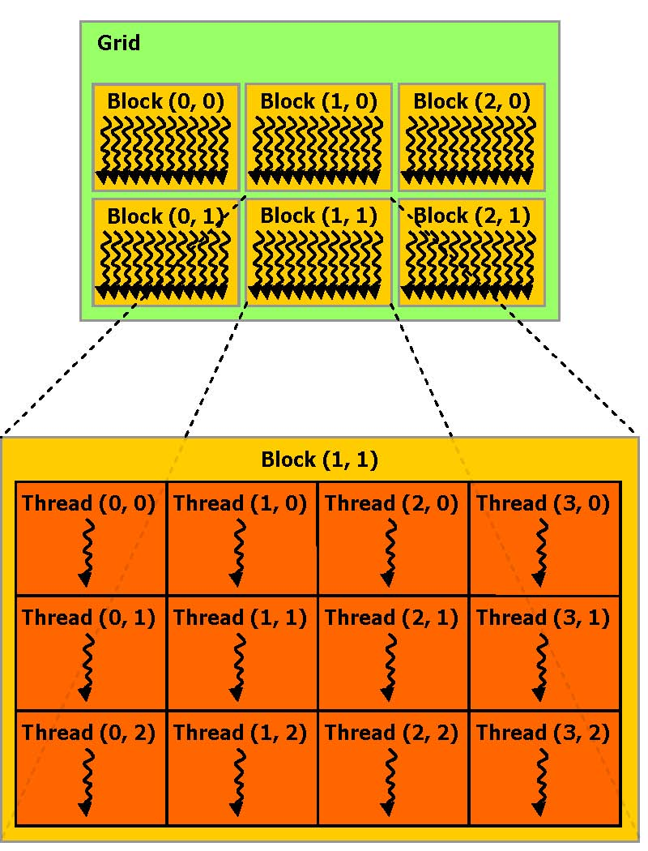
CUDA Thread Hierarchy
Allows flexibility and efficiency in processing 1D, 2-D, and 3-D data on GPU.
Linked to internal organization
Threads in one block execute together.
Can be 1, 2 or 3 dimensions

Slide 27
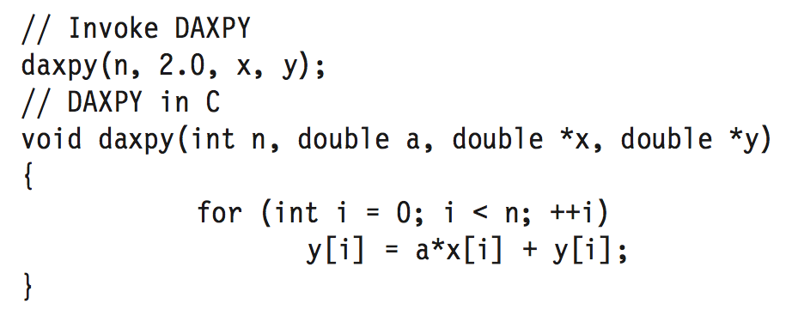
DAXPY
// DAXPY in CUDA
__global__
void daxpy(int n, double a, double *x, double *y) {
int i = blockIdx.x*blockDim.x + threadIdx.x;
if (i < n) y[i] = a*x[i] + y[i];
}
// Invoke DAXPY with 256 threads per Thread Block
int nblocks = (n + 255) / 256;
daxpy<<<nblocks, 256>>>(n, 2.0, x, y);
Each thread finds it element to compute and do the work.
Creating a number of threads which is (or slightly greater) the number of elements to be processed, and each thread launch the same daxpy function.

Slide 28
Hello World!
int main(void) {
printf("Hello World!\n");
return 0;
}
Standard C that runs on the host
NVIDIA compiler (nvcc) can be used to compile programs with no device code
fornax.cse.sc.edu
Using nvcc compiler
Output:
$ nvcc hello.cu
$ ./a.out
Hello World!
$

Slide 29
Hello World! with Device Code
__global__ void hellokernel() {
printf(”Hello World!\n”);
}
int main(void){
int num_threads = 1;
int num_blocks = 1;
hellokernel<<<num_blocks,num_threads>>>();
cudaDeviceSynchronize();
return 0;
}
Two new syntactic elements…
Output:
$ nvcc hello.cu
$ ./a.out
Hello World!
$

Slide 30
Access to fornax
ssh fornax.cse.sc.edu -l<username>
Or ssh <username>@fornax.cse.sc.edu
You need college VPN to access, go to vpn.cse.sc.edu to download and install on your computer

Slide 31
GPU code examples
https://passlab.github.io/CSCE790/resources/gpu_code_examples/
Use wget to download each file when you login:
E.g. wget https://passlab.github.io/CSCE790/resources/gpu_code_examples/hello-1.cu
nvcc hello-1.cu –o hello-1
./hello-1
nvcc hello-2.cu –o hello-2
./hello-2

Slide 32
Hello World! with Device Code
__global__ void hellokernel(void)
CUDA C/C++ keyword __global__ indicates a function that:
Runs on the device
Is called from host code
nvcc separates source code into host and device components
Device functions (e.g. hellokernel()) processed by NVIDIA compiler
Host functions (e.g. main()) processed by standard host compiler
gcc, cl.exe

Slide 33
Hello World! with Device COde
hellokernel<<<num_blocks,num_threads>>>();
Triple angle brackets mark a call from host code to device code
Also called a “kernel launch”
<<< ... >>> parameters are for thread dimensionality
That’s all that is required to execute a function on the GPU!

Slide 34
Hello World! with Device Code
__device__ const char *STR = "Hello World!";
const char STR_LENGTH = 12;
__global__ void hellokernel(){
printf("%c", STR[threadIdx.x % STR_LENGTH]);
}
int main(void){
int num_threads = STR_LENGTH;
int num_blocks = 1;
hellokernel<<<num_blocks,num_threads>>>();
cudaDeviceSynchronize();
return 0;
}
Two new syntactic elements…
Output:
$ nvcc hello.cu
$ ./a.out
Hello World!
$

Slide 35
Hello World! with Device Code
__device__ const char *STR = "Hello World!";
const char STR_LENGTH = 12;
__global__ void hellokernel(){
printf("%c", STR[threadIdx.x % STR_LENGTH]);
}
int main(void){
int num_threads = STR_LENGTH;
int num_blocks = 2;
hellokernel<<<num_blocks,num_threads>>>();
cudaDeviceSynchronize();
return 0;
}
Two new syntactic elements…
__device__: Identify device-only data
threadIdx.x: the thread ID
Each thread only prints one character
Notes:
Each thread only prints one character

Slide 36
Manycore GPU Architectures and Programming
GPU architectures, graphics and GPGPUs
GPU Execution model
CUDA Programming model
Working with Memory in CUDA
Global memory, shared and constant memory
Streams and concurrency
CUDA instruction intrinsic and library
Performance, profiling, debugging, and error handling
Directive-based high-level programming model
OpenACC and OpenMP

Slide 37
GPU Execution Model
The GPU is a physically separate processor from the CPU
Discrete vs. Integrated
The GPU Execution Model offers different abstractions from the CPU to match the change in architecture
PCI Bus

Slide 38
GPU Execution Model
The GPU is a physically separate processor from the CPU
Discrete vs. Integrated
The GPU Execution Model offers different abstractions from the CPU to match the change in architecture
PCI Bus

Slide 39
The Simplest Model: Single-Threaded
Single-threaded Execution Model
Exclusive access to all variables
Guaranteed in-order execution of loads and stores
Guaranteed in-order execution of arithmetic instructions
Also the most common execution model, and simplest for programmers to conceptualize and optimize
Single-Threaded

Slide 40
CPU SPMD Multi-Threading
Single-Program, Multiple-Data (SPMD) model
Makes the same in-order guarantees within each thread
Says little or nothing about inter-thread behaviour or exclusive variable access without explicit inter-thread synchronization
SPMD
Synchronize

Slide 41
GPU Multi-Threading
Uses the Single-Instruction, Multiple-Thread model
Many threads execute the same instructions in lock-step
Implicit synchronization after every instruction (think vector parallelism)
SIMT

Slide 42
GPU Multi-Threading
In SIMT, all threads share instructions but operate on their own private registers, allowing threads to store thread-local state
SIMT

Slide 43
GPU Multi-Threading
SIMT threads can be “disabled” when they need to execute instructions different from others in their group
Improves the flexibility of the SIMT model, relative to similar vector-parallel models (SIMD)
a = 4
b = 3
a = 3
b = 4
if (a > b) {
max = a;
Disabled
} else {
Disabled
max = b;
}

Slide 44
GPU Multi-Threading
GPUs execute many groups of SIMT threads in parallel
Each executes instructions independent of the others
SIMT Group 0
SIMT Group 1

Slide 45
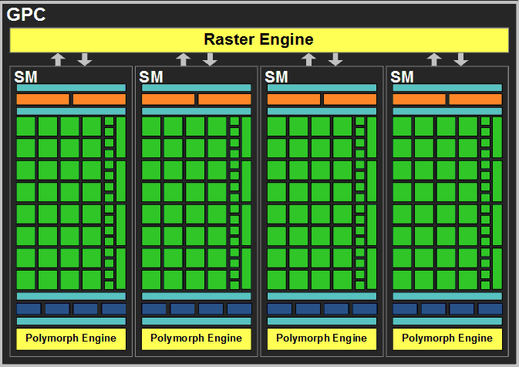
Execution Model to Hardware
How does this execution model map down to actual GPU hardware?
NVIDIA GPUs consist of many streaming multiprocessors (SM)

Slide 46
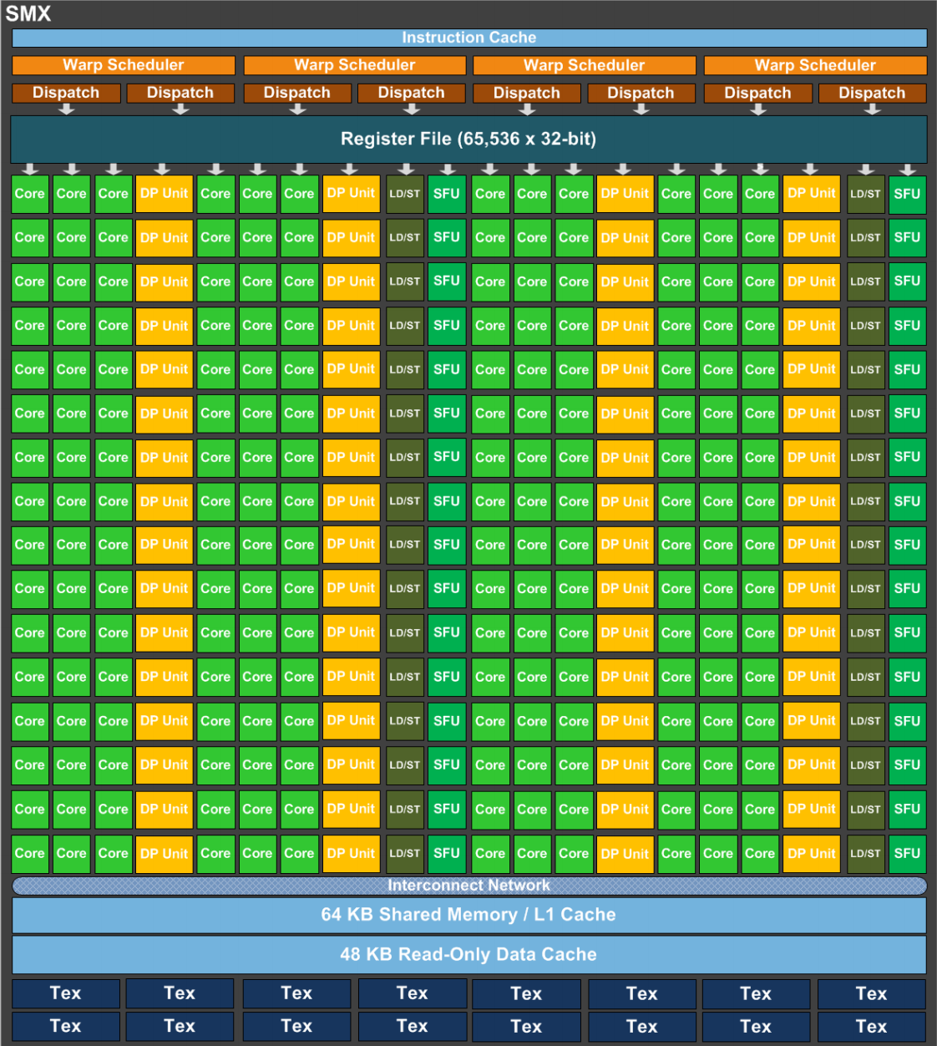
Execution Model to Hardware
NVIDIAGPU Streaming Multiprocessors (SM) are analogous to CPU cores
Single computational unit
Think of an SM as a single vector processor
Composed of multiple CUDA “cores”, load/store units, special function units (sin, cosine, etc.)
Each CUDA core contains integer and floating-point arithmetic logic units

Slide 47
Execution Model to Hardware
GPUs can execute multiple SIMT groups on each SM
For example: on NVIDIA GPUs a SIMT group is 32 threads, each Kepler SM has 192 CUDA cores ➔ simultaneous execution of 6 SIMT groups on an SM
SMs can support more concurrent SIMT groups than core count would suggest
Each thread persistently stores its own state in a private register set
Many SIMT groups will spend time blocked on I/O, not actively computing
Keeping blocked SIMT groups scheduled on an SM would waste cores
Groups can be swapped in and out without worrying about losing state

Slide 48
Execution Model to Hardware
This leads to a nested thread hierarchy on GPUs
A single thread
SIMT Groups that concurrently run on the same SM
SIMT Groups that execute together on the same GPU
SIMT Group

Slide 49
References
The sections on Introducing the CUDA Execution Model, Understanding the Nature of Warp Execution, and Exposing Parallelism in Chapter 3 of Professional CUDA C Programming
Michael Wolfe. Understanding the CUDA Data Parallel Threading Model. https://www.pgroup.com/lit/articles/insider/v2n1a5.htm
Will Ramey. Introduction to CUDA Platform. http://developer.download.nvidia .com/compute/developertrainingmaterials/presentations/general/Why_GPU_ Computing.pptx
Timo Stich. Fermi Hardware & Performance Tips. http://theinf2.informatik.uni-jena.de/ theinf2_multimedia/Website_downloads/NVIDIA_Fermi_Perf_Jena_2011.pdf

Slide 50
More information about GPUs

Slide 51
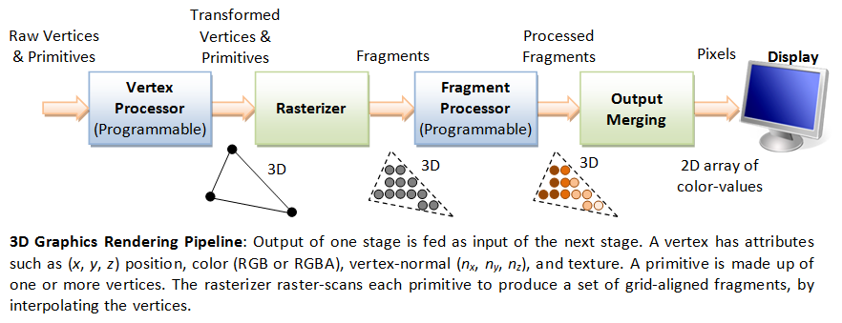
GPU Architecture Revolution
Unified Scalar Shader Architecture
Highly Data Parallel Stream Processing
Image: http://www.ntu.edu.sg/home/ehchua/programming/opengl/CG_BasicsTheory.html
An Introduction to Modern GPU Architecture, Ashu Rege, NVIDIA Director of Developer Technology
ftp://download.nvidia.com/developer/cuda/seminar/TDCI_Arch.pdf

Slide 52
GPUs with Dedicated Pipelines -- late 1990s-early 2000s
Graphics chips generally had a pipeline structure with individual stages performing specialized operations, finally leading to loading frame buffer for display.
Individual stages may have access to graphics memory for storing intermediate computed data.
Input stage
Vertex shader stage
Graphics memory
Geometry shader stage
Rasterizer stage
Frame buffer
Pixel shading stage

Slide 53
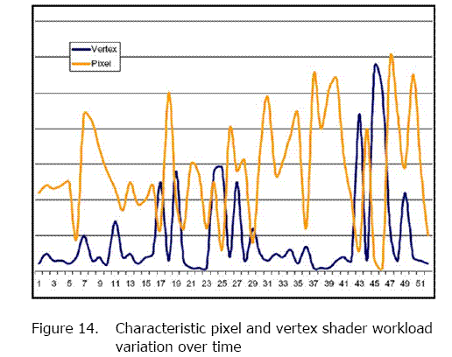
Graphics Logical Pipeline
Processor Per Function, each could be vector
Graphics logical pipeline. Programmable graphics shader stages are blue, and fixed-function blocks are white. Copyright © 2009 Elsevier, Inc. All rights reserved.
Unbalanced
and inefficient utilization

Slide 54
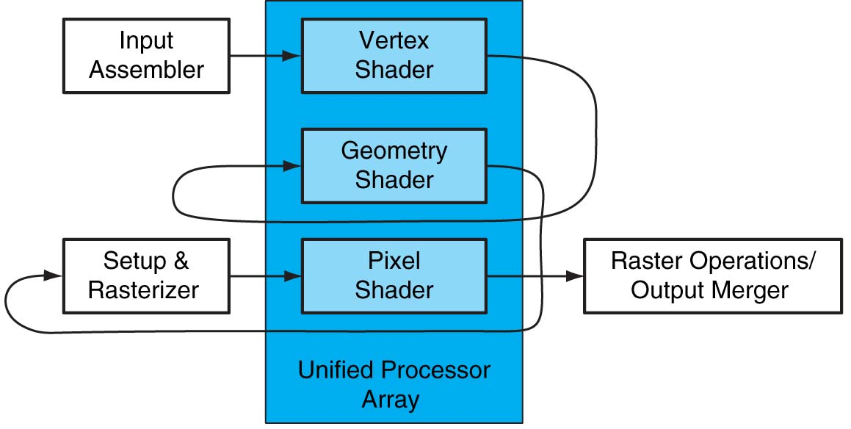
Unified Shader
Optimal utilization in unified architecture
FIGURE A.2.4 Logical pipeline mapped to physical processors. The programmable shader stages execute on the array of unified processors, and the logical graphics pipeline dataflow recirculates through the processors. Copyright © 2009 Elsevier, Inc. All rights reserved.

Slide 55
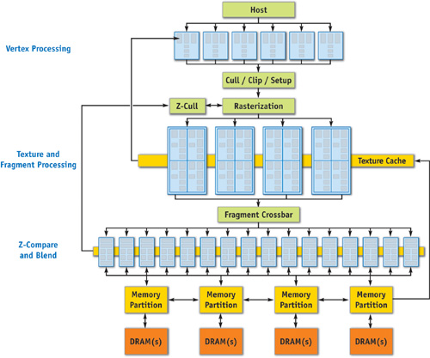
Specialized Pipeline Architecture
GeForce 6 Series Architecture
(2004-5)
From GPU Gems 2

Slide 56
GPU Memory Model
Now that we understand how abstract threads of execution are mapped to the GPU:
How do those threads store and retrieve data?
What rules are there about memory consistency?
How can we efficiently use GPU memory?
SIMT Thread Groups on a GPU
SIMT Thread Groups on an SM
SIMT Thread Group
Registers
Local Memory
On-Chip Shared Memory
Global Memory
Constant Memory
Texture Memory

Slide 57
GPU Memory Model
There are many levels and types of GPU memory, each of which has special characteristics that make it useful
Size
Latency
Bandwidth
Readable and/or Writable
Optimal Access Patterns
Accessibility by threads in the same SIMT group, SM, GPU
Later lectures will go into detail on each type of GPU memory

Slide 58
GPU Memory Model
For now, we focus on two memory types: on-chip shared memory and registers
These memory types affect the GPU execution model
Each SM has a limited set of registers, each thread receives its own private set of registers
Each SM has a limited amount of Shared Memory, all SIMT groups on an SM share that Shared Memory
SIMT Thread Groups on a GPU
SIMT Thread Groups on an SM
SIMT Thread Group
Registers
Local Memory
On-Chip Shared Memory
Global Memory
Constant Memory
Texture Memory

Slide 59
GPU Memory Model
➔ Shared Memory and Registers are limited
Per-SM resources which can impact how many threads can execute on an SM
For example: consider an imaginary SM that supports executing 1,024 threads concurrently (32 SIMT groups of 32 threads)
Suppose that SM has a total of 16,384 registers
Suppose each thread in an application requires 64 registers to execute
Even though we can theoretically support 1,024 threads, we can only simultaneously store state for 16,384 registers / 64 registers per thread = 256 threads

Slide 60
GPU Memory Model
➔ Parallelism is limited by both the computational and storage resources of the GPU.
In the GPU Execution Model, they are closely tied together.

Slide 61
The Host and the GPU
Cooperative co-processors
CPU and GPU work together on the problem at hand
Keep both processors well-utilized to get to the solution
Many different work partitioning techniques across CPU and GPU
PCIe Bus

Slide 62
The Host and the GPU
Management processor + accelerator
CPU is dedicated to GPU management and other ancillary functions (network I/O, disk I/O, system memory management, scheduling decisions)
CPU may spend a large amount of application time blocked on the GPU
GPU is the workhorse of the application, most computation is offloaded to it
Allows for a light-weight, inexpensive CPU to be used
PCIe Bus

Slide 63
The Host and the GPU
Co-processor
More computational bandwidth
Higher power consumption
Programmatically challenging
Requires knowledge of both architectures to be implemented effectively
Note useful for all applications
Accelerator
Computational bandwidth of GPU only
Lower power consumption
Programming and optimizing focused on the GPU
Limited knowledge of CPU architecture required

Slide 64
GPU Communication
Communicating between the host and GPU is a piece of added complexity, relative to homogeneous programming models
Generally, CPU and GPU have physically and logically separate address spaces (though this is changing)
PCIe Bus

Slide 65
GPU Communication
Data transfer from CPU to GPU over the PCI bus adds
Conceptual complexity
Performance overhead
Communication Medium | Latency | Bandwidth
On-Chip Shared Memory | A few clock cycles | Thousands of GB/s
GPU Memory | Hundreds of clock cycles | Hundreds of GB/s
PCI Bus | Hundreds to thousands of clock cycles | Tens of GB/s

Slide 66
GPU Communication
As a result, computation-communication overlap is a common technique in GPU programming
Asynchrony is a first-class citizen of most GPU programming frameworks
GPU
Compute
Compute
Compute
Compute
PCIe Bus
Copy
Copy
Copy
Copy
Copy

Slide 67
GPU Execution Model
GPUs introduce a new conceptual model for programmers used to CPU single- and multi-threaded programming
While the concepts are different, they are no more complex than those you would need to learn to extract optimal performance from CPU architectures
GPUs offer programmers more control over how their workloads map to hardware, which makes the results of optimizing applications more predictable

