Slide 1
Lecture 03: Programming with OpenMP
CSCE 790: Parallel Programming Models for Multicore and Manycore Processors
Department of Computer Science and Engineering
Yonghong Yan
yanyh@cse.sc.edu
http://cse.sc.edu/~yanyh

Slide 2
Outline
OpenMP Introduction
Parallel Programming with OpenMP
  Worksharing, tasks, data environment, synchronization
OpenMP Performance and Best Practices
Case Studies and Examples
Reference Materials

Slide 3
What is OpenMP
Standard API to write shared memory parallel applications in C, C++, and Fortran
  Compiler directives, Runtime routines, Environment variables
OpenMP Architecture Review Board (ARB)
  Maintains OpenMP specification
  Permanent members
    AMD, Cray, Fujitsu, HP, IBM, Intel, NEC, PGI, Oracle, Microsoft, Texas Instruments, NVIDIA, Convey
  Auxiliary members
    ANL, ASC/LLNL, cOMPunity, EPCC, LANL, NASA, TACC, RWTH Aachen University, UH
  http://www.openmp.org
Latest Version 4.5 released Nov 2015

Slide 4

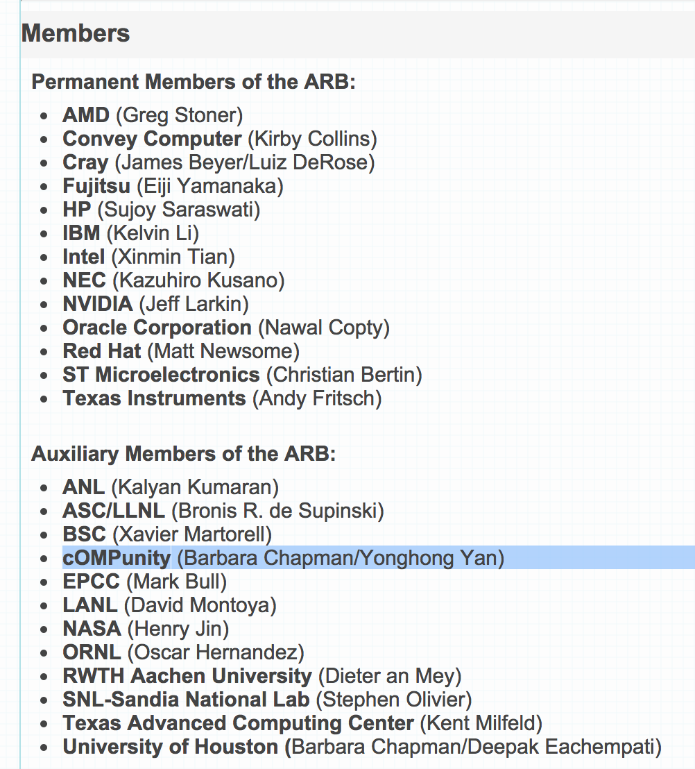
My role with OpenMP

Slide 5
“Hello Word” Example/1
#include <stdlib.h>
#include <stdio.h>
int main(int argc, char *argv[]) {
printf("Hello World\n");
return(0);
}

Slide 6
“Hello Word” - An Example/2
#include <stdlib.h>
#include <stdio.h>
int main(int argc, char *argv[]) {
#pragma omp parallel
{
printf("Hello World\n");
} // End of parallel region
return(0);
}

Slide 7
“Hello Word” - An Example/3
$ gcc –fopenmp hello.c
$ export OMP_NUM_THREADS=2
$ ./a.out
Hello World
Hello World
$ export OMP_NUM_THREADS=4
$ ./a.out
Hello World
Hello World
Hello World
Hello World
$
#include <stdlib.h>
#include <stdio.h>
int main(int argc, char *argv[]) {
#pragma omp parallel
{
printf("Hello World\n");
} // End of parallel region
return(0);
}

Slide 8
OpenMP Components
Directives
Runtime Environment
Environment Variable
Parallel region
Worksharing constructs
Tasking
Offloading
Affinity
Error Handing
SIMD
Synchronization
Data-sharing attributes
Number of threads
Thread ID
Dynamic thread adjustment
Nested parallelism
Schedule
Active levels
Thread limit
Nesting level
Ancestor thread
Team size
Locking
Wallclock timer
Number of threads
Scheduling type
Dynamic thread adjustment
Nested parallelism
Stacksize
Idle threads
Active levels
Thread limit

Slide 9
“Hello Word” - An Example/3
#include <stdlib.h>
#include <stdio.h>
#include <omp.h>
int main(int argc, char *argv[]) {
#pragma omp parallel
{
int thread_id = omp_get_thread_num();
int num_threads = omp_get_num_threads();
printf("Hello World from thread %d of %d\n",
thread_id, num_threads);
}
return(0);
}
Directives
Runtime Environment

Slide 10
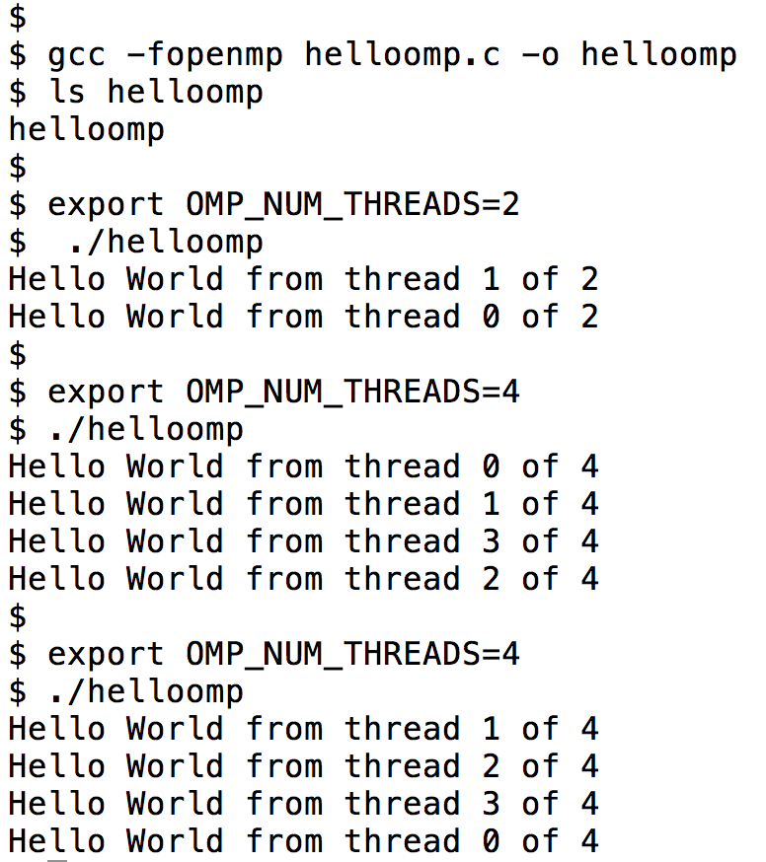
“Hello Word” - An Example/4
Environment Variable
Environment Variable: it is similar to program arguments used to change the configuration of the execution without recompile the program.
NOTE: the order of print

Slide 11
The Design Principle Behind
#pragma omp parallel
{
int thread_id = omp_get_thread_num();
int num_threads = omp_get_num_threads();
printf("Hello World from thread %d of %d\n",
thread_id, num_threads);
}
Each printf is a task
A parallel region is to claim a set of cores for computation
  Cores are presented as multiple threads
Each thread execute a single task
  Task id is the same as thread id
    omp_get_thread_num()
  Num_tasks is the same as total number of threads
    omp_get_num_threads()
1:1 mapping between task and thread
  Every task/core do similar work in this simple example

Slide 12
OpenMP Parallel Computing Solution Stack
End User
User layer
Application
Prog. Layer (OpenMP API)
Directives,
Compiler
OpenMP library
Environment
variables
Runtime library
System layer
OS/system

Slide 13
OpenMP Syntax
Most OpenMP constructs are compiler directives using pragmas.
  For C and C++, the pragmas take the form:
    #pragma …
pragma vs language
  pragma is not language, should not express logics
  To provide compiler/preprocessor additional information on how to processing directive-annotated code
  Similar to #include, #define

Slide 14
OpenMP Syntax
For C and C++, the pragmas take the form:
  #pragma omp construct [clause [clause]…]
For Fortran, the directives take one of the forms:
  Fixed form
  *$OMP construct [clause [clause]…]
  C$OMP construct [clause [clause]…]
  Free form (but works for fixed form too)
  !$OMP construct [clause [clause]…]
Include file and the OpenMP lib module
    #include <omp.h>
    use omp_lib

Slide 15
OpenMP Compiler
OpenMP: thread programming at “high level”.
  The user does not need to specify the details
    Program decomposition, assignment of work to threads
    Mapping tasks to hardware threads
User makes strategic decisions
Compiler figures out details
  Compiler flags enable OpenMP (e.g. –openmp, -xopenmp, -fopenmp, -mp)

Slide 16
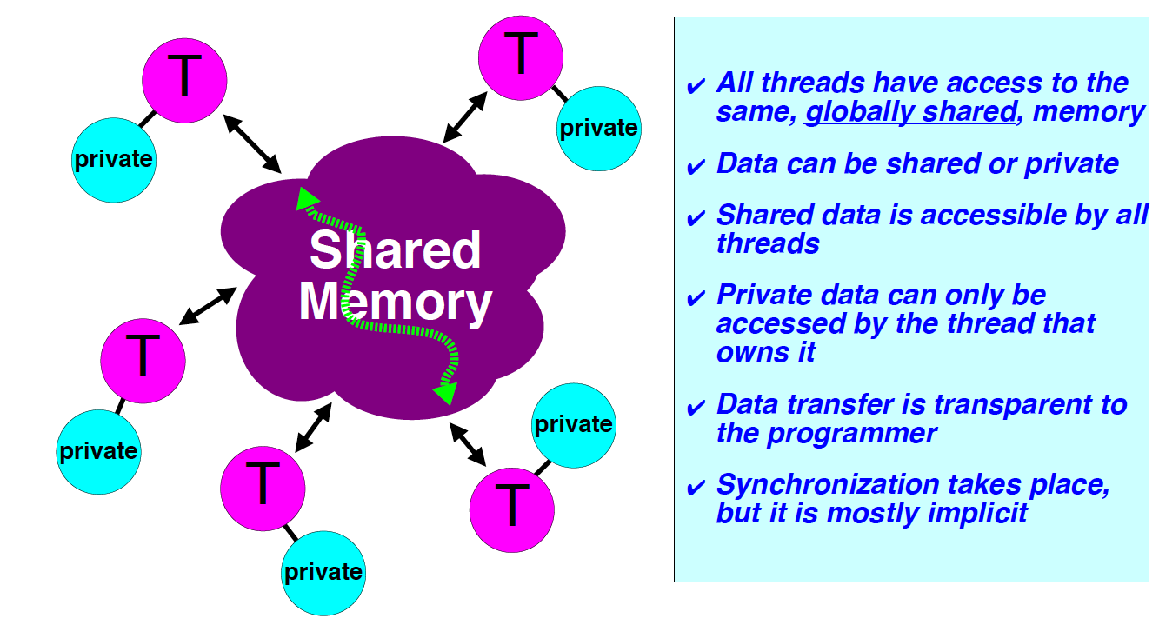
OpenMP Memory Model
OpenMP assumes a shared memory
    Threads communicate by sharing variables.
Synchronization protects data conflicts.
  Synchronization is expensive.
    Change how data is accessed to minimize the need for synchronization.

Slide 17
OpenMP Fork-Join Execution Model
Master thread spawns multiple worker threads as needed, together form a team
Parallel region is a block of code executed by all threads in a team simultaneously
Fork
Join
Master thread
Worker threads
A Nested Parallel region
Parallel Regions

Slide 18
SPMD Program Models
SPMD (Single Program, Multiple Data) for parallel regions
  All PEs (Processor Elements) execute the same program in parallel, but has its own data
  Each PE uses a unique ID to access its portion of data
  Different PE can follow different paths through the same code
Each PE knows its own ID
SPMD is by far the most commonly used pattern for structuring parallel programs
  MPI, OpenMP, CUDA, etc
  if(my_id == x) { }
  else { }

Slide 19
OpenMP Parallel Regions
In C/C++: a block is a single statement or a group of statement between { }
In Fortran: a block is a single statement or a group of statements between directive/end-directive pairs.
#pragma omp parallel
{
id = omp_get_thread_num();
res[id] = lots_of_work(id);
}
#pragma omp parallel for
for(i=0;i<N;i++) {
res[i] = big_calc(i);
A[i] = B[i] + res[i];
}
C$OMP PARALLEL
10 wrk(id) = garbage(id)
res(id) = wrk(id)**2
if(.not.conv(res(id)) goto 10
C$OMP END PARALLEL
C$OMP PARALLEL DO
do i=1,N
res(i)=bigComp(i)
end do
C$OMP END PARALLEL DO
Notes:
The first example is a parallel region only, the second one is a parallel region combined with a loop

Slide 20
Scope of OpenMP Region
A parallel region can span multiple source files.
bar.f
foo.f
C$OMP PARALLEL
call whoami
C$OMP END PARALLEL
subroutine whoami
external omp_get_thread_num
integer iam, omp_get_thread_num
iam = omp_get_thread_num()
C$OMP CRITICAL
print*,’Hello from ‘, iam
C$OMP END CRITICAL
return
end
+
lexical extent of parallel region
Dynamic extent of parallel region includes lexical extent
Orphaned directives can appear outside a parallel construct

Slide 21
OpenMP Worksharing Constructs
Divides the execution of the enclosed code region among the members of the team
The “for” worksharing construct splits up loop iterations among threads in a team
  Each thread gets one or more “chunk” -> loop chuncking
#pragma omp parallel
#pragma omp for
for (i = 0; i < N; i++) {
work(i);
}
By default, there is a barrier at the end of the “omp for”. Use the “nowait” clause to turn off the barrier.
#pragma omp for nowait
“nowait” is useful between two consecutive, independent omp for loops.

Slide 22
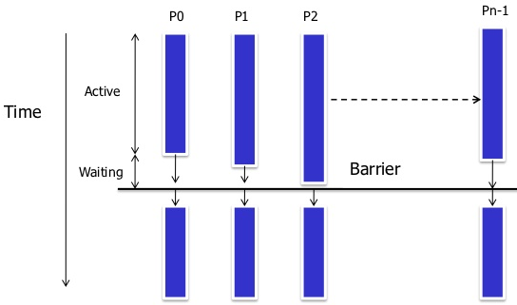
Barrier

Slide 23
Worksharing Constructs
Sequential code
for(i=0;i<N;i++) { a[i] = a[i] + b[i]; }
#pragma omp parallel shared (a, b)
{
int id, i, Nthrds, istart, iend;
id = omp_get_thread_num();
Nthrds = omp_get_num_threads();
istart = id * N / Nthrds;
iend = (id+1) * N / Nthrds;
for(i=istart;i<iend;i++) { a[i] = a[i] + b[i]; }
}
OpenMP parallel region
OpenMP parallel region and a worksharing for construct
#pragma omp parallel shared (a, b) private (i)
#pragma omp for schedule(static)
for(i=0;i<N;i++) { a[i] = a[i] + b[i]; }

Slide 24
OpenMP schedule Clause
schedule ( static | dynamic | guided [, chunk] )
schedule ( auto | runtime )
static | Distribute iterations in blocks of size "chunk" over the threads in a round-robin fashion
dynamic | Fixed portions of work; size is controlled by the value of chunk; When a thread finishes, it starts on the next portion of work
guided | Same dynamic behavior as "dynamic", but size of the portion of work decreases exponentially
auto | The compiler (or runtime system) decides what is best to use; choice could be implementation dependent
runtime | Iteration scheduling scheme is set at runtime through environment variable OMP_SCHEDULE
Notes:
First off, I would add "static,1" to table. In my experience, many users expect that "static" will make each thread get at least 1 iteration if you have p threads and >p iterations. This guarantee is only present for "static,1" and we should add that here. "static" tries to divide the work evenly, but does not guarantee that each thread will get something. Most static scheduling algorithms use the formula (n+p)/p for each thread, remainder for 1 thread, and 0 for remaining thread.
Also, I think adding "pre-determined" to the static descriptions is important.

Slide 25
OpenMP Sections
Worksharing construct
Gives a different structured block to each thread
#pragma omp parallel
#pragma omp sections
{
#pragma omp section x_calculation();
#pragma omp section
y_calculation();
#pragma omp section
z_calculation();
}
By default, there is a barrier at the end of the “omp sections”. Use the “nowait” clause to turn off the barrier.

Slide 26
Loop Collapse
Allows parallelization of perfectly nested loops without using nested parallelism
The collapse clause on for/do loop indicates how many loops should be collapsed
!$omp parallel do collapse(2) ...
do i = il, iu, is
do j = jl, ju, js
do k = kl, ku, ks
.....
end do
end do
end do
!$omp end parallel do

Slide 27
OpenMP Master
Denotes a structured block executed by the master thread
The other threads just skip it
  no synchronization is implied
#pragma omp parallel private (tmp)
{
do_many_things_together();
#pragma omp master
{ exchange_boundaries_by_master_only (); }
#pragma barrier
do_many_other_things_together();
}

Slide 28
OpenMP Single
Denotes a block of code that is executed by only one thread.
  Could be master
A barrier is implied at the end of the single block.
#pragma omp parallel private (tmp)
{
do_many_things_together();
#pragma omp single
{ exchange_boundaries_by_one(); }
do_many_other_things_together();
}

Slide 29
OpenMP Tasks
Define a task:
  C/C++: #pragma omp task
  Fortran: !$omp task
A task is generated when a thread encounters a task construct
  Contains a task region and its data environment
  Task can be nested
A task region is a region consisting of all code encountered during the execution of a task.
The data environment consists of all the variables associated with the execution of a given task.
  constructed when the task is generated

Slide 30
Task completion and synchronization
Task completion occurs when the task reaches the end of the task region code
Multiple tasks joined to complete through the use of task synchronization constructs
  taskwait
  barrier construct
taskwait constructs:
  #pragma omp taskwait
  !$omp taskwait
int fib(int n) {
int x, y;
if (n < 2) return n;
else {
#pragma omp task shared(x)
x = fib(n-1);
#pragma omp task shared(y)
y = fib(n-2);
#pragma omp taskwait
return x + y;
}
}

Slide 31
Example: A Linked List

Slide 32
Example: A Linked List with Tasking

Slide 33
Data Environment
Most variables are shared by default
Global variables are SHARED among threads
  Fortran: COMMON blocks, SAVE variables, MODULE variables
  C: File scope variables, static
But not everything is shared...
  Stack variables in sub-programs called from parallel regions are PRIVATE
  Automatic variables defined inside the parallel region are PRIVATE.

Slide 34
OpenMP Data Environment
double a[size][size], b=4;
#pragma omp parallel private (b)
{ .... }
shared data
a[size][size]
private data
b’=?
private data
b’=?
private data
b’=?
private data
b’=?
T0
T1
T2
T3
b becomes undefined

Slide 35
OpenMP Data Environment
program sort
common /input/ A(10)
integer index(10)
C$OMP PARALLEL
call work (index)
C$OMP END PARALLEL
print*, index(1)
subroutine work (index)
common /input/ A(10)
integer index(*)
real temp(10)
integer count
save count
…………
A, index, count
A, index and count are shared by all threads.
temp is local to each thread
temp
temp
temp
A, index, count
Notes:
Save attribute

Slide 36
Data Environment:
Changing storage attributes
Selectively change storage attributes constructs using the following clauses
  SHARED
  PRIVATE
  FIRSTPRIVATE
  THREADPRIVATE
The value of a private inside a parallel loop and global value outside the loop can be exchanged with
  FIRSTPRIVATE, and LASTPRIVATE
The default status can be modified with:
  DEFAULT (PRIVATE | SHARED | NONE)
Notes:
All data clauses apply to parallel regions and worksharing constructs except “shared” which only applies to parallel regions.

Slide 37
OpenMP Private Clause
private(var) creates a local copy of var for each thread.
  The value is uninitialized
  Private copy is not storage-associated with the original
  The original is undefined at the end
IS = 0
C$OMP PARALLEL DO PRIVATE(IS)
DO J=1,1000
IS = IS + J
END DO
C$OMP END PARALLEL DO
print *, IS

Slide 38
OpenMP Private Clause
private(var) creates a local copy of var for each thread.
  The value is uninitialized
  Private copy is not storage-associated with the original
  The original is undefined at the end
IS = 0
C$OMP PARALLEL DO PRIVATE(IS)
DO J=1,1000
IS = IS + J
END DO
C$OMP END PARALLEL DO
print *, IS
✗
IS was not initialized
✗
IS is undefined here

Slide 39
Firstprivate Clause
firstprivate is a special case of private.
  Initializes each private copy with the corresponding value from the master thread.
IS = 0
C$OMP PARALLEL DO FIRSTPRIVATE(IS)
DO 20 J=1,1000
IS = IS + J
CONTINUE
C$OMP END PARALLEL DO
print *, IS

Slide 40
Firstprivate Clause
firstprivate is a special case of private.
  Initializes each private copy with the corresponding value from the master thread.
IS = 0
C$OMP PARALLEL DO FIRSTPRIVATE(IS)
DO 20 J=1,1000
IS = IS + J
CONTINUE
C$OMP END PARALLEL DO
print *, IS
✔
✗
Each thread gets its own IS with an initial value of 0
Regardless of initialization, IS is undefined at this point

Slide 41
Lastprivate Clause
Lastprivate passes the value of a private from the last iteration to the variable of the master thread
✔
IS = 0
C$OMP PARALLEL DO FIRSTPRIVATE(IS)
C$OMP& LASTPRIVATE(IS)
DO 20 J=1,1000
IS = IS + J
CONTINUE
C$OMP END PARALLEL DO
print *, IS
Is this code meaningful?
Each thread gets its own IS with an initial value of 0
IS is defined as its value at the last iteration (i.e. for J=1000)

Slide 42
OpenMP Reduction
Here is the correct way to parallelize this code.
IS = 0
C$OMP PARALLEL DO REDUCTION(+:IS)
DO 20 J=1,1000
IS = IS + J
20 CONTINUE
print *, IS
Reduction NOT implies firstprivate, where is the initial 0 comes from?

Slide 43
Reduction operands/initial-values
Associative operands used with reduction
Initial values are the ones that make sense mathematically
Operand | Initial value
+ | 0
* | 1
- | 0
.AND. | All 1’s
Operand | Initial value
.OR. | 0
MAX | 1
MIN | 0
// | All 1’s

Slide 44
OpenMP Threadprivate
Makes global data private to a thread, thus crossing parallel region boundary
  Fortran: COMMON blocks
  C: File scope and static variables
Different from making them PRIVATE
  With PRIVATE, global variables are masked.
  THREADPRIVATE preserves global scope within each thread
Threadprivate variables can be initialized using COPYIN or by using DATA statements.

Slide 45
Threadprivate/copyin
You initialize threadprivate data using a copyin clause.
parameter (N=1000)
common/buf/A(N)
C$OMP THREADPRIVATE(/buf/)
C Initialize the A array
call init_data(N,A)
C$OMP PARALLEL COPYIN(A)
… Now each thread sees threadprivate array A initialized
… to the global value set in the subroutine init_data()
C$OMP END PARALLEL
....
C$OMP PARALLEL
... Values of threadprivate are persistent across parallel regions
C$OMP END PARALLEL

Slide 46
OpenMP Synchronization
High level synchronization:
  critical section
  atomic
  barrier
  ordered
Low level synchronization
  flush
  locks (both simple and nested)

Slide 47
Critical section
Only one thread at a time can enter a critical section.
C$OMP PARALLEL DO PRIVATE(B)
C$OMP& SHARED(RES)
DO 100 I=1,NITERS
B = DOIT(I)
C$OMP CRITICAL
CALL CONSUME (B, RES)
C$OMP END CRITICAL
100 CONTINUE
C$OMP END PARALLEL DO

Slide 48
Atomic
Atomic is a special case of a critical section that can be used for certain simple statements
It applies only to the update of a memory location
C$OMP PARALLEL PRIVATE(B)
B = DOIT(I)
tmp = big_ugly();
C$OMP ATOMIC
X = X + temp
C$OMP END PARALLEL

Slide 49
Barrier
Barrier: Each thread waits until all threads arrive.
#pragma omp parallel shared (A, B, C) private(id)
{
id=omp_get_thread_num();
A[id] = big_calc1(id);
#pragma omp barrier
#pragma omp for
for(i=0;i<N;i++){C[i]=big_calc3(I,A);}
#pragma omp for nowait
for(i=0;i<N;i++){ B[i]=big_calc2(C, i); }
A[id] = big_calc3(id);
}
implicit barrier at the end of a for work-sharing construct
implicit barrier at the end of a parallel region
no implicit barrier due to nowait

Slide 50
Ordered
The ordered construct enforces the sequential order for a block.
#pragma omp parallel private (tmp)
#pragma omp for ordered
for (i=0;i<N;i++){
tmp = NEAT_STUFF_IN_PARALLEL(i);
#pragma ordered
res += consum(tmp);
}

Slide 51
OpenMP Synchronization
The flush construct denotes a sequence point where a thread tries to create a consistent view of memory.
  All memory operations (both reads and writes) defined prior to the sequence point must complete.
  All memory operations (both reads and writes) defined after the sequence point must follow the flush.
  Variables in registers or write buffers must be updated in memory.
Arguments to flush specify which variables are flushed. No arguments specifies that all thread visible variables are flushed.
Notes:
The following directives imply flush
barrier
parallel - upon entry and exit
critical - upon entry and exit
ordered - upon entry and exit
for - upon exit
sections - upon exit
single - upon exit

Slide 52
A flush example
pair-wise synchronization.
integer ISYNC(NUM_THREADS)
C$OMP PARALLEL DEFAULT (PRIVATE) SHARED (ISYNC)
IAM = OMP_GET_THREAD_NUM()
ISYNC(IAM) = 0
C$OMP BARRIER
CALL WORK()
ISYNC(IAM) = 1 ! I’m all done; signal this to other threads
C$OMP FLUSH(ISYNC)
DO WHILE (ISYNC(NEIGH) .EQ. 0)
C$OMP FLUSH(ISYNC)
END DO
C$OMP END PARALLEL
Make sure other threads can see my write.
Make sure the read picks up a good copy from memory.
Note: flush is analogous to a fence in other shared memory APIs.
Notes:
Need to add NEIGH calculation

Slide 53
OpenMP Lock routines
Simple Lock routines: available if it is unset.
      omp_init_lock(), omp_set_lock(),
      omp_unset_lock(), omp_test_lock(), omp_destroy_lock()
Nested Locks: available if it is unset or if it is set but owned by the thread executing the nested lock function
      omp_init_nest_lock(), omp_set_nest_lock(), omp_unset_nest_lock(), omp_test_nest_lock(), omp_destroy_nest_lock()

Slide 54
OpenMP Locks
Protect resources with locks.
omp_lock_t lck;
omp_init_lock(&lck);
#pragma omp parallel private (tmp, id)
{
id = omp_get_thread_num();
tmp = do_lots_of_work(id);
omp_set_lock(&lck);
printf(“%d %d”, id, tmp);
omp_unset_lock(&lck);
}
omp_destroy_lock(&lck);
Wait here for your turn.
Release the lock so the next thread gets a turn.
Free-up storage when done.
Notes:
I need a better example. I want it this short, but it would be nice if the locks allowed me to do something I couldn’t do with a critical.

Slide 55
OpenMP Library Routines
Modify/Check the number of threads
  omp_set_num_threads(), omp_get_num_threads(), omp_get_thread_num(), omp_get_max_threads()
Are we in a parallel region?
  omp_in_parallel()
How many processors in the system?
  omp_num_procs()

Slide 56
OpenMP Environment Variables
Set the default number of threads to use.
  OMP_NUM_THREADS int_literal
Control how “omp for schedule(RUNTIME)” loop iterations are scheduled.
  OMP_SCHEDULE “schedule[, chunk_size]”

Slide 57
Outline
OpenMP Introduction
Parallel Programming with OpenMP
  Worksharing, tasks, data environment, synchronization
OpenMP Performance and Best Practices
Case Studies and Examples
Reference Materials

Slide 58
OpenMP Performance
Relative ease of using OpenMP is a mixed blessing
We can quickly write a correct OpenMP program, but without the desired level of performance.
There are certain “best practices” to avoid common performance problems.
Extra work needed to program with large thread count

Slide 59
Typical OpenMP Performance Issues
Overheads of OpenMP constructs, thread management. E.g.
  dynamic loop schedules have much higher overheads than static schedules
  Synchronization is expensive, use NOWAIT if possible
  Large parallel regions help reduce overheads, enable better cache usage and standard optimizations
Overheads of runtime library routines
  Some are called frequently
Load balance
Cache utilization and false sharing

Slide 60
Overheads of OpenMP Directives

Slide 61
OpenMP Best Practices
Reduce usage of barrier with nowait clause
#pragma omp parallel
{
#pragma omp for
for(i=0;i<n;i++)
….
#pragma omp for nowait
for(i=0;i<n;i++)
}

Slide 62
OpenMP Best Practices
#pragma omp parallel private(i)
{
#pragma omp for nowait
for(i=0;i<n;i++)
a[i] +=b[i];
#pragma omp for nowait
for(i=0;i<n;i++)
c[i] +=d[i];
#pragma omp barrier
#pragma omp for nowait reduction(+:sum)
for(i=0;i<n;i++)
sum += a[i] + c[i];
}

Slide 63
OpenMP Best Practices
Avoid large ordered construct
Avoid large critical regions
#pragma omp parallel shared(a,b) private(c,d)
{
….
#pragma omp critical
{
a += 2*c;
c = d*d;
}
}
Move out this
Statement

Slide 64
OpenMP Best Practices
Maximize Parallel Regions
#pragma omp parallel
{
#pragma omp for
for (…) { /* Work-sharing loop 1 */ }
}
opt = opt + N; //sequential
#pragma omp parallel
{
#pragma omp for
for(…) { /* Work-sharing loop 2 */ }
#pragma omp for
for(…) { /* Work-sharing loop N */}
}
#pragma omp parallel
{
#pragma omp for
for (…) { /* Work-sharing loop 1 */ }
#pragma omp single nowait
opt = opt + N; //sequential
#pragma omp for
for(…) { /* Work-sharing loop 2 */ }
#pragma omp for
for(…) { /* Work-sharing loop N */}
}

Slide 65
OpenMP Best Practices
Single parallel region enclosing all work-sharing loops.
for (i=0; i<n; i++)
for (j=0; j<n; j++)
pragma omp parallel for private(k)
for (k=0; k<n; k++) {
……
}
#pragma omp parallel private(i,j,k)
{
for (i=0; i<n; i++)
for (j=0; j<n; j++)
#pragma omp for
for (k=0; k<n; k++) {
…….
}
}

Slide 66
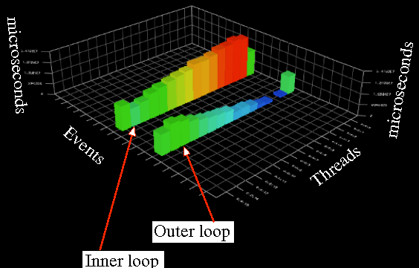
OpenMP Best Practices
Address load imbalances
Use parallel for dynamic schedules and
different chunk sizes
Smith-Waterman Sequence
Alignment Algorithm

Slide 67
OpenMP Best Practices
Smith-Waterman Algorithm
  Default schedule is for static even →load imbalance
#pragma omp for
for(…)
for(…)
for(…)
for(…)
{ /* compute alignments */ }
#pragma omp critical
{. /* compute scores */ }

Slide 68
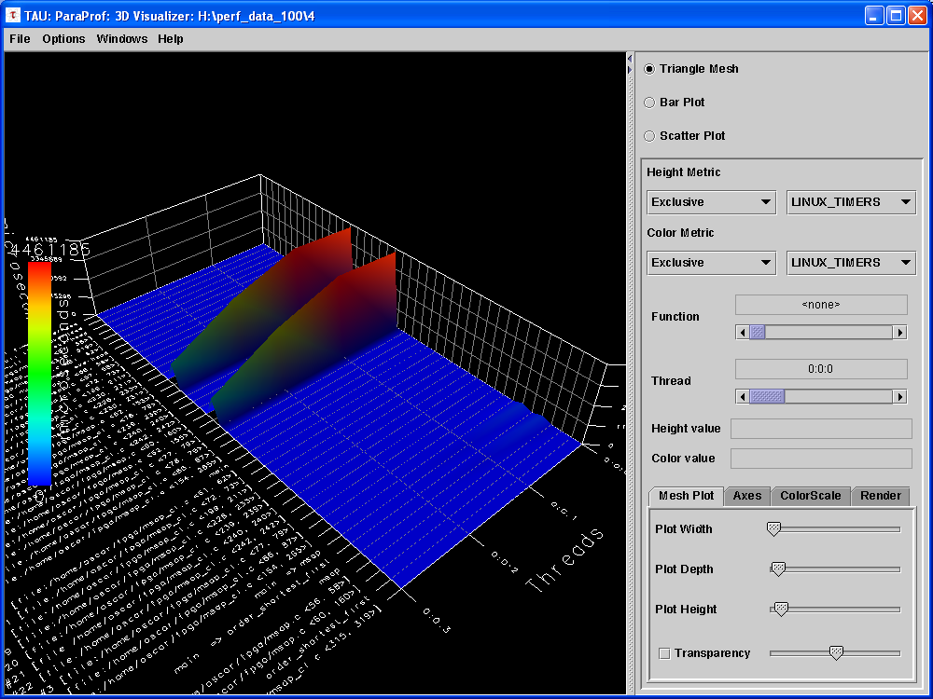
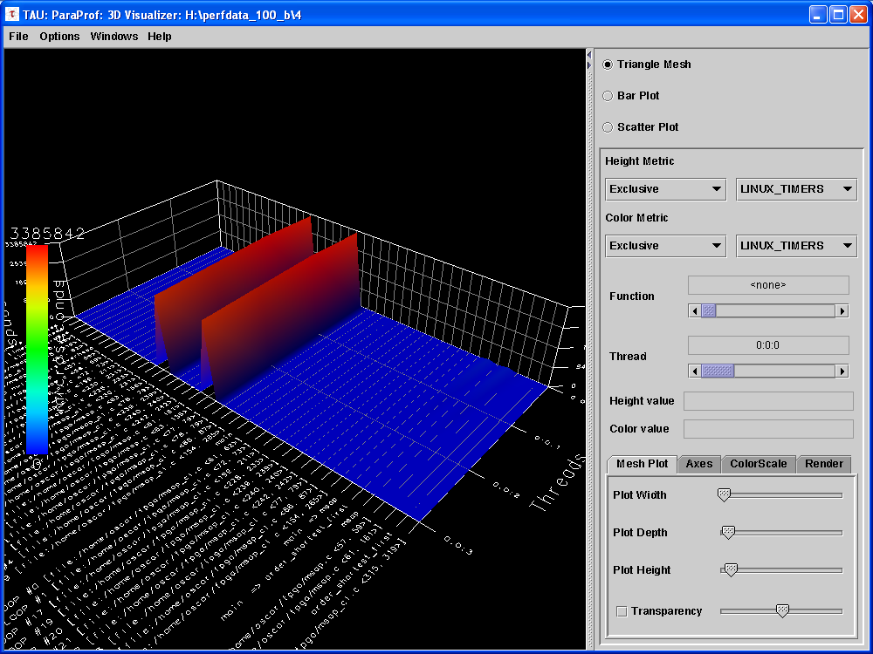
OpenMP Best Practices
Smith-Waterman Sequence Alignment Algorithm
#pragma omp for
#pragma omp for dynamic(schedule, 1)
128 threads with 80% efficiency

Slide 69
OpenMP Best Practices
Address load imbalances by selecting the best schedule and chunk size
Avoid selecting small chunk size when work in chunk is small.
Notes:
Address load imbalances by selecting the best schedszuler and chunk size
Avoid selecting small chunk size when work in chunk is small.

Slide 70
OpenMP Best Practices
Pipeline processing to overlap I/O and computations
for (i=0; i<N; i++) {
ReadFromFile(i,…);
for(j=0; j<ProcessingNum; j++)
ProcessData(i, j);
WriteResultsToFile(i)
}

Slide 71
OpenMP Best Practices
Pipeline Processing
Pre-fetches I/O
Threads reading or writing files joins the computations
#pragma omp parallel
{
#pragma omp single
{ ReadFromFile(0,...); }
for (i=0; i<N; i++) {
#pragma omp single nowait
{ if (i<N-1) ReadFromFile(i+1,….); }
#pragma omp for schedule(dynamic)
for (j=0; j<ProcessingNum; j++)
ProcessChunkOfData(i, j);
#pragma omp single nowait
{ WriteResultsToFile(i); }
}
}
For dealing with the last file
The implicit barrier here is very important: 1) file i is finished so we can write to file. 2) file i+1 is read in so we can process in the next loop iteration

Slide 72
OpenMP Best Practices
single vs. master work-sharing
  master is more efficient but requires thread 0 to be available
  single is more efficient if master thread not available
  single has implicit barrier

Slide 73
Cache Coherence
Real-world shared memory systems have caches between memory and CPU
Copies of a single data item can exist in multiple caches
Modification of a shared data item by one CPU leads to outdated copies in the cache of another CPU
Memory
Original data item
Cache
Cache
Copy of data item
in cache of CPU 0
Copy of data item
in cache of CPU 1
CPU 0
CPU 1

Slide 74
OpenMP Best Practices
False sharing
  When at least one thread write to a cache line while others access it
    Thread 0: = A[1] (read)
    Thread 1: A[0] = … (write)
Solution: use array padding
T0
A
T1
int a[max_threads];
#pragma omp parallel for schedule(static,1)
for(int i=0; i<max_threads; i++)
a[i] +=i;
int a[max_threads][cache_line_size];
#pragma omp parallel for schedule(static,1)
for(int i=0; i<max_threads; i++)
a[i][0] +=i;
Notes:
A store into a shared cache line invalidates the other copies of that line:
The system is not able to distinguish between changes within one individual line
For a 64 byte cache line, if 16 threads is working on the array A, then the 16 writes are all cause false sharing

Slide 75
OpenMP Best Practices
Data placement policy on NUMA architectures
First Touch Policy
  The process that first touches a page of memory causes that page to be allocated in the node on which the process is running

Slide 76
NUMA First-touch placement/1
Only reserve the vm address
int a[100];
Notes:
First Touch
All array elements are in the memory of
the processor executing this thread

Slide 77
NUMA First-touch placement/2
Notes:
First Touch
All array elements are in the memory of
the processor executing this thread

Slide 78
OpenMP Best Practices
First-touch in practice
  Initialize data consistently with the computations
#pragma omp parallel for
for(i=0; i<N; i++) {
a[i] = 0.0; b[i] = 0.0 ; c[i] = 0.0;
}
readfile(a,b,c);
#pragma omp parallel for
for(i=0; i<N; i++) {
a[i] = b[i] + c[i];
}

Slide 79
OpenMP Best Practices
Privatize variables as much as possible
  Private variables are stored in the local stack to the thread
Private data close to cache
double a[MaxThreads][N][N]
#pragma omp parallel for
for(i=0; i<MaxThreads; i++) {
for(int j…)
for(int k…)
a[i][j][k] = …
}
double a[N][N]
#pragma omp parallel private(a)
{
for(int j…)
for(int k…)
a[j][k] = …
}

Slide 80
OpenMP Best Practices
CFD application psudo-code
  Shared arrays initialized incorrectly (first touch policy)
  Delays in remote memory accesses are probable causes by saturation of interconnect
procedure diff_coeff()‏ {
array allocation by master thread
initialization of shared arrays
PARALLEL REGION
{
loop lower_bn [id] , upper_bn [id]
computation on shared arrays
…..
}
}
Notes:
80
80
: Privatization & First Touch

Slide 81
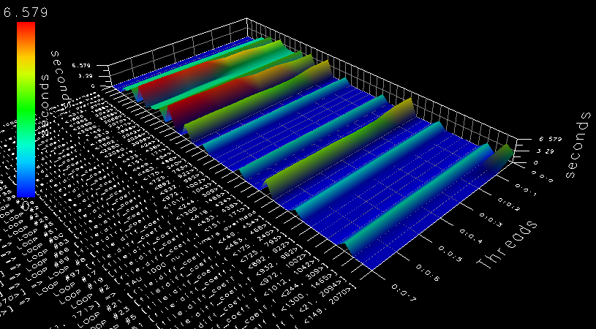
OpenMP Best Practices
Array privatization
  Improved the performance of the whole program by 30%
  Speedup of 10 for the procedure, now only 5% of total time
Processor stalls are reduced significantly
Notes:
81

Slide 82
OpenMP Best Practices
Avoid Thread Migration
  Affects data locality
Bind threads to cores.
Linux:
  numactl –cpubind=0 foobar
  taskset –c 0,1 foobar
SGI Altix
  dplace –x2 foobar

Slide 83
OpenMP Source of Errors
Incorrect use of synchronization constructs
  Less likely if user sticks to directives
  Erroneous use of NOWAIT
Race conditions (true sharing)
  Can be very hard to find
Wrong “spelling” of sentinel
Use tools to check for data races.

Slide 84
Outline
OpenMP Introduction
Parallel Programming with OpenMP
  Worksharing, tasks, data environment, synchronization
OpenMP Performance and Best Practices
Hybrid MPI/OpenMP
Case Studies and Examples
Reference Materials

Slide 85
Matrix vector multiplication

Slide 86
Performance – 2-socket Nehalem

Slide 87
2-socket Nehalem

Slide 88
Data initialization
Initialization will cause the allocation of memory according to the first touch policy

Slide 89
Exploit First Touch

Slide 90
A 3D matrix update

Slide 91
The idea

Slide 92
A 3D matrix update

Slide 93
The performance

Slide 94
Performance analyzer data

Slide 95
False sharing at work

Slide 96
Performance compared

Slide 97
The first implementation

Slide 98
OpenMP version

Slide 99
How this works
… etc …
… etc …

Slide 100
Performance

Slide 101
Performance

Slide 102
Reference Material on OpenMP
OpenMP Homepage www.openmp.org:
  The primary source of information about OpenMP and its development.
OpenMP User’s Group (cOMPunity) Homepage
  www.compunity.org:
Books:
  Using OpenMP, Barbara Chapman, Gabriele Jost, Ruud Van Der Pas, Cambridge, MA : The MIT Press 2007, ISBN: 978-0-262-53302-7
  Parallel programming in OpenMP, Chandra, Rohit, San Francisco, Calif. : Morgan Kaufmann ; London : Harcourt, 2000, ISBN: 1558606718
102

Slide 103
Standard OpenMP Implementation
Directives implemented via code modification and insertion of runtime library calls
  Basic step is outlining of code in parallel region
Runtime library responsible for managing threads
  Scheduling loops
  Scheduling tasks
  Implementing synchronization
Implementation effort is reasonable
OpenMP Code | Translation
int main(void) { int a,b,c; #pragma omp parallel \ private(c) do_sth(a,b,c); return 0; } | _INT32 main() { int a,b,c; /* microtask */ void __ompregion_main1() { _INT32 __mplocal_c; /*shared variables are kept intact, substitute accesses to private variable*/ do_sth(a, b, __mplocal_c); } … /*OpenMP runtime calls */ __ompc_fork(&__ompregion_main1); … }
Each compiler has custom run-time support. Quality of the runtime system has major impact on performance.

Slide 104
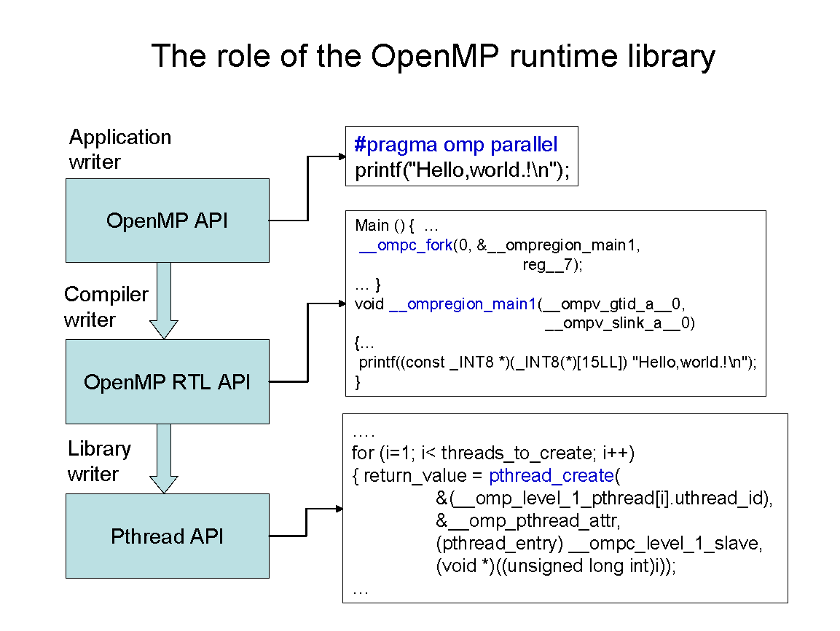
OpenMP Implementation

Slide 105
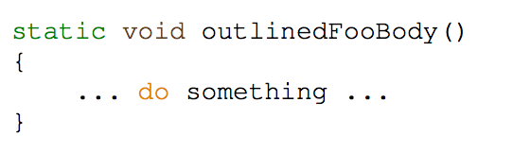
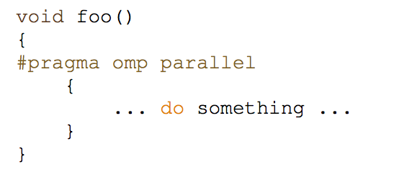
OpenMP Implementation in LLVM/Intel Compiler
https://www.openmprtl.org
https://www.openmprtl.org/sites/default/files/resources/libomp_20160808_manual.pdf
void foo( ) {
__kmpc_fork_call (outlinedFooBody, (void*)0);
// Not the real function name!
}

Slide 106
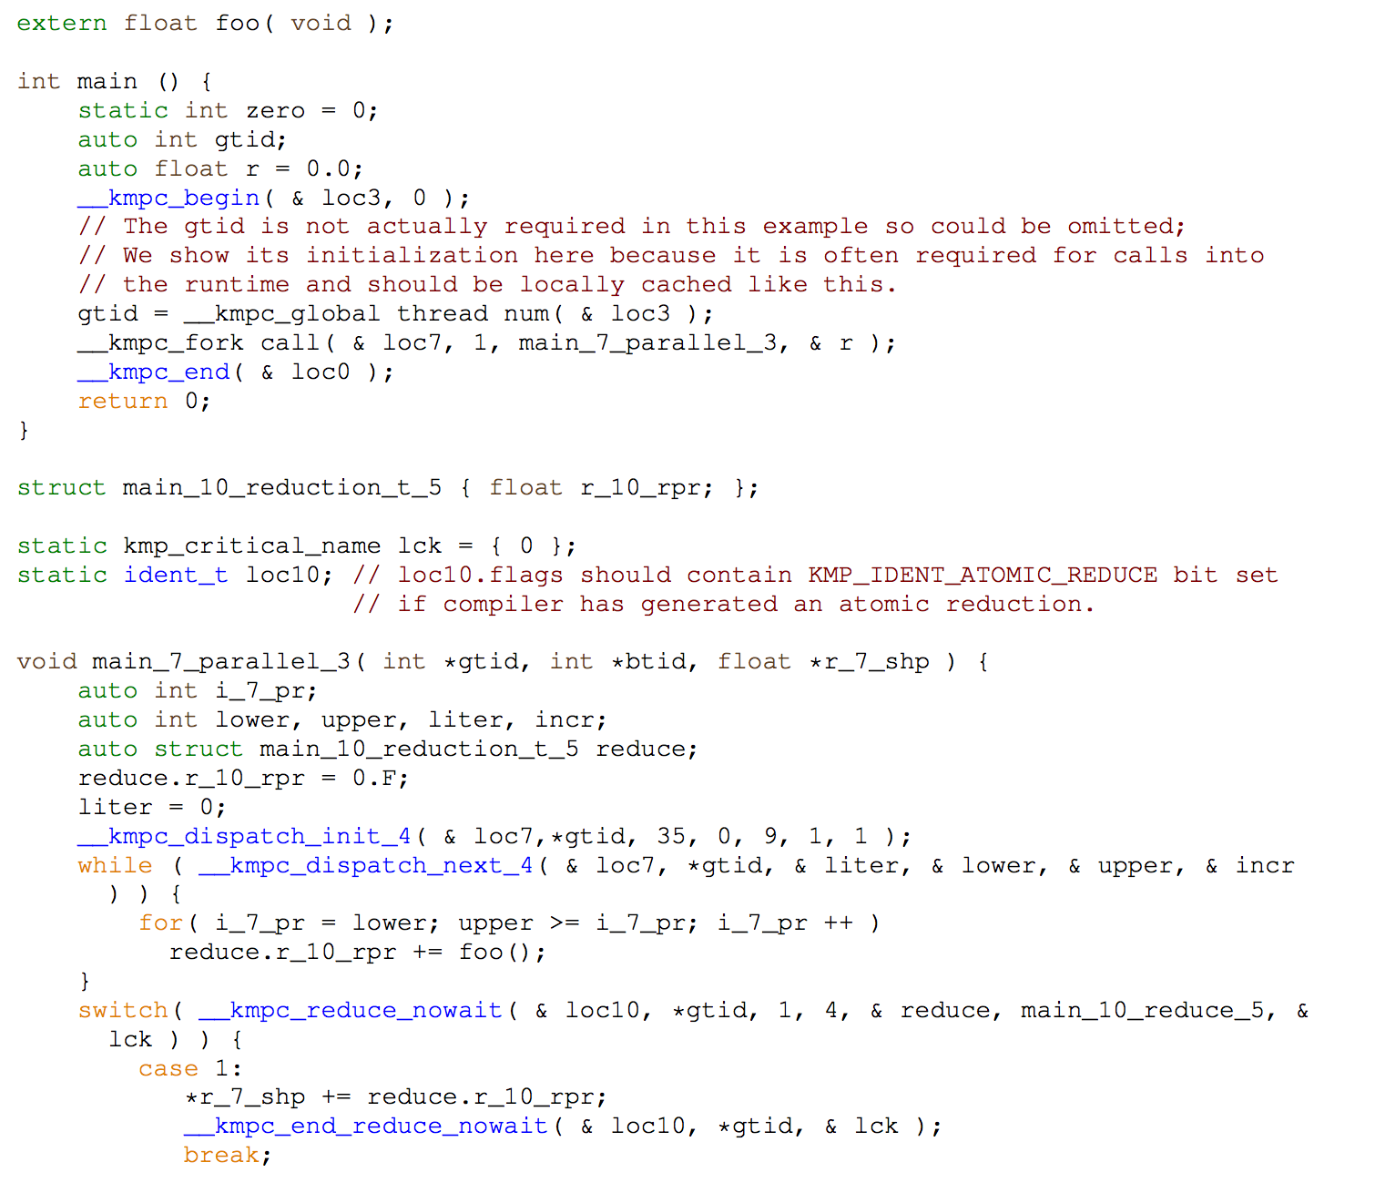
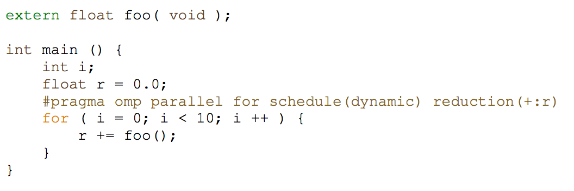
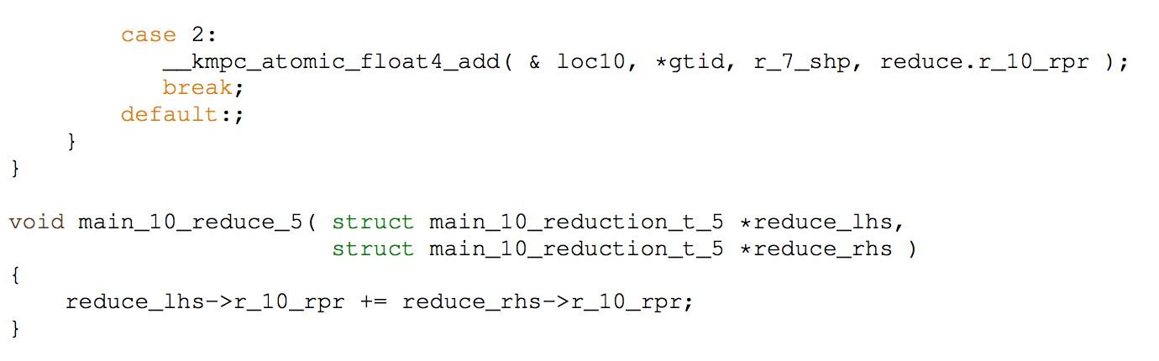
OpenMP Worksharing Implementation

Slide 107
LLVM OpenMP
Source code browser (need vpn to access):
  http://pivo.cse.sc.edu:8080/llvm
  Improving the runtime

