Slide 1
Texas Instruments TDA2x and Vision SDK

Slide 2
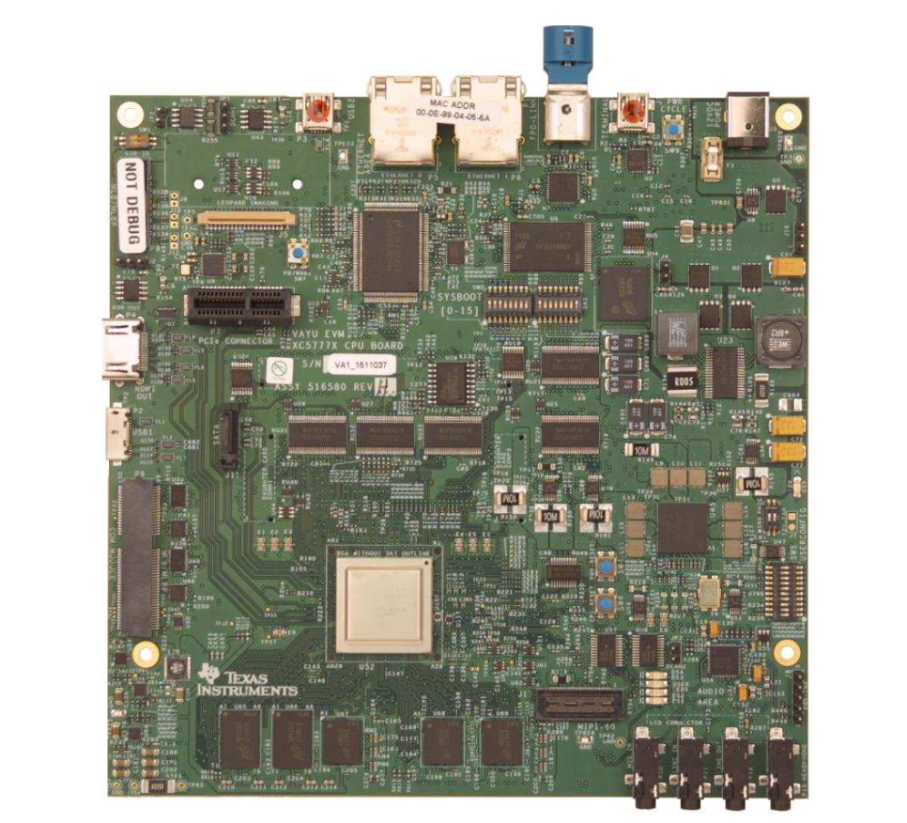
Board Characteristics
Texas Instruments TDA2x EVM CPU Board

Slide 3
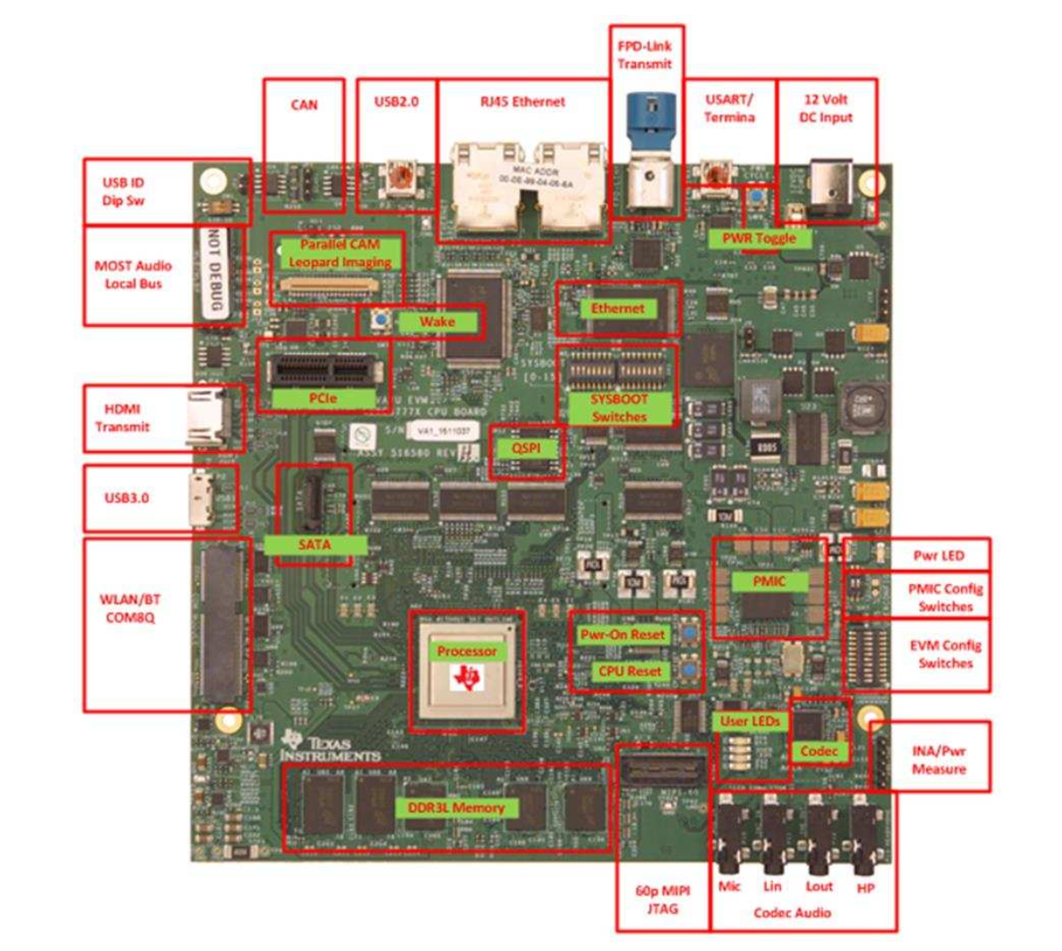
Board Characteristics
Texas Instruments TDA2x EVM CPU Board

Slide 4
TDA2X System on Chip
ARM Cortex-A15 MP Core Processor
ARM dual-Cortex-M4 Processor
2 TI DSP Cores
4 TI EVE Cores
GPU

Slide 5
Vision SDK
Vision SDK is a multi-processor multi-channel software development package for TI’s family of ADAS SoCs.
The C library framework allows users to create different ADAS application dataflow involving video and Radar capture, processing, analytics algorithms and display.

Slide 6
TDA2x Debugging Capability
Vision SDK includes a fully fledged Software Emulator which can be used as the first phase of debugging
Real time debug support using hardware emulators like Black Hawk & Spectrum Digital XDS560V2 STM.

Slide 7
OpenVX
OpenVX is a new standard from Khronos, offering a set of optimized primitives for low-level image processing and computer vision primitives. The OpenVX specification provides a way to write code that is portable across multiple vendors and platforms, as well as multiple hardware types.
The OpenVX enable hardware vendors to optimize implementation with a strong focus on a particular platform.
Developers using OpenVX don’t need to understand all of the details required to optimize code for specific hardware.
The graph-based programming interface is intended for creating vision algorithms using graph concepts. One of the major advantages of the graph interface is the ability of the underlying implementation to aggressively optimize full vision pipelines instead of specific functions.

Slide 8
OpenVX vs OpenCV
 | OpenCV | OpenVX
Implementation | Community driven open source library | Open standard API designed to be implemented by hardware vendors
Conformance | Extensive OpenCV Test Suite but no formal Adopters program | Implementations must pass defined conformance test suite to use trademark
Scope | Very wide 1000s of imaging and vision functions Multiple camera APIs/interfaces | Tight focus on core hardware accelerated functions for mobile vision
Efficiency | Memory-based architecture Each operation reads and writes to memory | Graph-based execution Optimizable computation and data transfer
Typical Use Case | Rapid experimentation and prototyping - especially on desktop | Production development & deployment on mobile and embedded devices
Embedded Deployment | Re-usable code | Callable library

Slide 9
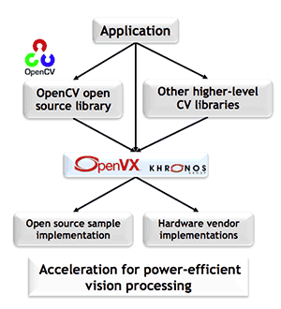
OpenVX vs OpenCV

Slide 10
OpenVX Example in Vision SDK

Slide 11
Current Research Focus
Even though TDA2x has a highly parallel architecture, currently Vision SDK is not utilizing the parallelism at all.
Also Vision SDK doesn’t optimize across nodes in the graph before processing it.
Vision SDK doesn’t support an OpenMP runtime.

Slide 12
Current Research Focus
Static Kernel Table
Lookup
Kernel Instance Table
Pass descriptors
Node Queue
Read queue
Create
Host (ARM)
Target
(DSP)
Execute

